Slide 1


Mid-Day-Meal Scheme
PAB – MDM - ASSAM
Date : 22nd February, 2017 at 5:00 PM
Venue: Aluminum Room, 1st Floor, “D” Wing, Shastri Bhawan, MHRD, New Delhi-1

Slide 2
BEST PRACTICES / INITIATIVES IN ASSAM – MDM
“Kitchen Garden” developed within the school campus with the help of community.
“Monthly Honourarium to Cook cum Helpers” is being paid to their individual bank account through e-transfer [RTGS] from State Nodal Office w.e.f. April, 2016.
Implemented “Smapriti Bhojan”.
Implemented “Group Hand Washing Facilities”.
“MDM Calendar” provided to schools as Information Education and Communication (IEC) material where norms etc. of MDM are reflected.
National “Guidelines on Food Safety and Hygiene for School level Kitchens under MDM Scheme” have been translated into Assamese, Bengali and Bodo languages and distributed to the schools. Notification of National Food Safety Act, 2015 has also been translated into Assamese, Bengali and Bodo languages and incorporated in the booklet of the guideline.
Process has already been initiated to provide LPG connection to 11,394 schools for cooking MDM. Further, Hon'ble Education Minister, Assam has taken initiatives for providing LPG connection to the remaining schools (43,382) in convergence with other Deptt./NGO.

Slide 3
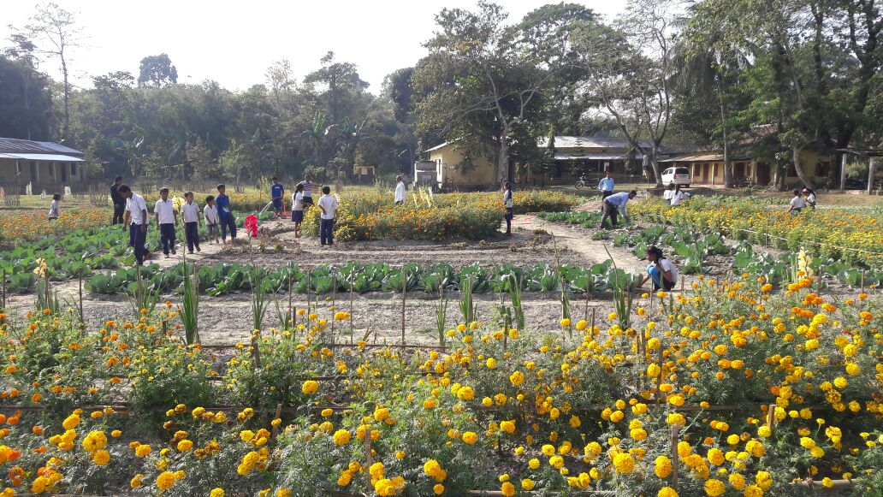
BEST PRACTICES
Kitchen Garden

Slide 4
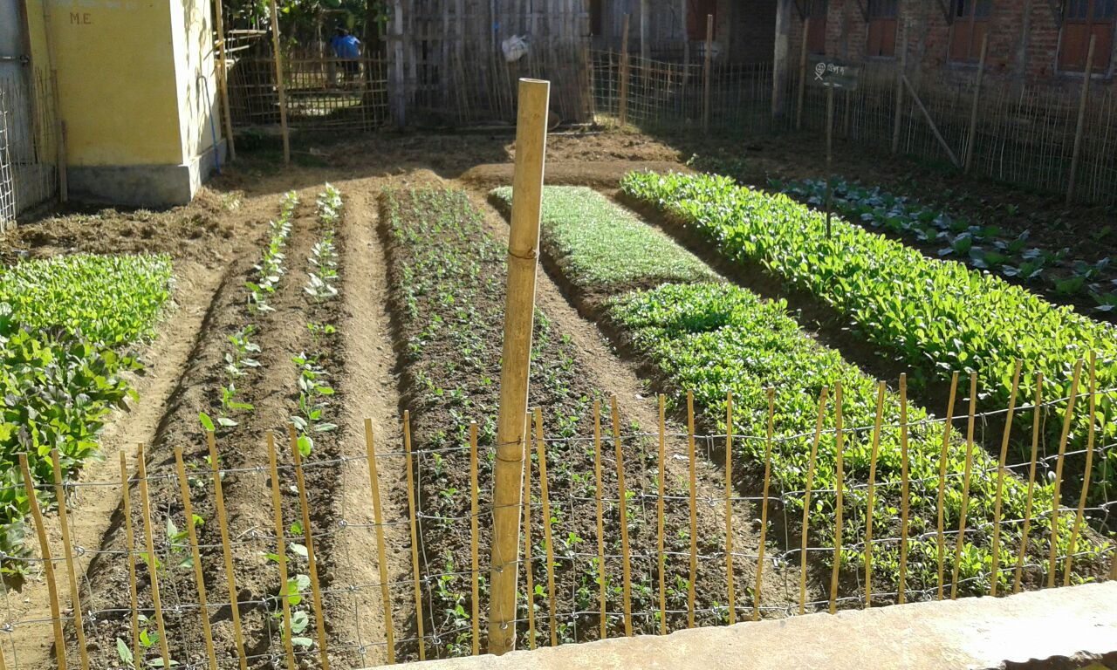
BEST PRACTICES
Kitchen Garden

Slide 5
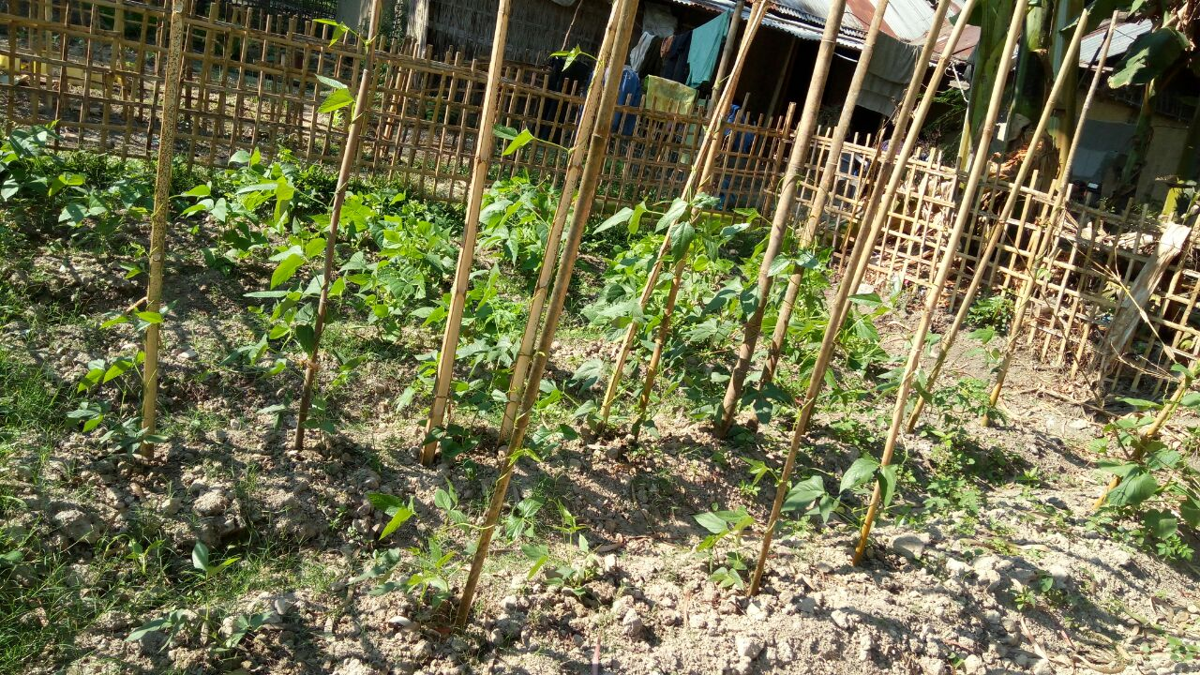
BEST PRACTICES
Kitchen Garden

Slide 6
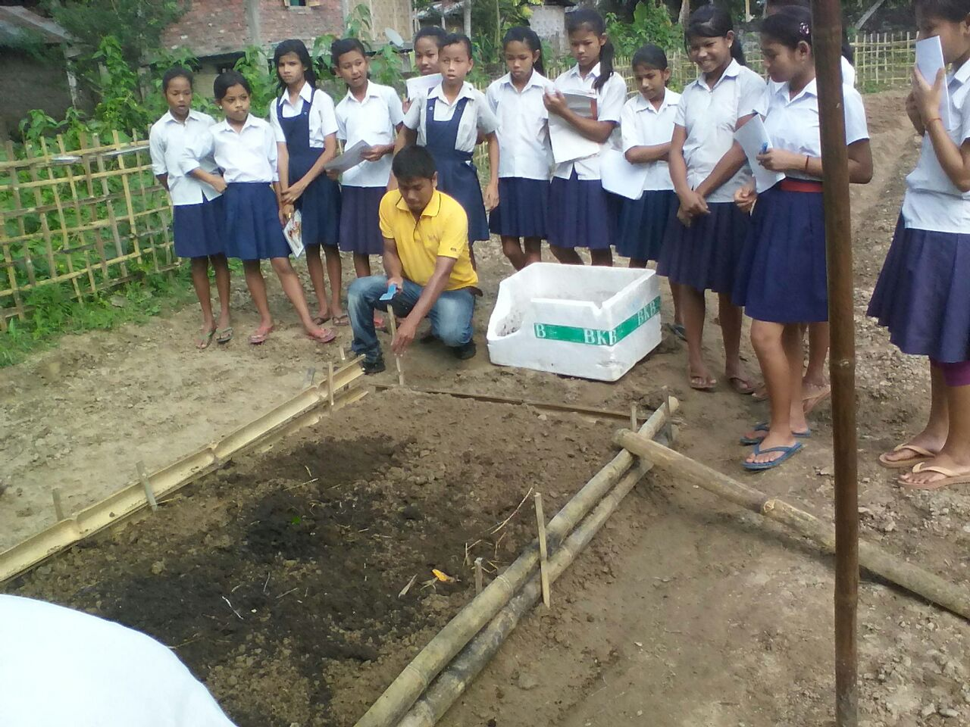
BEST PRACTICES
Kitchen Garden

Slide 7
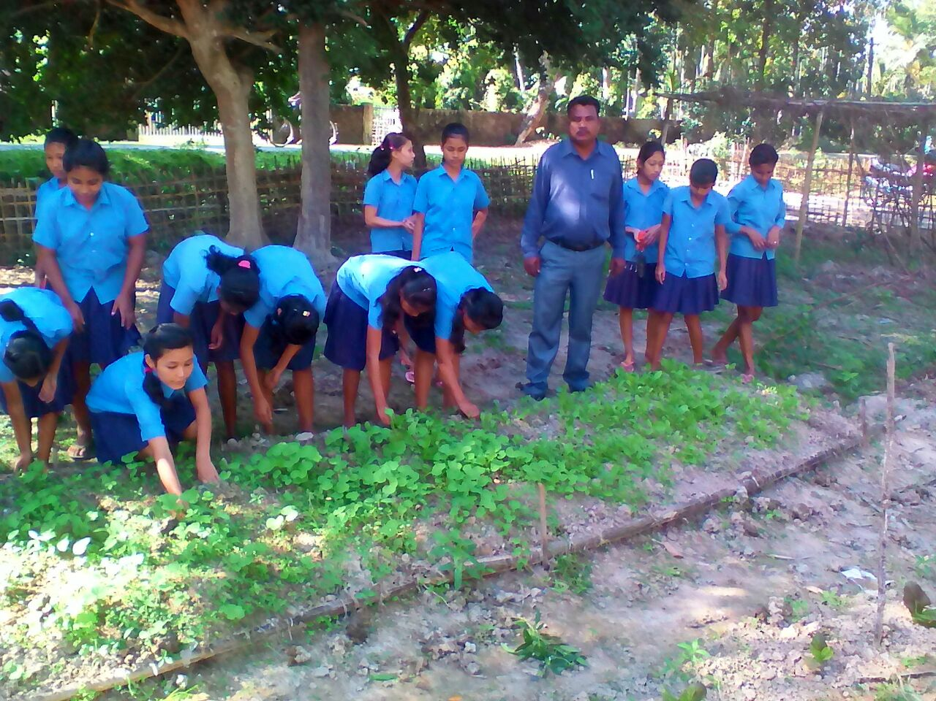
BEST PRACTICES
Kitchen Garden

Slide 8
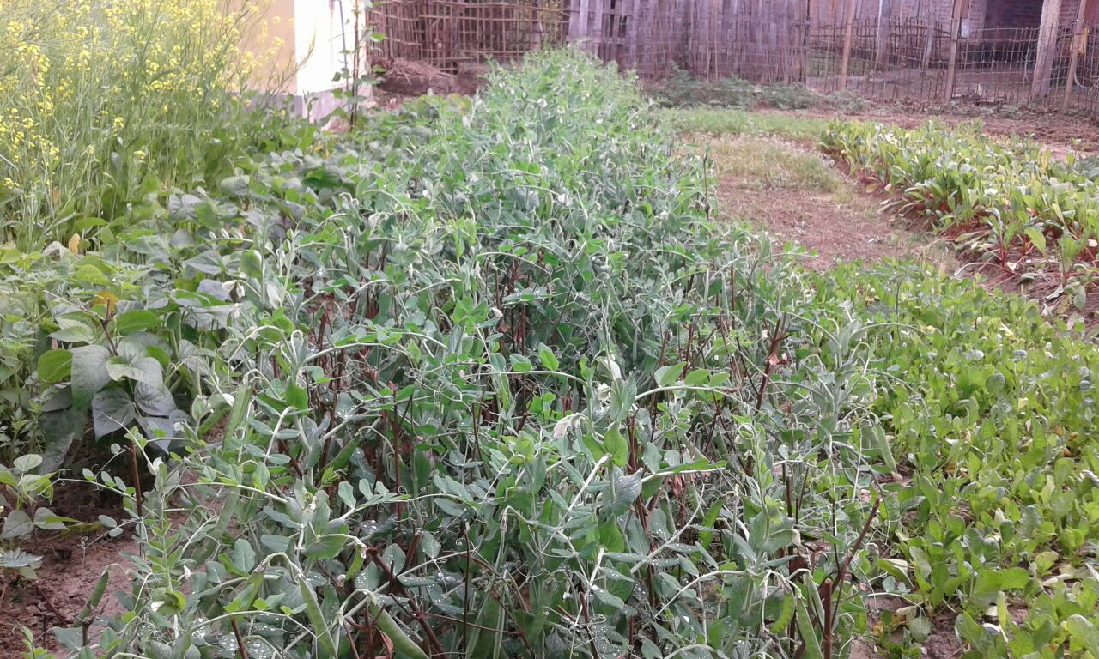
BEST PRACTICES
Kitchen Garden

Slide 9
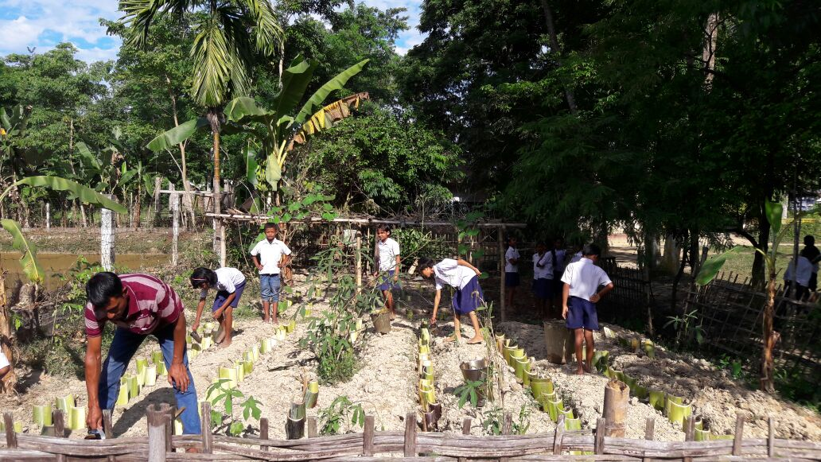
BEST PRACTICES
Kitchen Garden

Slide 10
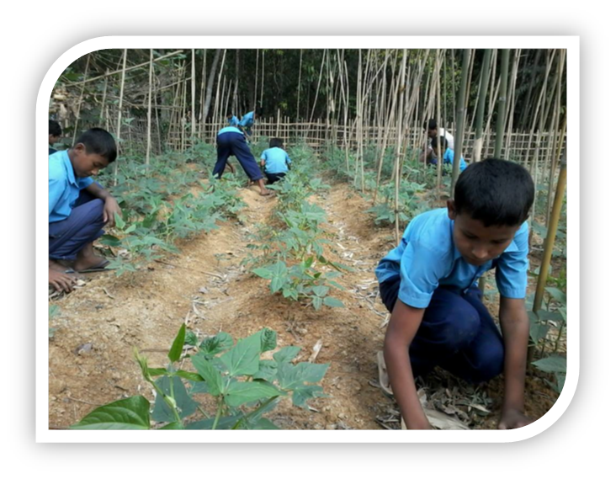
BEST PRACTICES
Kitchen Garden

Slide 11
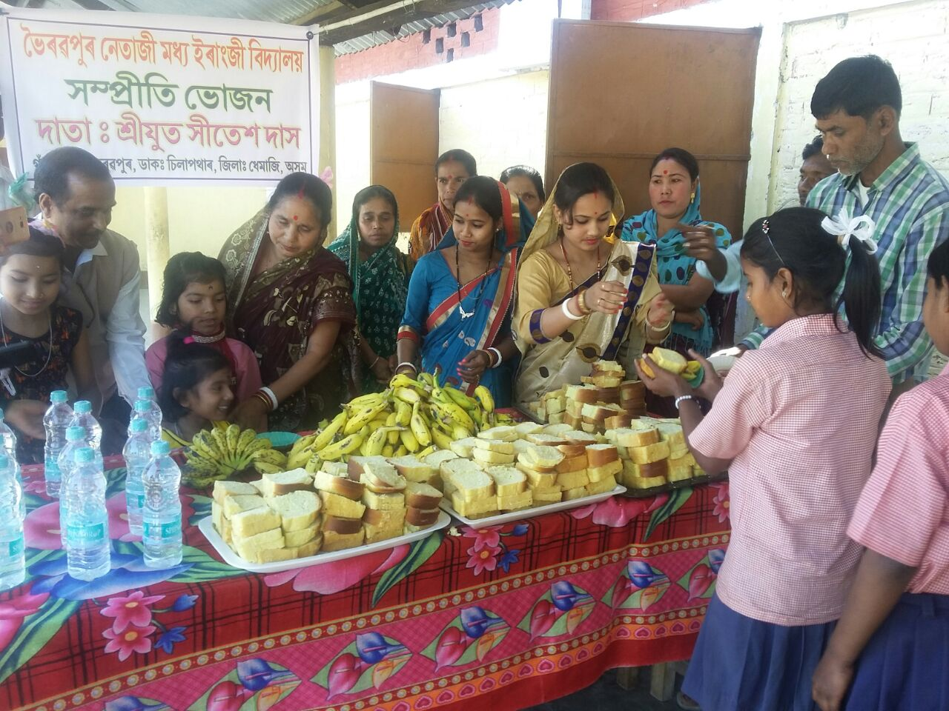
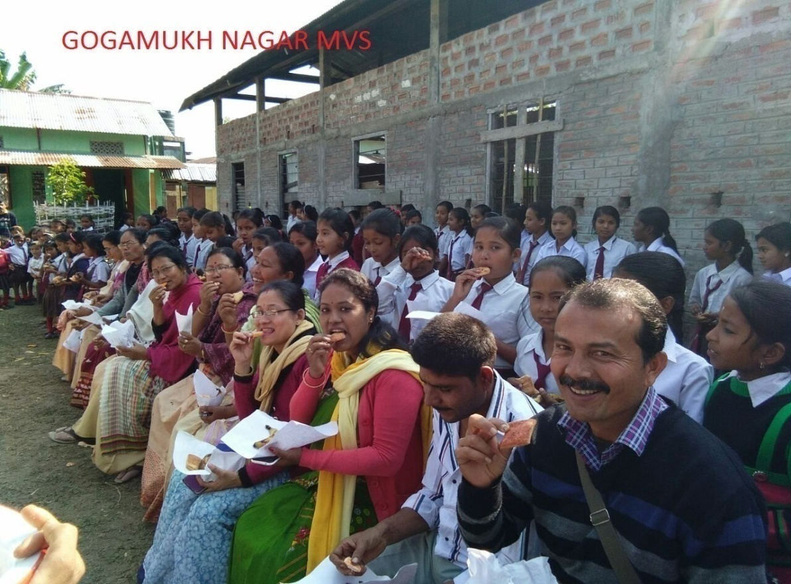
BEST PRACTICES
Sampriti Bhojan

Slide 12
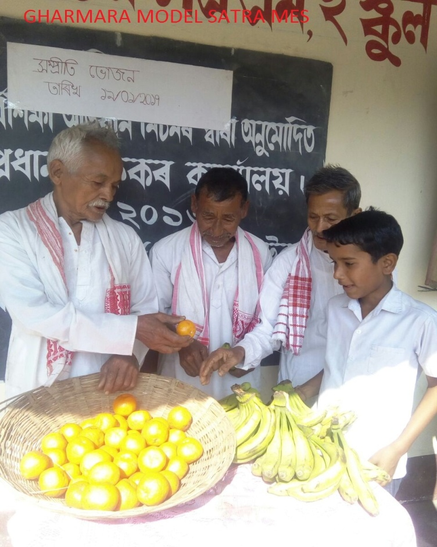
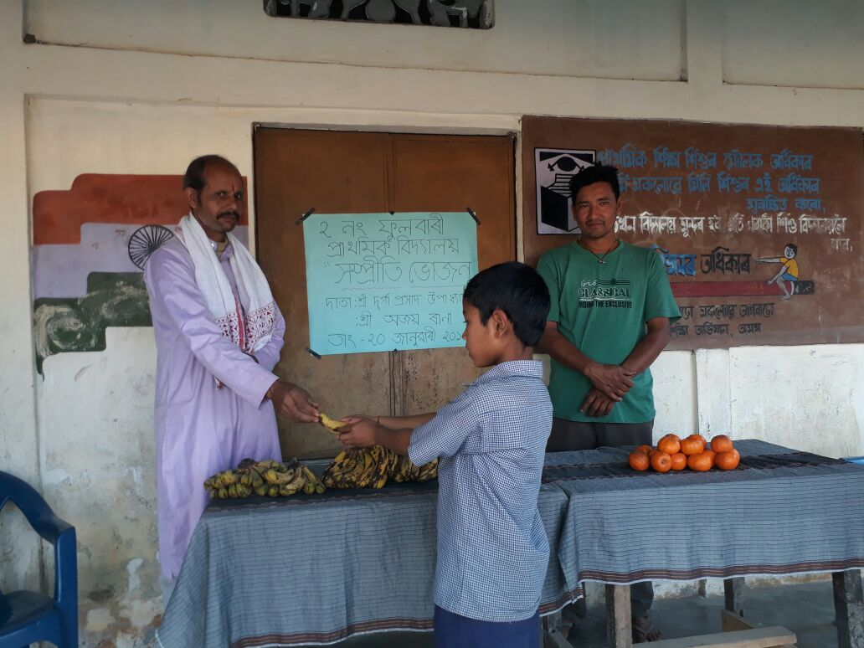
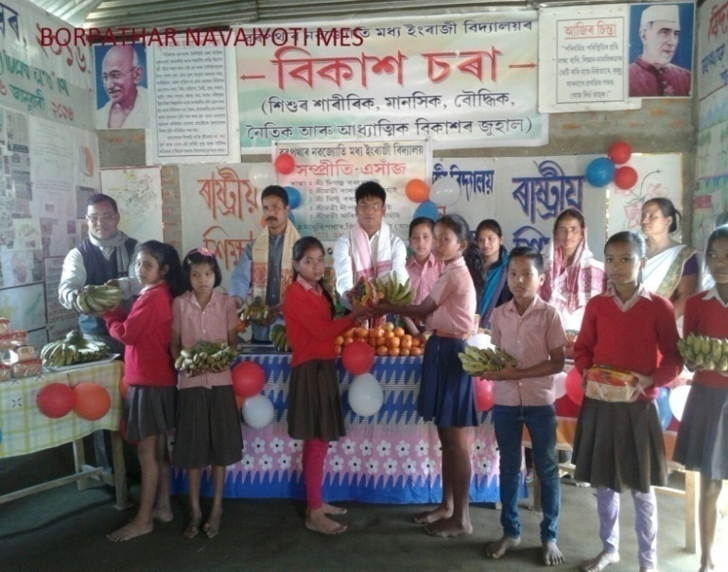
BEST PRACTICES
Sampriti Bhojan

Slide 13
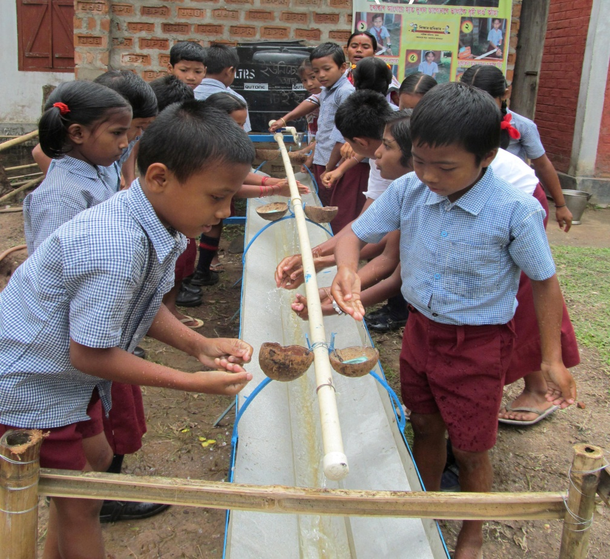
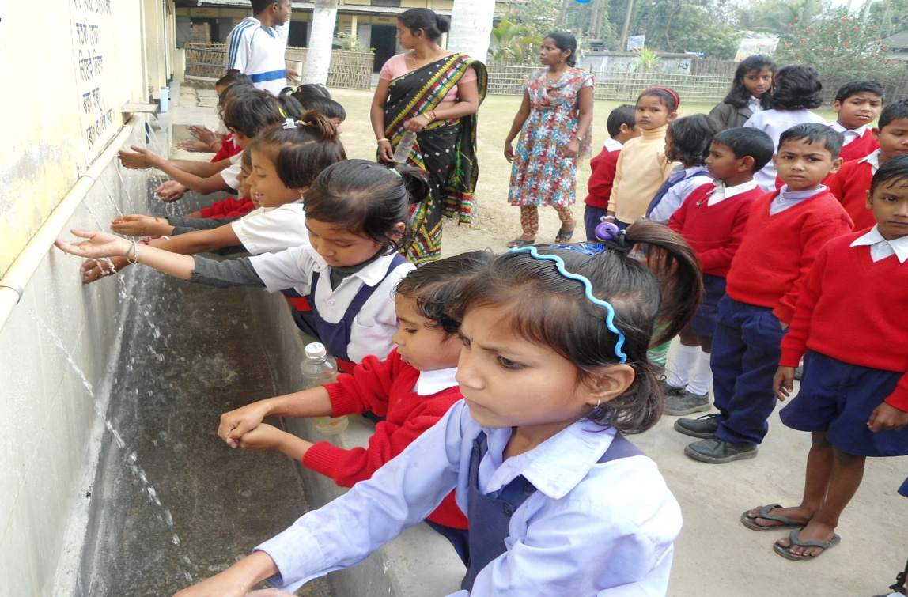
BEST PRACTICES
Group Hand Washing

Slide 14
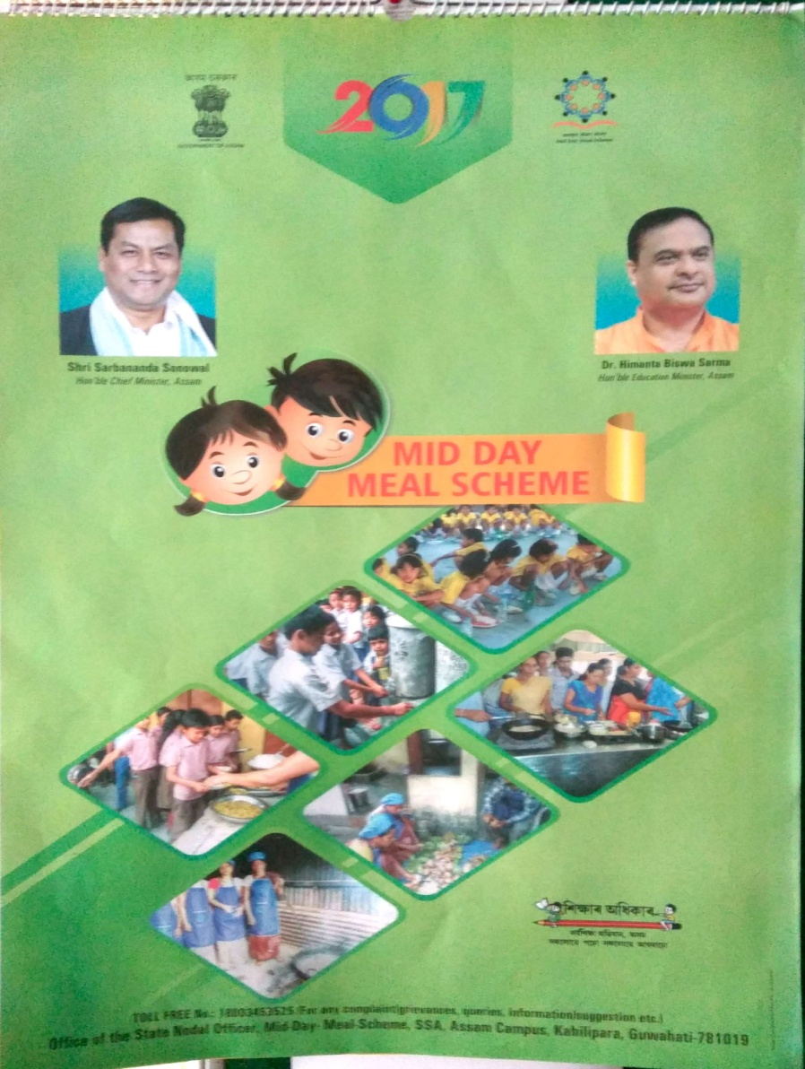
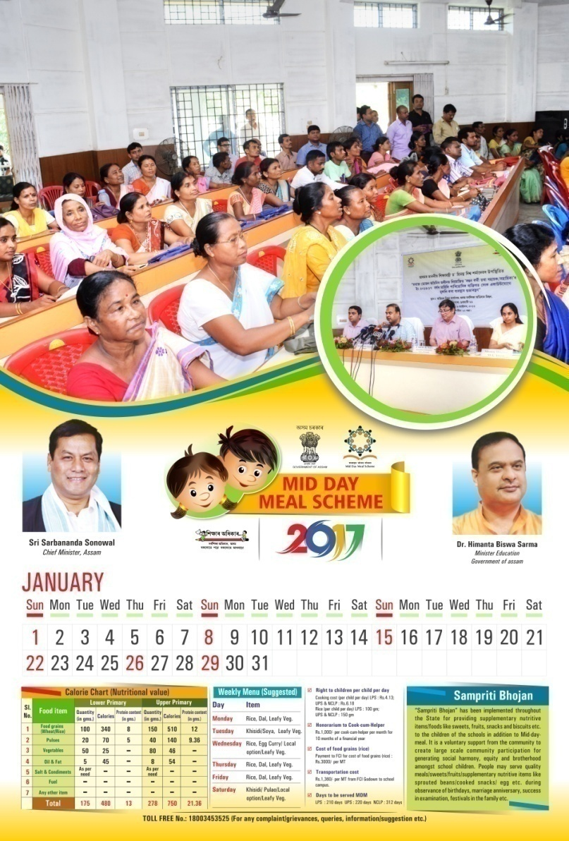
BEST PRACTICES
MDM Calendar

Slide 15


BEST PRACTICES
Guidelines of Food Safety & Hygiene in 4 languages [Assamese, Bengali, Bodo & English]
Assamese
Bengali

Slide 16
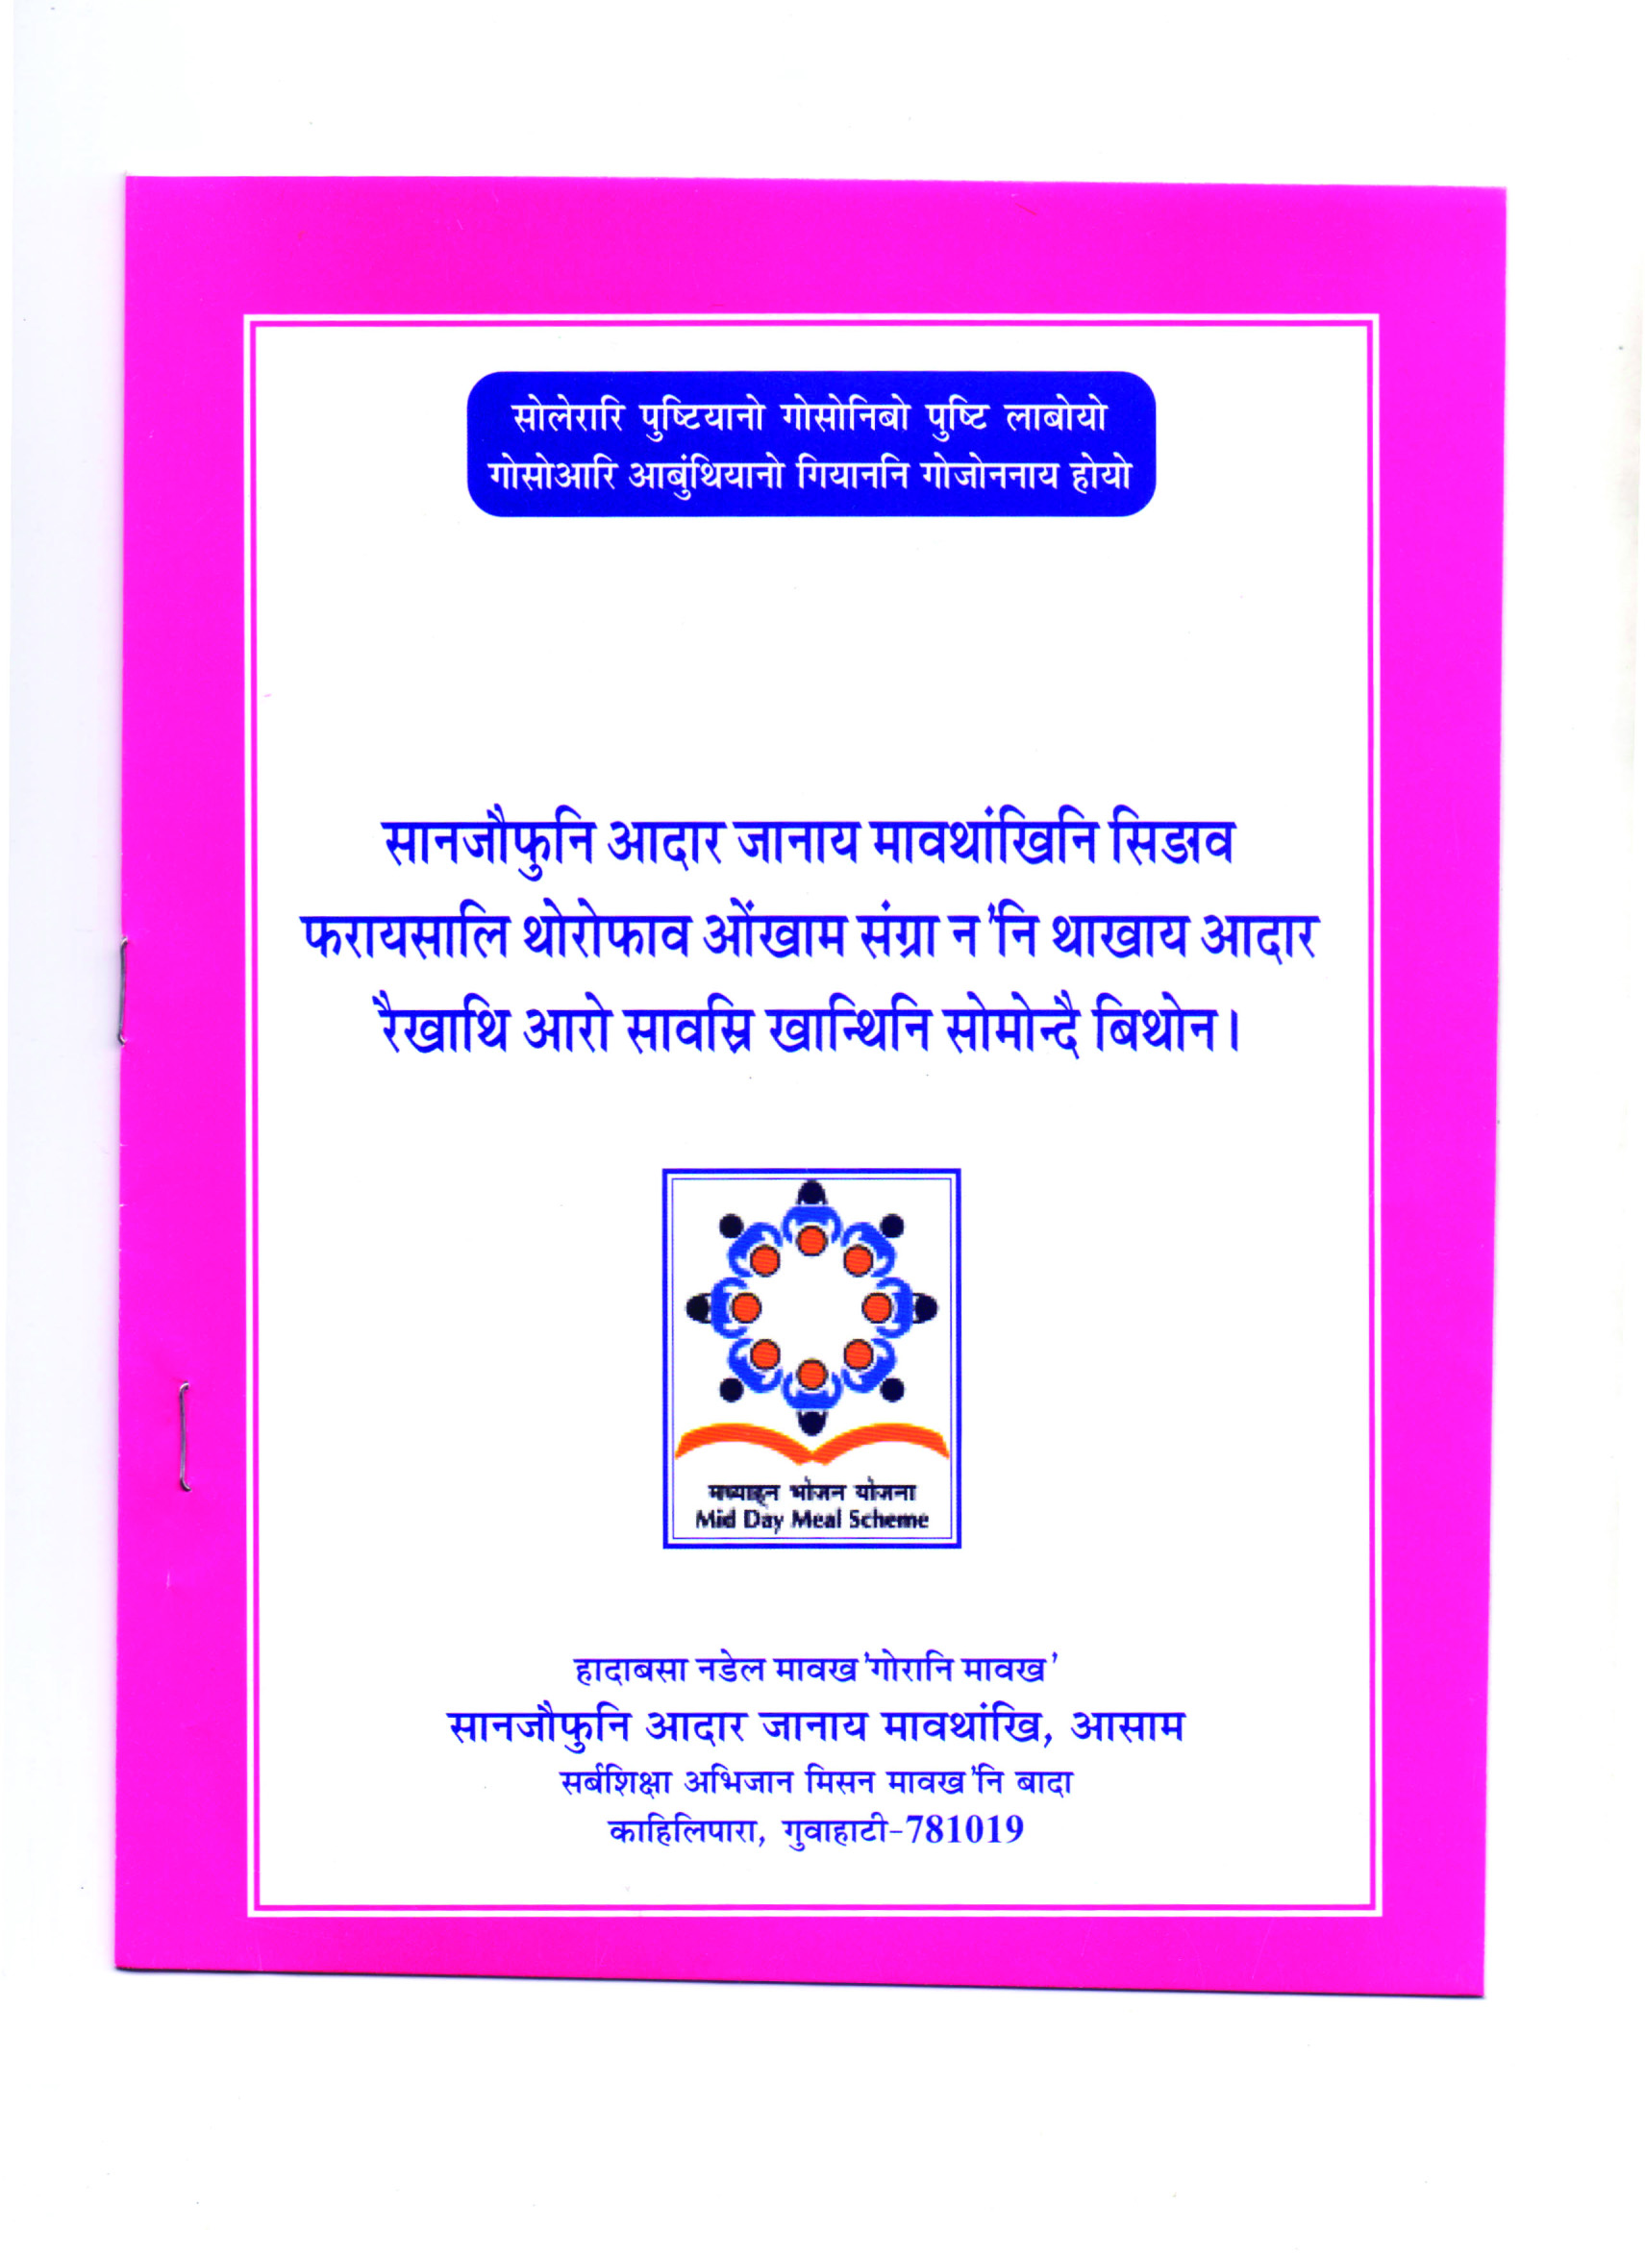
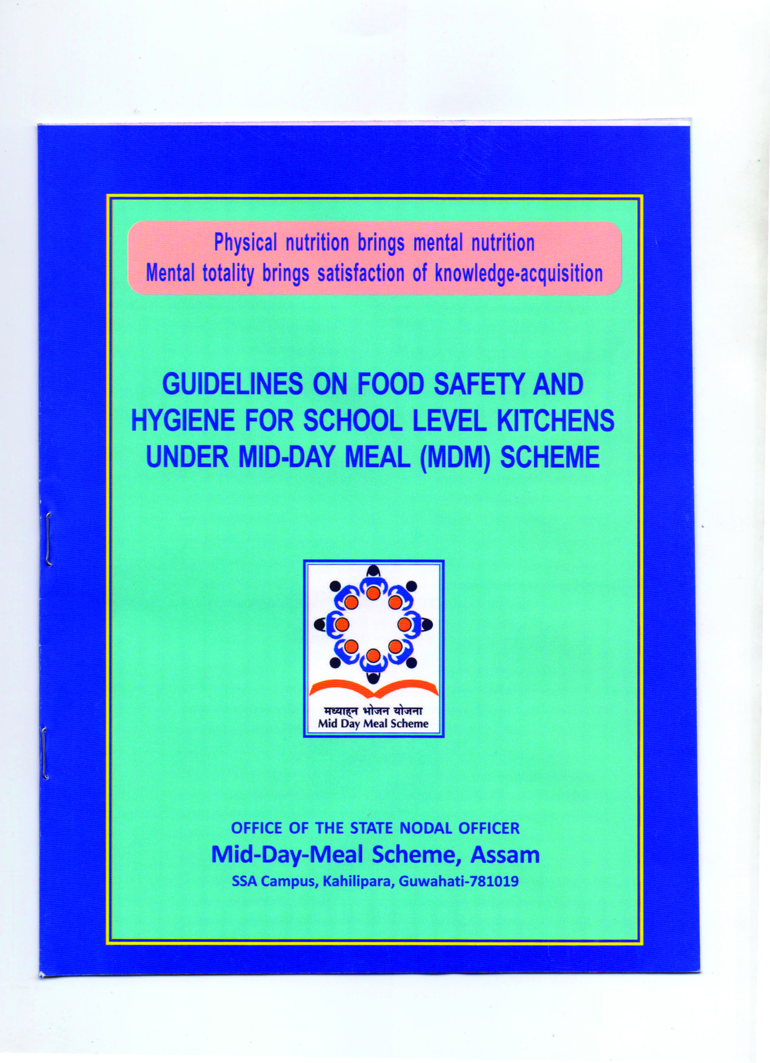
BEST PRACTICES
Guidelines of Food Safety & Hygiene in 4 languages [Assamese, Bengali, Bodo & English]
Bodo
English

Slide 17
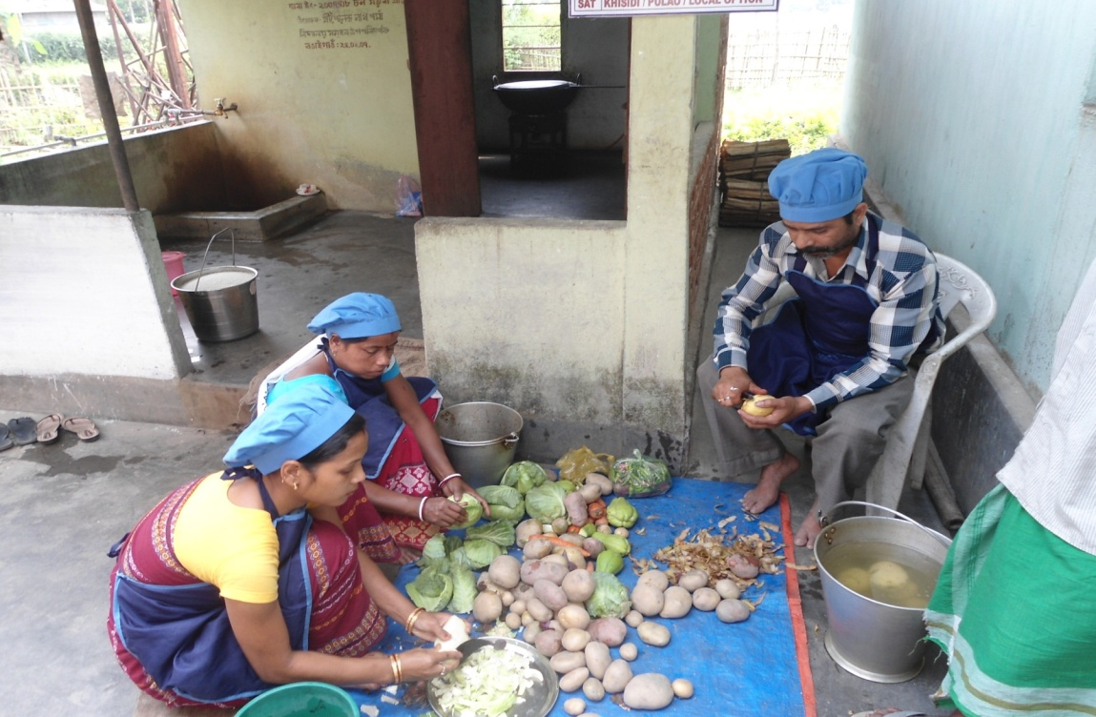
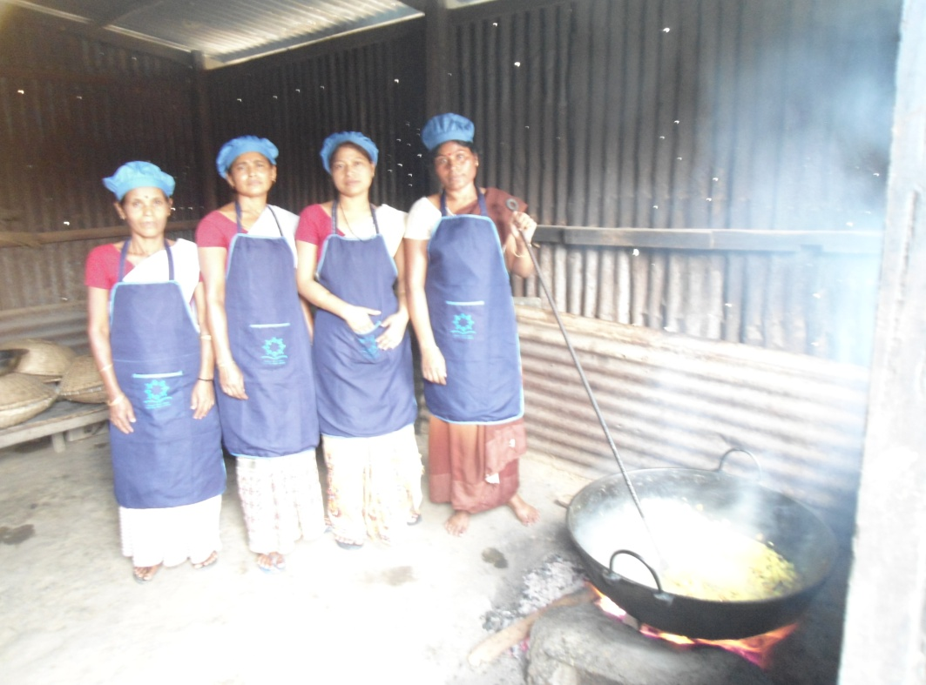
Cook cum Helpers Preparing Mid-Day-Meal

Slide 18
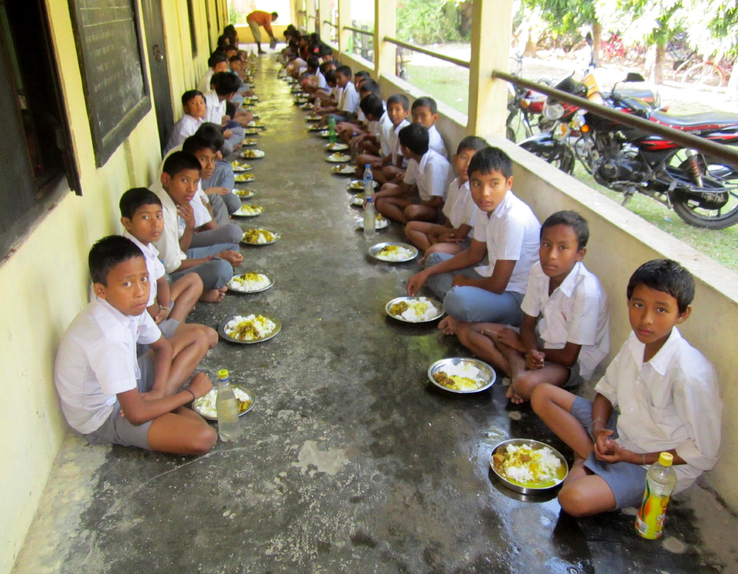
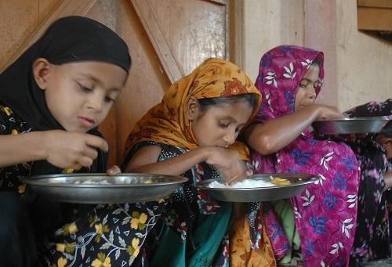
Children Having Mid-Day-Meal

Slide 19
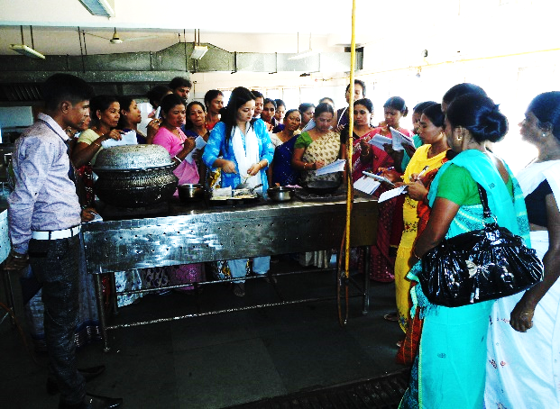
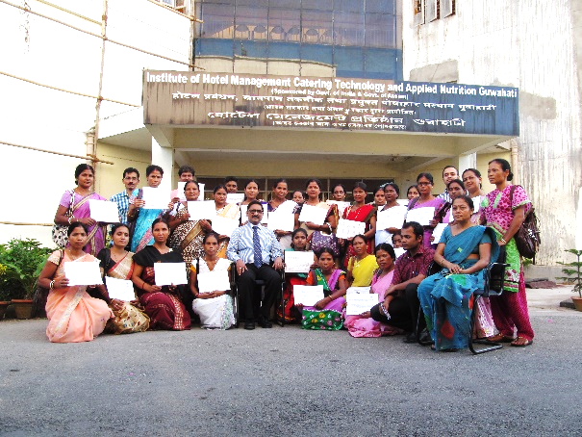
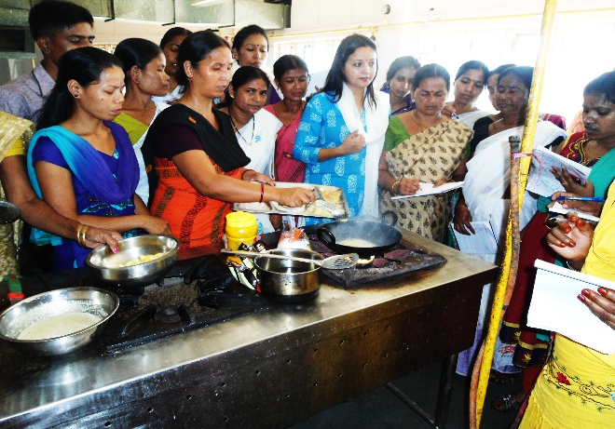
Training of Cook-cum-Helper
19

Slide 20
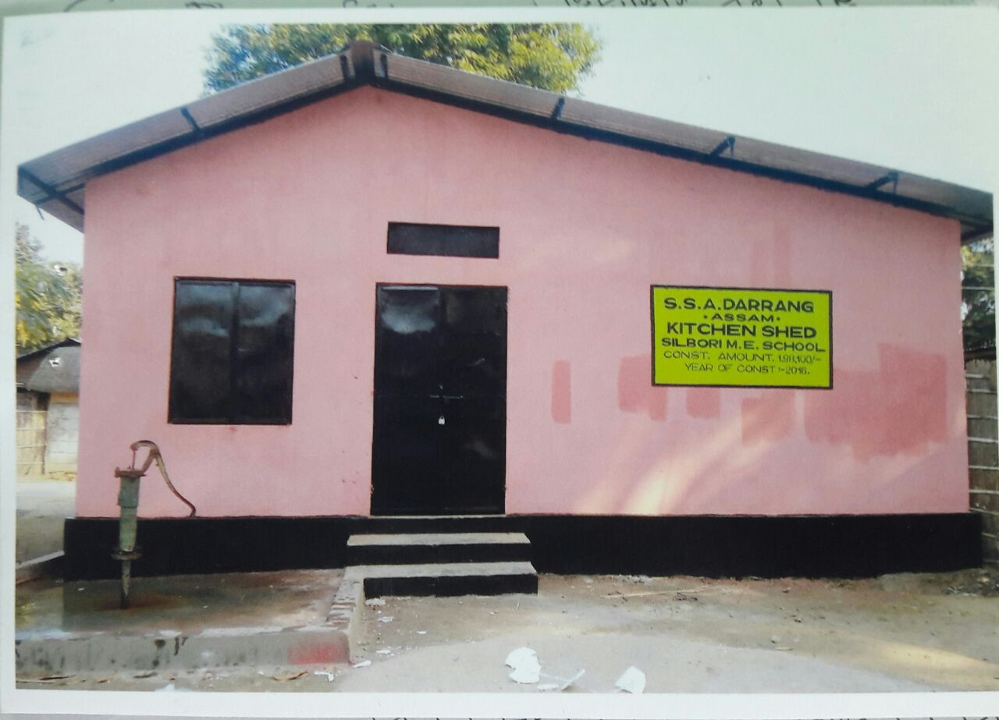
Newly Constructed Kitchen cum Store

Slide 21
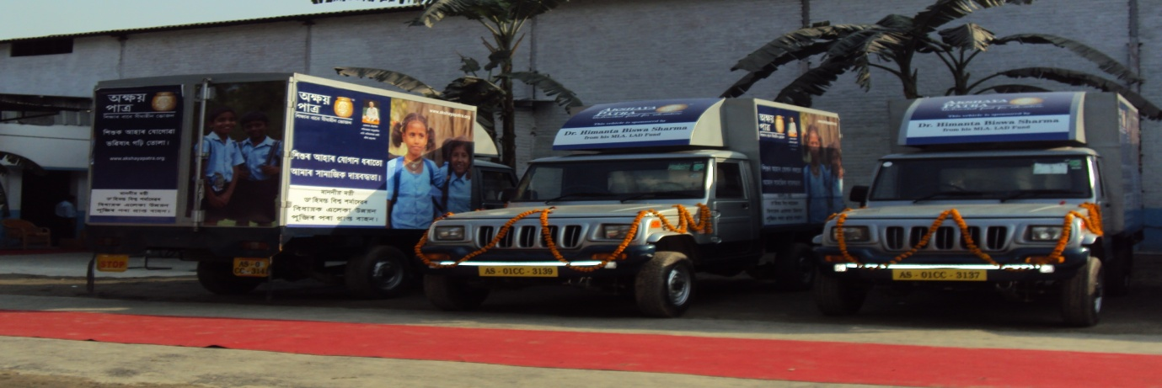
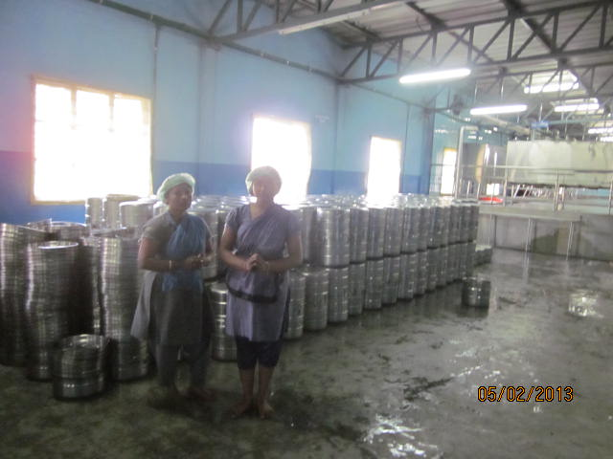
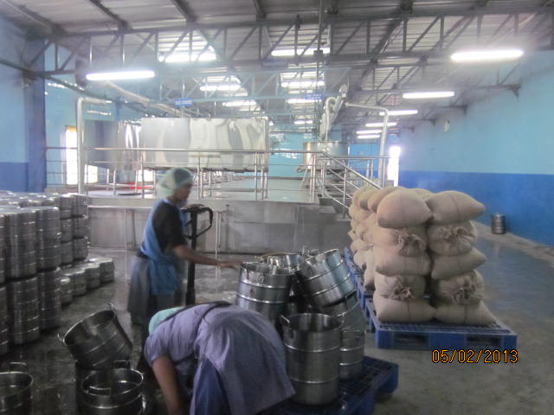
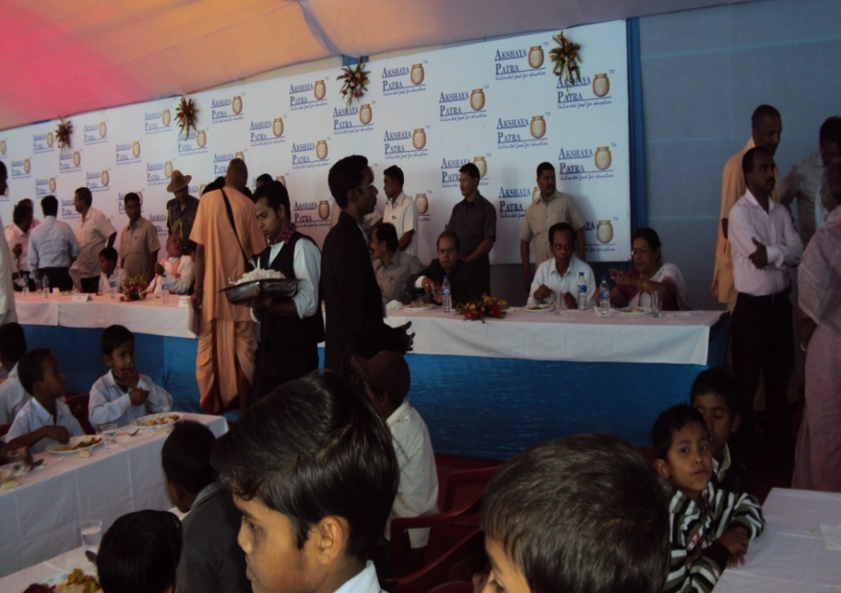
Central Kitchen of Akshaya Patra Foundation
21

Slide 22
Action taken note on suggestion of PAB-MDM Meeting held on 4th March, 2016 for approval of AWP&B, 2016-17
Point 1: Inadequate release of State matching share in cooking cost and honourarium to Cook
cum Helpers:
PAB Suggestion | Action Taken/Status
Director, MDM, Govt. of India enquire the reason for inadequate release of matching State share in case of cooking cost and honourarium to cook cum helpers. | Govt. has has passed SD for an amount of Rs.2309.69 lakh in the Budget Session, 2017-18 to meet the short fall of State share. Accordingly, necessary proposal has been submitted to the Finance Department for sanctioning of Rs.123.26 lakh for shortfall amount of mandatory State share.
Point 2: None of the Cook cum Helpers is paid honourarium through e-transfer
PAB Suggestion | Action Taken/Status
Joint Secretary, Department of School Education & Literacy, Government of India advised to release honorarium to Cook-Cum-Helpers through e-transfer by June, 2016. | The State Govt. has released honorarium to all Cook-Cum-Helpers (CCH) directly to their individual bank accounts through e-transfer (RTGS) w.e.f. April, 2016.

Slide 23
PAB-MDM [2016-17] Suggestion: Action taken note …contd..
Point 3: Slow progress in construction of kitchen cum stores:
PAB Suggestion | Action Taken/Status
[A] Govt. of India has instructed for completion of ongoing construction of Kitchen-cum-Store within August, 2016 [total units 12,222]. [B] Joint Secretary, Govt. of India advised to explore possibility of construction of 5122 units of kitchen cum stores at the rate of Rs.60,000/- per unit failing which the funds for the said units may be surrender to the Central Govt. | Govt. of India had sanctioned 56,795 units for construction of Kitchen cum stores. Construction of total 39,451 units has already been completed by Housefed & ASHB. Construction of total 9,829 units has already been completed by SMC. Construction of total 2,393 units is under progress and will be completed within March, 2017. Total 5,122 units with unit cost of Rs.60,000/- have not yet been started. However, it may be mentioned that Govt. of Maharasthra had constructed low cost modular pre fabricated kitchen cum stores under MDMS @Rs.74,000/- (approx.) per unit, which is recognized as best practice and documented in the compendium published by MHRD, MDM Division, Govt. of India.

Slide 24
PAB-MDM [2016-17] Suggestion: Action taken note …contd..
Point 3: Slow progress in construction of kitchen cum stores:
PAB Suggestion | Action Taken/Status
 | The matter was discussed in the SSMC meeting held on 06/02/2017. As per resolution of the SSMC meeting, State Nodal Officer, MDM has visited Maharasthra to see the entire process and procedure adopted for construction of low cost modular pre fabricated kitchen cum stores under MDMS for exploring the possibility for adopting the same in Assam. The findings of the study has already been placed to the Hon'ble Minister, Education, Assam for necessary suggestion, direction and approval.
Point 4: Huge pendency of FCI bills
PAB Suggestion | Action Taken/Status
Govt. of India suggested to clear all pending bills and also suggested to reconcile the amount of pending bills in a joint meeting with FCI | All pending bills have been cleared up-to 2014-15. Rs.138.80 lakh was due for payment of cost of food grains to FCI during 2015-16 in the following districts: Karimganj : Rs.84.00 Lakh Lakhimpur : Rs.0.80 Lakh Dima Hasao : Rs.19.00 Lakh Sonitpur : Rs.35.00 Lakh

Slide 25
PAB-MDM [2016-17] Suggestion: Action taken note …contd..
Point 4: Huge pendency of FCI bills
PAB Suggestion | Action Taken/Status
 | A joint meeting was held with the FCI officials under the Chairmanship of the Commissioner & Secretary to the Govt. of Assam, Education (Elementary) Department on 15/12/2016 and reconciliation of pending bills with districts and FCI officials is under process and will be settled within February, 2017.
Point 5: Use of firewood as model of cooking in 98.7% schools:
PAB Suggestion | Action Taken/Status
Govt. of India advised to cover more schools with LPG connection. | Total 2080 schools have existing LPG connection. Another 11,394 schools would be covered with LPG connection during 2016-17. Process has already been initiated with IOC Ltd. and will be completed within March, 2017. However, it may be mentioned that Hon'ble Education Minister, Assam has taken initiatives for providing LPG connection to the remaining schools (43,382) in convergence with other Deptt./NGO.

Slide 26
Progress of Annual Work Plan & Budget (AWP&B), 2016-17
No. of institution and children approved by PAB (Programme Approval Board) of MHRD, Govt. of India for Mid-Day-Meal Scheme under AWP & B, 2016-17.
Category | Lower Primary | Upper Primary & NCLP | Total
 | (Class I-V) | (Class VI-VIII)
Institution | 44,386 | 13,558 | 57,944
Children | 29,11,309 | 13,50,000 | 42,61,309
Cook-cum-Helpers | 90,049 | 32,675 | 1,22,724
Working Days (Mandatory MDM serving day) | 210 | UP : 220 NCLP : 312 | LP-210 UP-220 NCLP -312
Food grains approved by PAB MDM for 2016-17
# | Norms | No. of Children | No. of Working days | Per child quantity | Total Quantity in MTs
1 | Primary @ 100 gms / child / school day) (2900000 x 210 x 0.00010) | 29,00000 | 210 | 100 gram | 60900.00
2 | Upper Primary @ 150 gms / child / school day (1350000 x 220 x 0.00015) | 13,50,000 | 220 | 150 gram | 44550.00
3 | NCLP @ 150 gms / child / school day (11309 x 312 x 0.00015) | 11,309 | 312 | 150 gram | 529.26
Total |  | 42,61,309 |  |  | 105979.26

Slide 27
c) Approved financial allocation under AWP &B, 2016-17.
(Rs. In Lakh)
Items | Central share & State Share
 | Primary | UP | NCLP | Total
Cooking cost | 23507.40 | 17166.60 | 203.94 | 40877.94
Cost of food grains | 3440.85 | 2517.08 | 29.90 | 5987.83
Transportation cost | 828.24 | 605.88 | 7.20 | 1441.32
MME | 603.10 | 387.14 | 3.97 | 994.21
Honorarium to Cook-cum-Helper (CCH) | 9004.90 | 3267.50 | - | 12272.40
Total | 37384.49 | 23944.20 | 245.01 | 61573.70
d) Release of recurring central assistance under Ad-hoc grant & balance of 1st instalment to the Govt. of Assam for the year 2016-17 along with Minimum Mandatory State Share
# | Component (Primary + Upper Primary) | Central Share | Minimum Mandatory State Share
1 | Cooking Cost | 21803.62 | 1631.59
2 | Cost of food grains | 1536.56 | -
3 | Honorarium to CCH | 6377.35 | 480.67
4 | Transportation Cost | 702.69 | -
5 | MME | 505.68 | -
Grand Total |  | 30925.90 | 2112.26
N.B. : Mandatory State share of Rs.1018.96 lakh [Cooking Cost = Rs.791.03 lakh and Honourariun to CCH = Rs.227.92 lakh] is yet to be received from Govt. of Assam by implementing agency against 1st installment of Central share due to which 2nd installment of Central share has not been released yet. Out of Rs.1018.96 lakh, the Govt. has sanctioned Rs.895.70 lakh, but Govt. Finance Deptt. Ceiling for drawl of the amount has not yet been received. Further, proposal submitted for amount of Rs.123.26 lakh to Finance Deptt. for issue of ceiling from the SD amount of Rs.2309.69 lakh.

Slide 28
e) Component-wise expenditure (available fund) till 3rd quarter under AWP &B, 2016-17
# | Component | Opening Balance | Fund Received | Fund available | Expenditure | % of expenditure
1 | Cooking Cost | 252.25 | 23435.21 | 23687.46 | 18584.4 | 78.46%
2 | Cost of food grains | 364.97 | 1536.56 | 1901.53 | 1382.8 | 72.72%
3 | Honorarium to CCH | 249.75 | 6858.02 | 7107.77 | 8270.45 | 116.36%
4 | Transportation Cost | 159.34 | 702.69 | 862.03 | 617.64 | 71.65%
5 | MME | 60.35 | 505.68 | 566.03 | 463.12 | 81.82%
Total |  | 1089.66 | 33042.16 | 34124.82 | 29318.41 | 85.92%
f) Allocation & lifting of rice during 1st , 2nd & 3rd quarter of 2016-17.
[Rice in MT]
Component | Primary Stage (1st April /16 to 31st Dec./16) |  |  | Upper Primary Stage (1st April /16 to 31st Dec./16)
 | Annual Allocation | Lifting up-to 3rd quarter | Percentage (%) of lifting | Annual Allocation | Lifting up-to 3rd quarter | Percentage (%) of lifting
Food grains (Rice) | 60813.339 | 40123.769 | 65.98 | 44706.204 | 28988.038 | 64.84

Slide 29
Proposal of Annual Work Plan & Budget (AWP&B), 2017-18:
No. of institution, enrolment & average no. of children to be opted Mid-Day Meal
# | Stage | Primary Stage |  |  | Upper Primary Stage |  |  | Total
 |  | Institution | Total Enrolment | No. of children to be opted MDM | Institution | Total Enrolment | No. of children to be opted MDM | Institution | Total Enrolment | No. of children to be opted MDM
1 | Govt. / LB | 40,466 | 29,11,816 | 27,37,832 | 9,549 | 12,11,382 | 10,91,313 | 50,015 | 41,23,198 | 38,29,145
2 | Govt. Aided school | 3,404 | 1,64,469 | 1,39,851 | 4,044 | 2,88,854 | 2,52,039 | 7,448 | 4,53,323 | 3,91,890
3 | STC | 275 | 11,413 | 7,175 | 157 | 11,867 | 6,615 | 432 | 23,280 | 13,790
4 | Madrassa& Moktab | 797 | 22,491 | 21,346 | - | - | - | 797 | 22,491 | 21,346
Total |  | 44,942 | 31,10,189 | 29,06,204 | 13,750 | 15,12,103 | 13,49,967 | 58,692 | 46,22,292 | 42,56,171

Slide 30
Contd… Proposal of Annual Work Plan & Budget (AWP&B), 2017-18:
Proposal of fund in AWP &B for 2017-18 (Component-wise)
Item | Central Share |  |  | State Share |  |  | Total (CS+SS)
 | LP | UP & NCLP | Total | LP | UP & NCLP | Total
Cooking cost | 22628.95 | 16643.25 | 39272.20 | 2514.33 | 1849.26 | 4363.59 | 43635.79
Cost of food grains | 1826.39 | 1346.54 | 3172.93 | 0 | 0 | 0 | 3172.93
Transportation cost | 827.96 | 610.44 | 1438.40 | 0 | 0 | 0 | 1438.40
Honourarium to CCH | 8104.41 | 2940.75 | 11045.16 | 900.49 | 326.75 | 1227.24 | 12272.40
MME | 599.31 | 386.11 | 985.42 | 0 | 0 | 0 | 985.42
Total | 33987.02 | 21927.09 | 55914.11 | 3414.82 | 2176.01 | 5590.83 | 61504.94
N.B.: 1. Rate for cooking cost: Rs. 4.13 per child per day for LPS; Rs. 6.18 per child per day for UPS & NCLP.
2. Cost of food grains (rice) : Rs. 3000/- per MT.
3. Transportation cost: Rs.1360/- per MT
4. Honourarium to Cook cum Helper proposed to be continued 1,22,724 : Rs.1000/- per month for 10 months in a financial year

Slide 31
Contd… Proposal of Annual Work Plan & Budget (AWP&B), 2017-18:
Proposal for Food grains Allocation in AWP &B, 2017-18
# | Stage | Proposal for food grains |  | Quantity in MTs.
 |  | No. of children | No. of working days
1 | Primary @ 100 gms / child / school day (2899029 x 210 x 0.0001) | 28,99,029 | 210 | 60879.60
2 | Upper Primary @ 150 gms / child / school day (1349967 x 220 x 0.00015) | 13,49,967 | 220 | 44548.90
3 | NCLP @ 150 gms / child / school day (7175 x 312 x 0.00015) | 7,175 | 312 | 335.79
 | Total | 42,56,171 | - | 105764.29

Slide 32
D. Fact sheet for requirement of funds & food grains as proposed in AWP&B, 2017-18
A. Lower Primary Stage
Requirement of Food Grains ( In MT) | 60879.609 MT
Requirement of Cost of Food Grains | 1826.39
Requirement of Cooking cost ( Central share) | 22628.95
Requirement of Cooking cost ( State share) | 2514.33
Transportation Cost | 827.96
Honorarium to Cook cum Helpers (Central share) | 8104.41
Honorarium to Cook cum Helpers (State share) | 900.49
MME | 599.31
Total (Central Share) | 33987.02
Total (State Share) | 3414.82
Grand Total (Central + State Share) | 37401.84

Slide 33
Contd…fact sheet for requirement of funds & food grains as proposed in AWP&B, 2017-18
B. Upper Primary Stage & NCLP
Requirement of Food Grains ( In MT) | 44884.700 MT
Requirement of Cost of Food Grains | 1346.54
Requirement of cooking cost ( Central share) | 16643.25
Requirement of cooking cost ( State share) | 1849.26
Transportation Cost | 610.44
Honorarium to Cook cum Helpers (Central share) | 2940.75
Honorarium to Cook cum Helpers (State share) | 326.75
MME | 386.11
Total (Central Share) | 21927.09
Total (State Share) | 2176.01
Grand Total (Central + State Share) | 24103.10
(Rs. In Lakh)
C. Total requirement for LP & UP (Central Share) | 55914.11
D. Total requirement for LP & UP (State Share) | 5590.83
E. ( C+D) grand total (Central & State Share) : | 61504.94

Slide 34
Thank You

