Slide 1
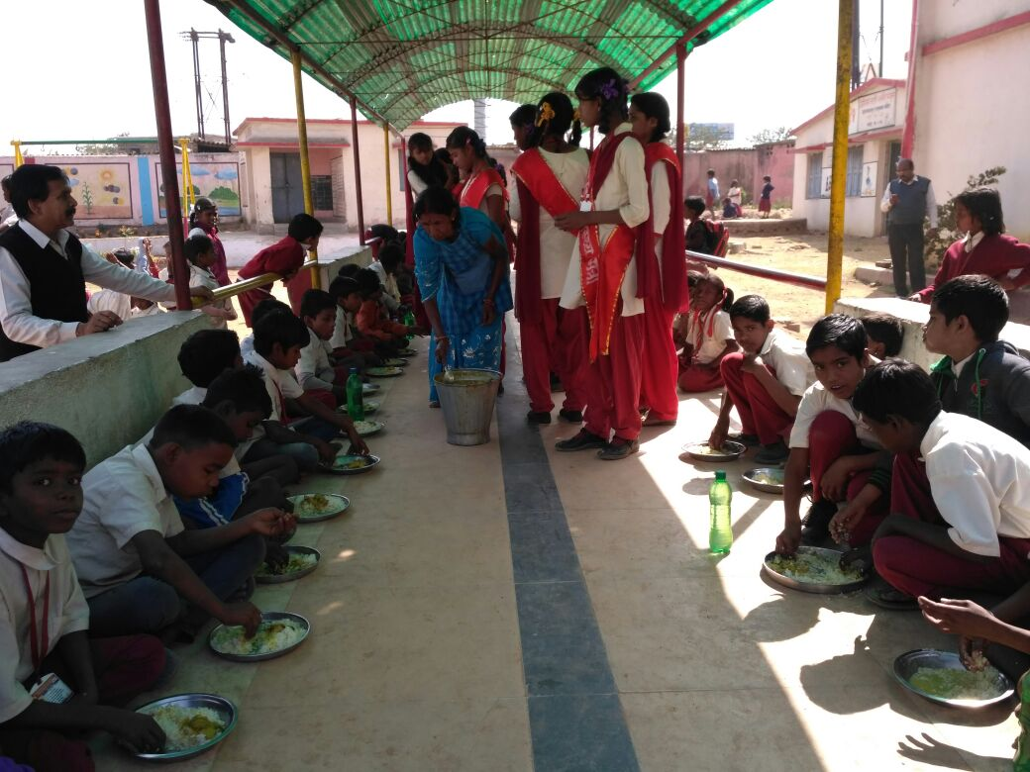
MID DAY MEAL SCHEME
Annual Work Plan & Budget
Dept. of School Education and Literacy
Government of Jharkhand 10.03.17

Slide 2
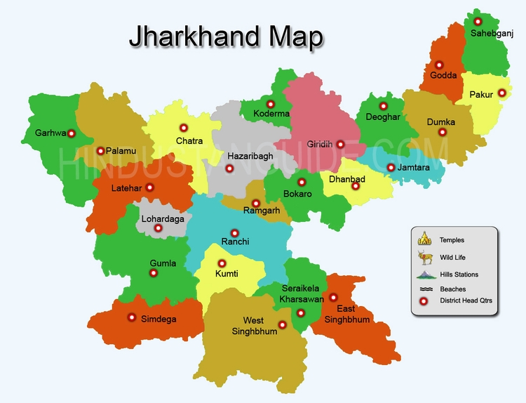
Demographic Profile of Jharkhand
No. of districts – 24
No. of blocks – 262
No. of division – 05

Slide 3
Management Structures at State level
Secretary
Dept. of School Education and Literacy
Director, Primary Education
Director, JSMDMA
District Superintendent of Education
Saraswati Vahini
(Sub committee of SMC)
Block Education Extension officer
Headmaster

Slide 4
Food grains and Fund Flow mechanism
Food grains
Cooking cost
Honorarium to cooks
MME
TC
KD
KS
FCI
District wise
allotment of
food grains
SFC
Dep. of school Edu. & Lit. : DPE
Block Godowns
DSE
JSMDMA
Schools
Saraswati Vahini
SMC Chairman
Cooking by Saraswati Vahini
MDM to children

Slide 5
Action taken note on the issues raised in PAB
Bal Panji at school level is maintained
To check fake enrollment students are being linked with Aadhar.
Prayas Karyakram
i. Coverage of Children against enrollment
Additional Nutrition Programme
e-madhyahan SMS Based Mid Day Meal Moitoring system.
School Kit to students with more than 50% attendance
Vidyalakshmi Yojana for SC, ST girls of class 6

Slide 6
ii. E-transfer of funds to schools and cook-cum-helpers.
Payment of cook-cum-helpers through DBT from April-2017.
A difference of 3649 cooks-cum-helper will be engaged in this FY 2017-18.
Mode of payment – e-transfer.
Funds are being transferred to schools directly in the bank account of SVS.
iii. Provision of LPG in the school.
Total no. of schools – 40025
Total no. of schools with gas based cooking - 2089
Rest schools to be provided with gas based cooking – 37936
Budget provision of Rs. 3984.00 lakh has been made in FY 2017-18 for facilitating 100% gas based cooking in schools.
Consent of Cabinet on Sanlekh for providing LPG is under process.

Slide 7
iii. Provision of LPG in the school.
Budget provision of Rs. 3984.00 lakh has been made in FY 2017-18 for facilitating 100% gas based cooking in schools.
Consent of Cabinet on Sanlekh for providing LPG is under process.

Slide 8
iv. Construction of Kitchen-cum-store.
Instructions are being issued to all districts for timely completion of kitchen sheds also direction has been given for surrender of funds for 2533 kitchen sheds where construction work couldn't be started due to some or the other reason. After surrender of funds at state level, state will surrender the same to GoI and fresh proposal for demand of kitchen-sheds will be prepared on current SOR. For this efforts are being made in this regard. Also proposal for demand of funds for 3500 kitchen shed for which funds could not be drawn at state level will be sent soon with current SOR.
v. Pending payment of FCI.
Directions have been issued to all District officials for clearing of outstanding dues of FCI. Also letter has been issued to all DSEs and FCI for providing year wise lifting and payment position from 2010-11 to 2015-16. After compilation of reports, the same will be sent to GoI. A total of Rs. 36.00 cr. required for clearing of outstanding bills of FCI.
vi. Complaints received during 1st three quarters.
All pending ATRs have been furnished to GoI.
vii. Rashtriya Bal Swasthya Karyakram (RBSK).
The directions have been given to the Districts for ensuring timely health check-ups of all students enrolled in primary and upper primary classes. A total of 50% students were covered under health check-up and efforts are being made for 100% coverage of students under RBSK and for timely distribution of IFA and de-worming tablets to students.

Slide 9
Performance against PAB approval and enrollment

Slide 10
Allocation & Lifted Rice During Year 2016-17

Slide 11
Payment to FCI during 2016-17 (amt. in cr.)

Slide 12
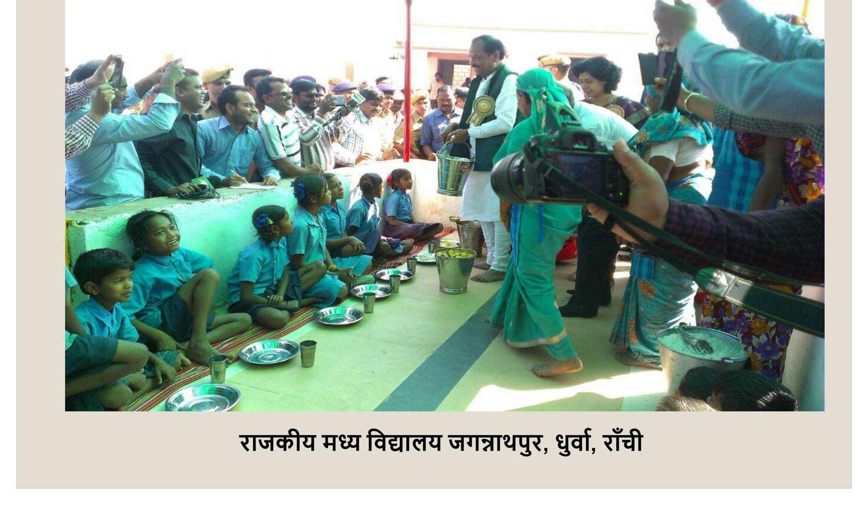
Best Practices
e-madhyahan-online SMS monitoring system initiated in FY 2016-17.
For additional nutrition in mid day meal to children, continuation of eggs/fruits to children thrice a week.

Slide 13
Best Practices
3. Government of Jharkhand is providing additional Rs. 500 as honorarium to cook-cum-helper from the state share.
4. Vidya lakshmi Yojana. – Under this scheme Rs 2000 (as fixed deposit) will be transferred to the accounts of ST & SC Girls of class 6 and this money will be used after passing class 8.
5. Monitoring of MDM by Telephone based system.
6. Effective management of MDM through Bal Sansad (Child Cabinet).
7. Schools are being tagged with local vegetable growing SHGs to provide fresh and cheaper vegetables for MDM.

Slide 14
New initiatives being taken in 2017-18
e-vidya vahini scheme – Schools will be provided with TAB.
Provision for running water in school from state funds for kitchen and toilets.
LPG – Budget Provision of 3984.00 lakh for providing LPG connections in schools of Jharkhand in FY 2017-18 from state fund.
Lifting of food grains under PDS system will be put in place.

Slide 15
Issues and suggestions
Kitchen Device
FCI
Funds for kitchen devices sanctioned in FY 2015-16 yet not released. Also amount of kitchen device should be increased.
FCI refusal to issue food grains without payment of pending bills of cost of food grains. Additional funds required for liability payments of FCI.
Honorarium of cooks
Transportation Cost
MME
Increase in honorarium of cook-cum-helpers
Increase in price for per MT of Transportation Cost. i.e. Rs. 250/MT.
Increase in funds for MME for effective management of MDM.

Slide 16
Proposal for FY 2017-18
S. No | Component | Proposal for | Proposed Outlay for 2017-18
 |  | 2017-18 | Central Share (in lakh Rs.) | State share (in lakh Rs.)
1 | Children (Pry) | 2182289 | 13746.67 | 9145.97
2 | Children (U Pry) | 1003935 | 9460.48 | 6298.49
3 | NCLP | 7309 | 84.33 | 56.15
Total Number of students (1+2+3) |  | 3193533 | 23291.48 | 15500.61
4 | Requirement of food grains | 93902.07 MTs
5 | Requirement of cost of food grains |  | 2820.63 | 0
6 | Requirement for transportation |  | 705.16 | 0
6 | Working Day (Pry and U. Pry) & NCLP | 254/254/311 | - | -
7 | Kitchen cum Store | 3500 kitchen sheds for revalidation | - | -
8 | Cook cum Helper | 85066 | 5103.96 | 7655.94
9 | Kitchen Devices | 11243 (for replacement) 4386 – new device | 781.45 | 0
10 | MME (Rs. in lakhs) |  | 1176.29
11 | Requirement of Central Assistance (Rs. in lakhs) |  | Rs. 33878.97 lakhs | Rs. 23156.55 lakhs

Slide 17
Plan under MME (amt. in lakh.)
Sl. No. | Proposal | Amount
1. | Proposal for Recurring expenditure for salary of Office staffs | 304.32
2. | Proposal for Recurring expenditure for Management Monitoring and Evaluation of MDM. | 266.47
3. | Proposal for Non-Recurring expenditure for Management Monitoring and Evaluation of MDM | 605.50
Total |  | 1176.29

Slide 20
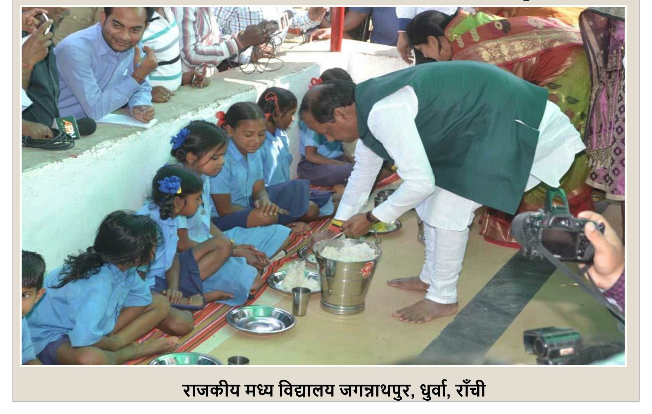

Slide 21
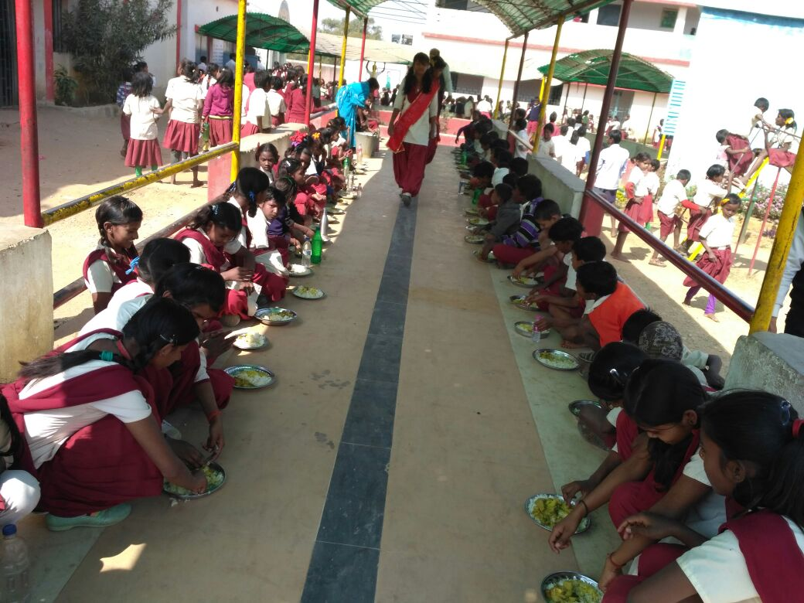

Slide 22
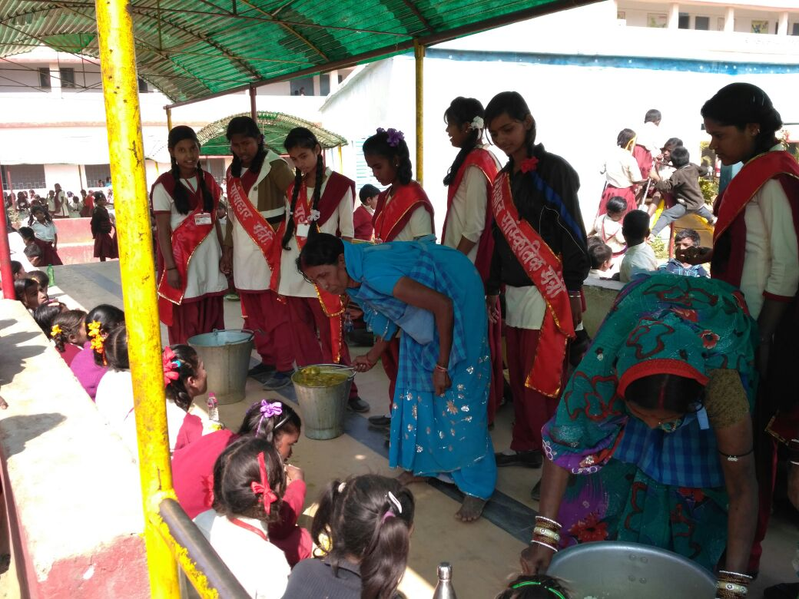

Slide 24
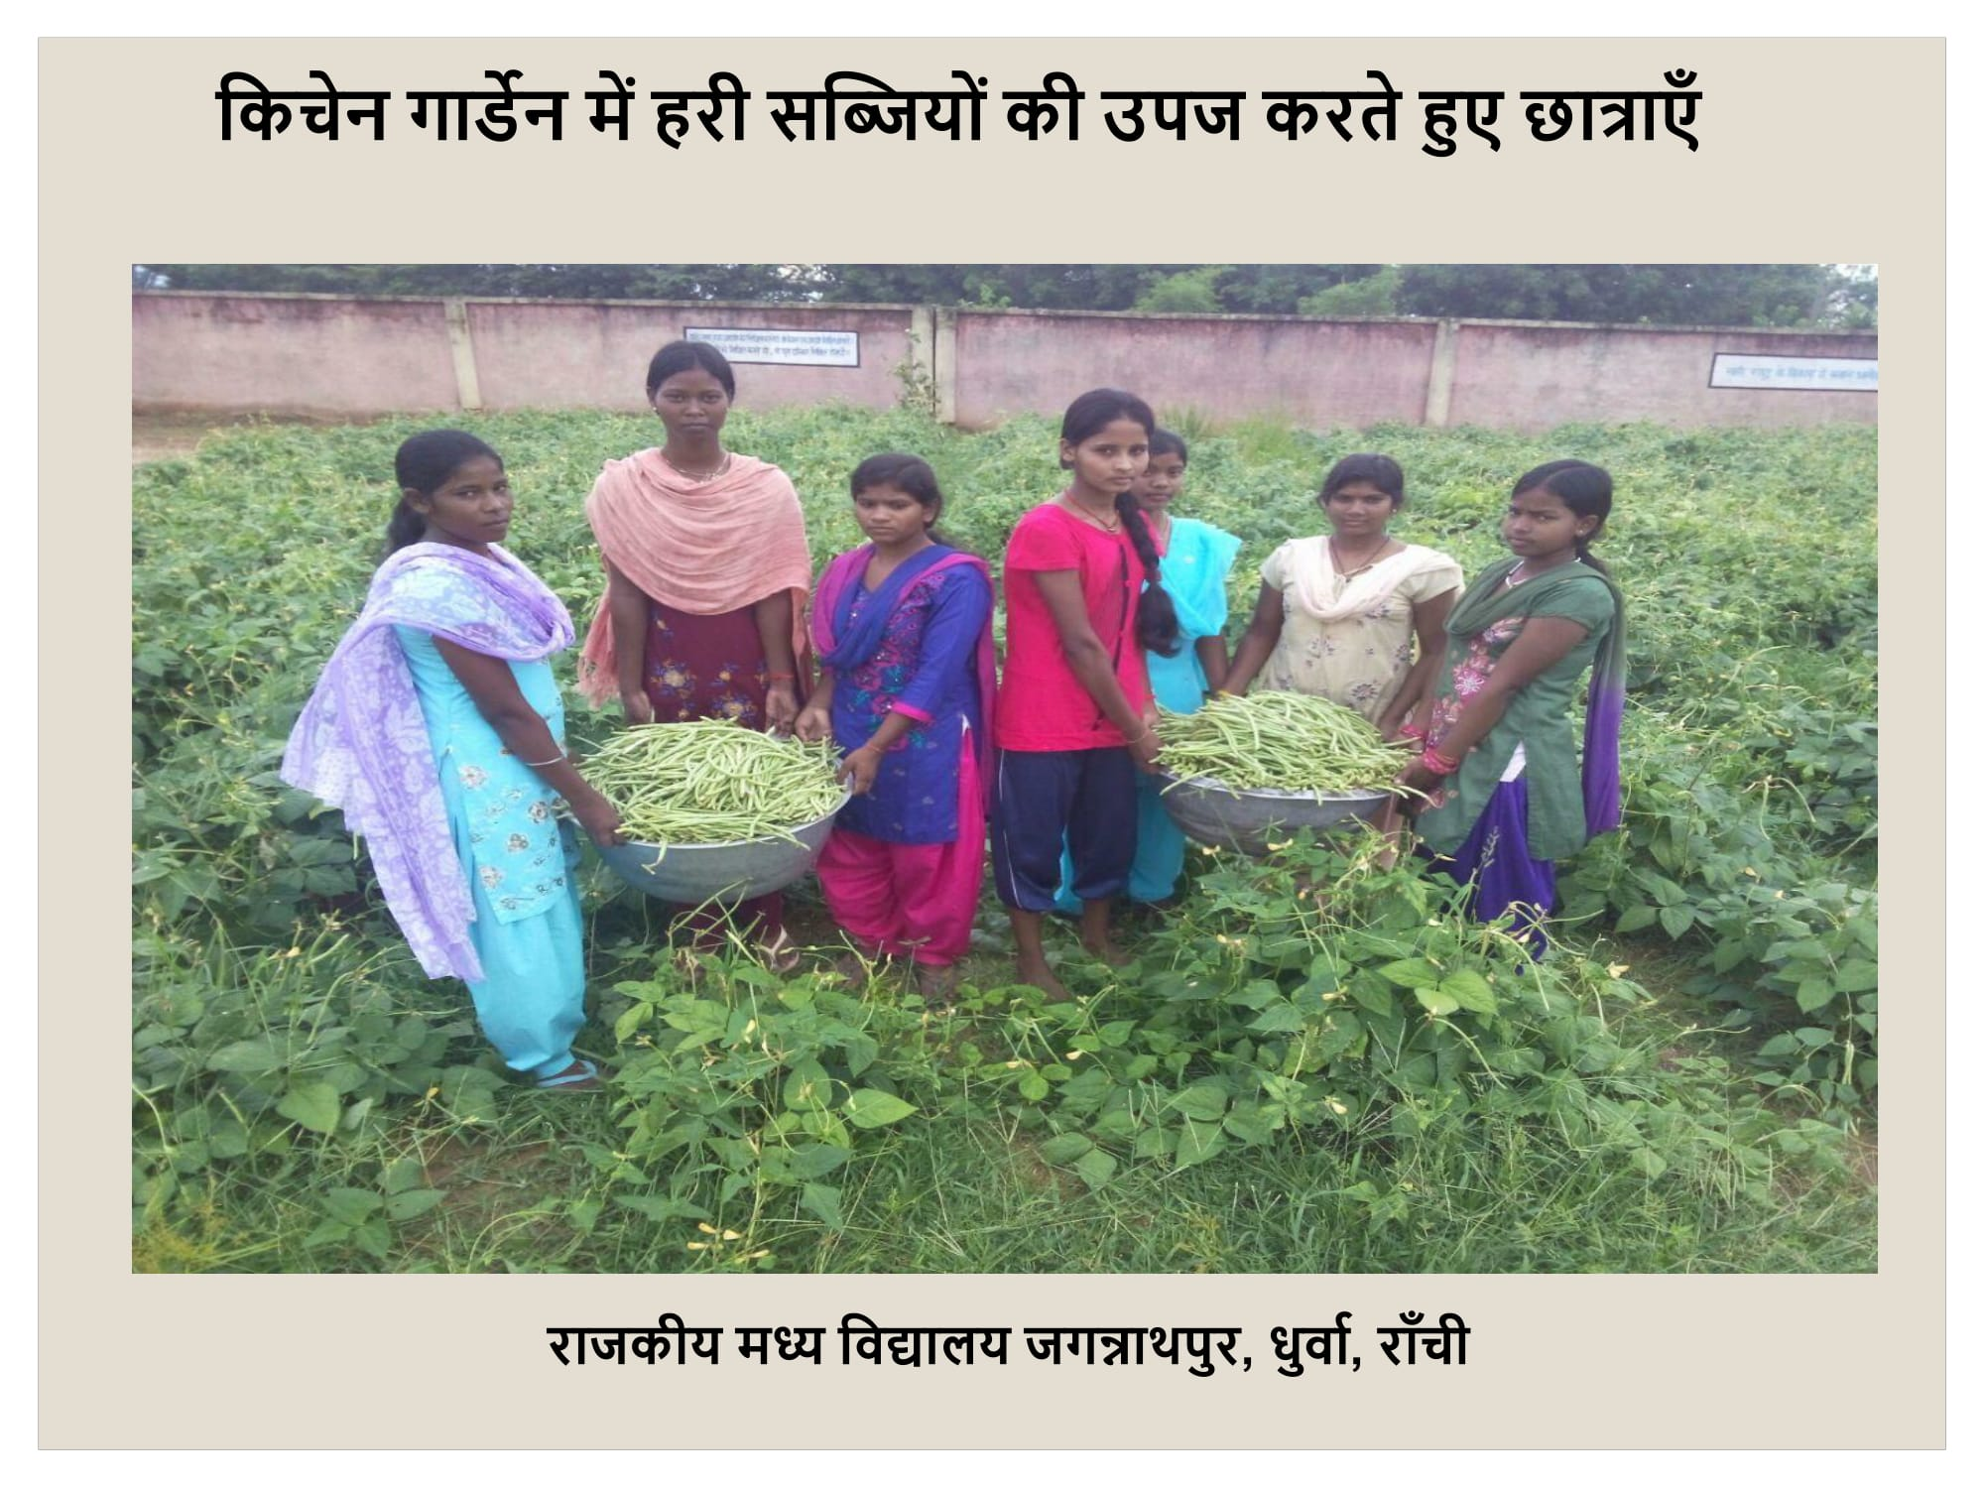

Slide 26
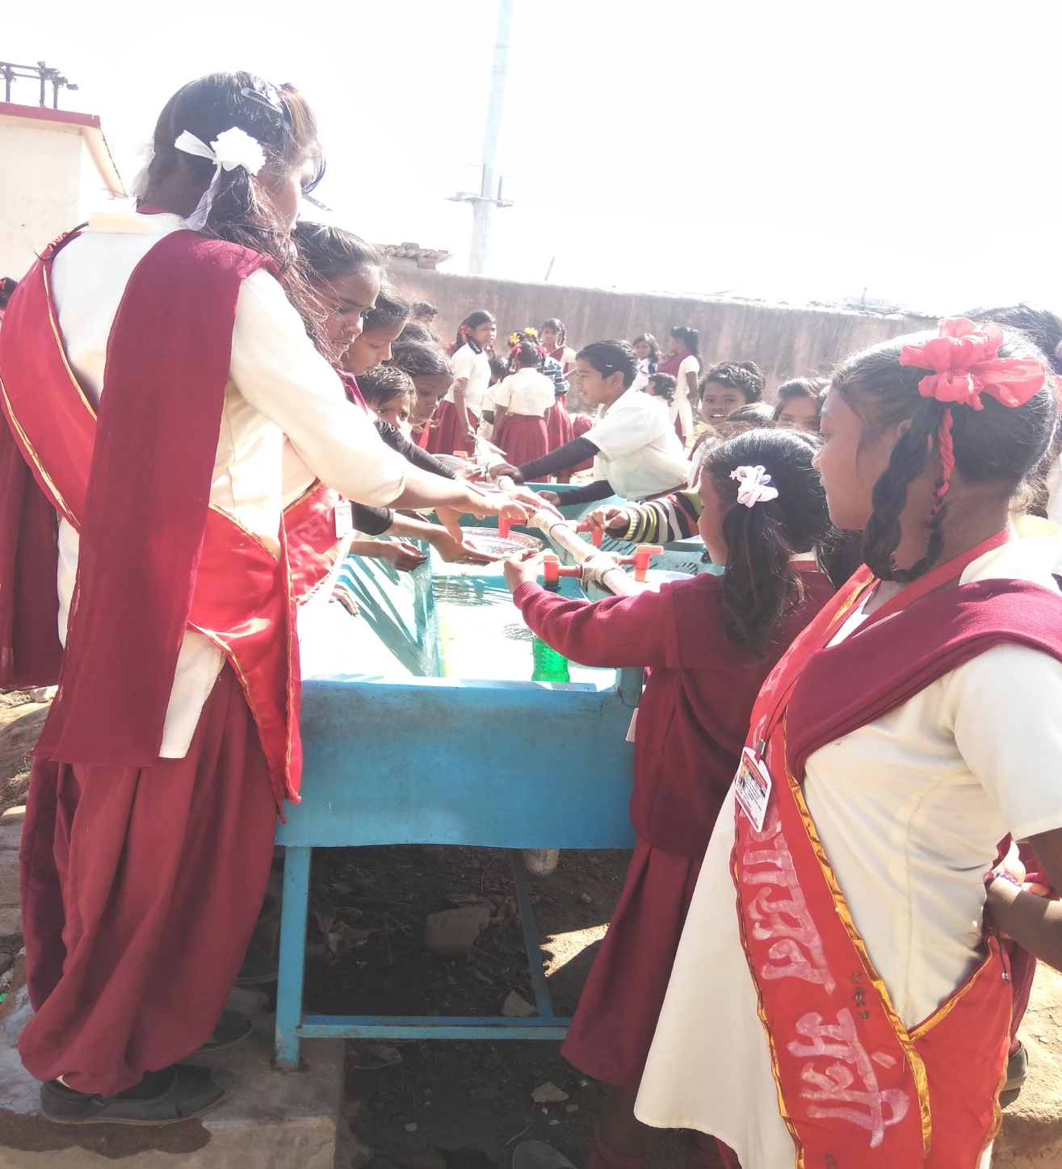

Slide 27
THANKS

