Slide 1
West Bengal
Mid Day Meal Scheme
Annual Work Plan and Budget
2018-19
Date : 21-06-2018

Slide 2
REVIEW OF IMPLEMENTATION OF Mid Day Meal Scheme
in
(Primary + Upper Primary) (1.4.2017 to 31.03.2018)
West Bengal
Ministry of HRD, Govt. of India

Slide 3
BEST PRACTICES
Rs.500 additional to Cook–cum-Helper as honorarium from State’s fund.
Eggs are served once a week to all the children.
50gm chicken per child once a week in 11 districts (Bankura, Hoogly, Howrah, Malda, Cooch Behar, Murshidabad, Nadia, Purba Medinipur, South 24 Parganas and North 24 Parganas).
Paneer 25gms are served once in a quarter in Malda district and Cheese 50gms are served once in a week in Uttar Dinajpur district.
6966 (8%) schools have kitchen gardens. In Purulia district 90% schools have kitchen garden.
Total 2973 dining hall constructed (1403 dining halls constructed through state funds and 1570 dining hall constructed from MPLAD funds in different districts).
79.95 lakh units of eating utensils purchased from State funds.

Slide 4
Issues
20 days less coverage of working days.
Less utilization of food grains (60%).
Variation of utilization of cooking cost (88%) and food grains (60%).
13,634 cook-cum-helpers did not engage.
62% schools are using fire wood as a mode of cooking.
Gazette notification of MDM Rules, 2015 has not discriminated to the District/Block/Schools.
Kalimpong district data not provided in the AWP&B – 2018-19.

Slide 5
Innovations etc.
It is proposed that the States and UTs may also be given flexibility to utilize, with prior approval of MHRD, 5% of their Annual Work Plan & Budget for new interventions provided they are not included under any of the Central or State Schemes and there is no overlapping of activities. This is subject to CCEA approval.
Some of the suggested innovation may be in the field of Water filters, kitchen gardens, provision of LPG connections, use of millets etc. These are only illustrative and not exhaustive.
Community participation.
Meetings of District committee headed by Dist. Collector.

Slide 6
Institutions : Existing vs Achievement (Primary)
No. of Institutions in thousand
100%
100%
100%
Ministry of HRD, Govt. of India

Slide 7
Institutions : Existing Vs Achievement (Upper Primary)
No. of Institutions in thousand
100%
100%
100%
Ministry of HRD, Govt. of India

Slide 8
Children : Enrolment Vs Coverage (Primary)
(Fig. in Lakh)
96%
94%
89%

Slide 9
Children : Enrolment Vs Coverage (Upper Primary)
96%
97%
91%
(Fig. in Lakh)

Slide 10
Aadhaar Enrolment
(Fig. in Lakh)

Slide 11
Working days coverage

Slide 12
Food grain: Allocation vs Utilization (in MTs)
(MTs in Lakh)

Slide 13
Food grain: Less Utilization Districts (in MTs)
Sl. No. | District | Allocated | Utilisation | % Utilisation | % Children Coverage
1 | GTA | 2397.38 | 925.41 | 39% | 97%
2 | Siliguri | 3508.36 | 1470.48 | 42% | 90%
3 | N/24 Pgs. | 28468.77 | 13546.20 | 48% | 92%
4 | Kolkata | 8675.21 | 4175.87 | 48% | 85%
5 | D/Dinajpur | 7531.10 | 3716.10 | 49% | 86%
6 | Nadia | 18356.04 | 9420.13 | 51% | 88%
7 | Malda | 19363.04 | 10384.83 | 54% | 86%
8 | Jalpaiguri | 7941.66 | 4312.86 | 54% | 88%
9 | Cooch Behar | 11960.26 | 6614.42 | 55% | 92%
(MTs in Lakh)

Slide 14
Payment of cost of food grains to FCI
As per FCI statement as on 31-03-2018 total pending bills is Rs. 7.19 Cr.
(Rs. in Lakh)

Slide 15
Cooking cost : Allocation vs utilization
(Rs. In Cr.)

Slide 16
Cook-cum-Helpers: Approval vs Engaged
(Fig. in Thousand)

Slide 17
MME: ALLOCATION vs UTILIZATION
(Rs. in Cr.)

Slide 18
Transportation Assistance : Allocation vs Utilization
(Rs. in Cr.)

Slide 19
Construction of Kitchen cum Stores
(%age)

Slide 20
Procurement of Kitchen Devices
(%age)

Slide 21
Replacement of Kitchen Devices
(%age)

Slide 22
Coverage : RBSK
Details | Institutions | Children
Children covered | 83690 | 11922163
Health Check up | 55046 | 6089145
IFA Distribution | 23558 | 1468103
Deworming Tablets | 12189 | 1655360
Spectacles | 5126 | 22789

Slide 23
Elements of Ayushman Bharat
Electronic Health Records
Electronic health record for each child
Upgrading skills of emergency care
Training on basic first aid for the teachers
School Health Promotion Activities
Provision of Services
Health Screening
Age appropriate learning for promotion of healthy behavior and prevention of various diseases
Delivered through school teachers trained as Health Ambassadors in coordination with health department staff.
Screening of children 30 identified health conditions for early detection, free treatment and management through dedicated RBSK mobile health teams
Iron Folic Acid (IFA) tablets, Albendazole administration will be provided by teachers through WIFS and National Deworming Day (NDD) programme respectively.
Provision of Sanitary Napkins.
Identification of malnourished and anemic children and appropriate referrals to PHCs and hospitals. The periodicity of such checkups may be increased.
Age appropriate vaccination.
Availability of potable drinking water
Yoga and Meditation

Slide 24
Drinking water facilities
Mode of safe Drinking water | Schools | %age
Schools having drinking water facilities | 83690 | 100%
Safe drinking water facilities | 78338 | 94%
Water filtration | 5543 | 7%
RO/UF | 120 | 0.1%
UV purification or e-boiling | 116 | 0.14%
Candle filter purifier | 4482 | 5%
Activated carbon filter purifier | 825 | 0.99%

Slide 25
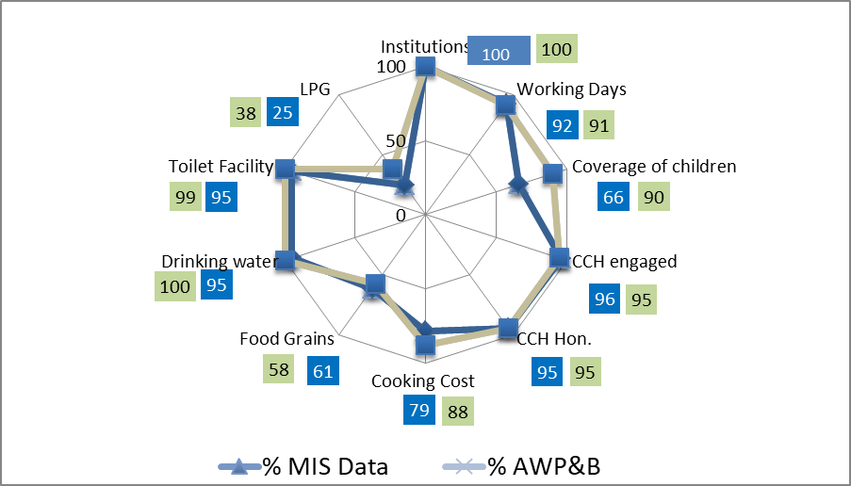
Comparison : AWP&B vs MIS Data

Slide 26
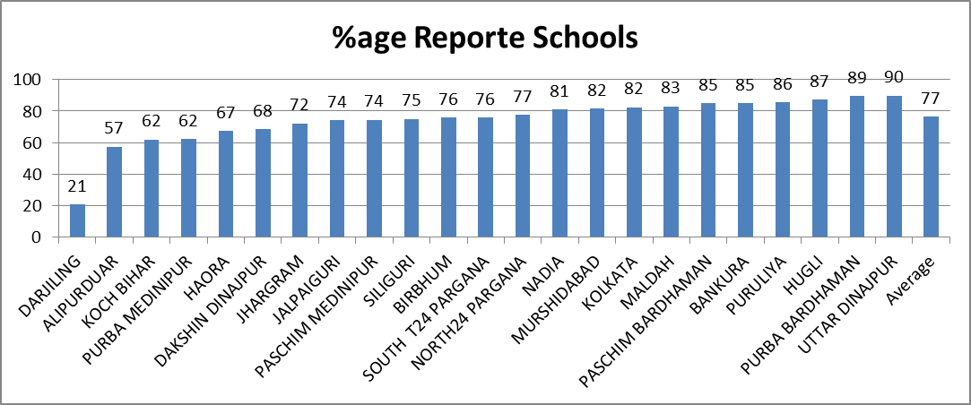
Automated Monitoring System (AMS)
(%age)

Slide 27
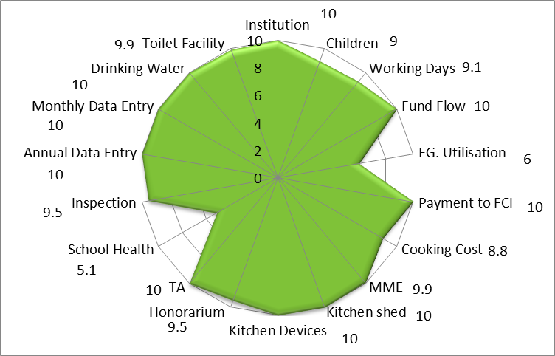
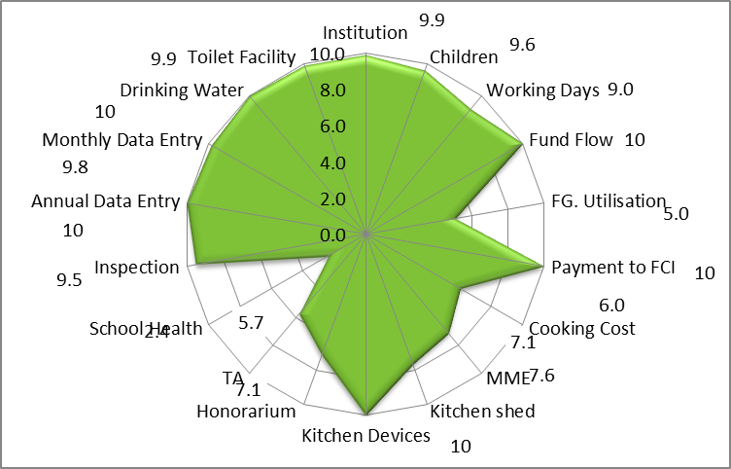
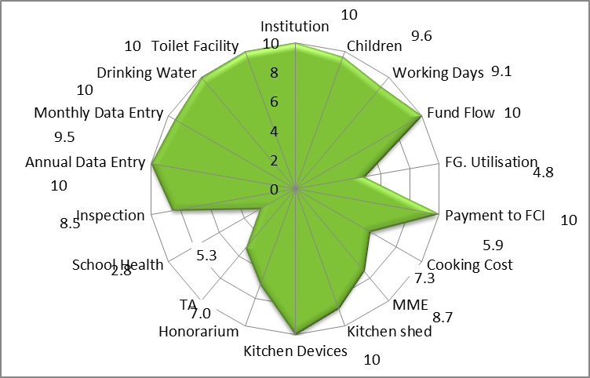
Over all Score Card for 3 Years :important Components
2017-18
2015-16
2016-17

Slide 28
State’s Proposal for 2018-19

Slide 29
Proposal for 2018-19 : Children (Primary)

Slide 30
Proposal for 2018-19 : Children (U. Primary)
(No. of Children in lakh)

Slide 31
Kitchen-cum-Store
An amount of Rs. 5.38 crore for construction of 268 Kitchen-cum-stores approved by PAB-2017-18 @Rs. 2.00 lakh/unit. State submitted details proposal at revised rate of Rs.769.16 @2.87/unit during 2017-18. Revised rate may placed for approval of PAB.
Central share = Rs.461.50 Lakh
State share = Rs.307.66 Lakh)

Slide 32
Proposals and Recommendations for FY-2018-19
S. | Component | PAB Approval 2017-18 | State’s Proposal for 2018-19 | Recommendation 2018-19
1 | Children (Pry) | 7086178 | 6469128 | 6469128
2 | Children (U Pry) | 4820977 | 4230973 | 4230973
3 | NCLP | 31227 | 28841 | 28841
4 | Working Days – Pry & Upy | 230 | 230 | 230
5 | Working Days – NCLP | 312 | 312 | 312
6 | Cook cum Helper (Pry + U.Pry) | 248799 | 248799 | 248799
7 | Drought - Children (Pry) | Nil | Nil | Nil
8 | Drought - Children (U Pry) | Nil | Nil | Nil
9 | Drought - Working days | Nil | Nil | Nil
10 | Drought - Cook-cum-helpers | Nil | Nil | Nil
11 | Kitchen cum Store | 268* | Nil | 268*
12 | Kitchen Devices (New) | Nil | Nil | Nil
13 | Kitchen Devices (Rep.) | Nil | 40874 | 40874
14 | Central Assistance (Rs in crore) | Rs. 1115.38 Cr. | Rs. 1011.57 Cr. | Rs.1011..57 Cr
*Total Central Assistance (including kitchen-cum-stores) =Rs. 1036.62 Cr.

Slide 33
Thank you

