Slide 1
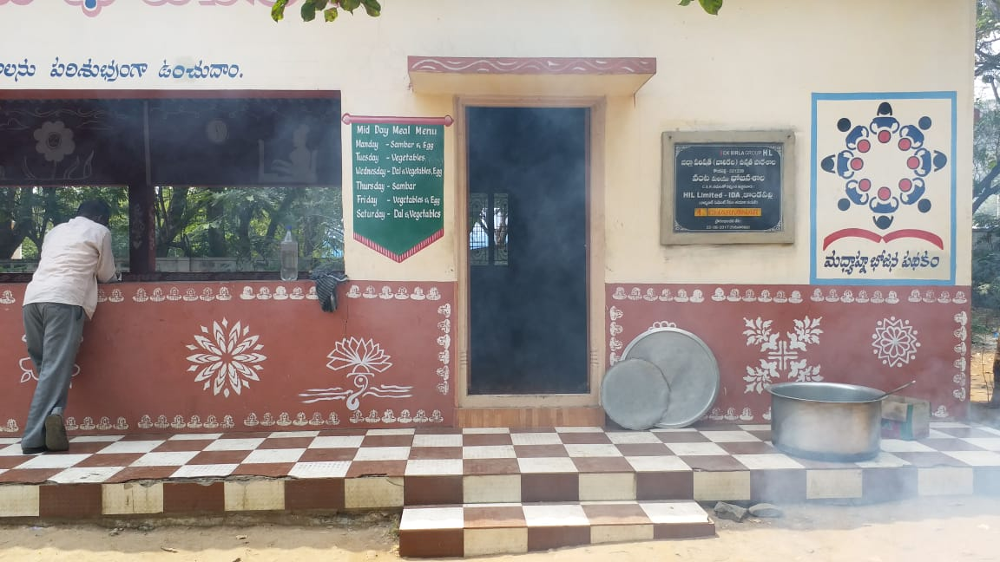
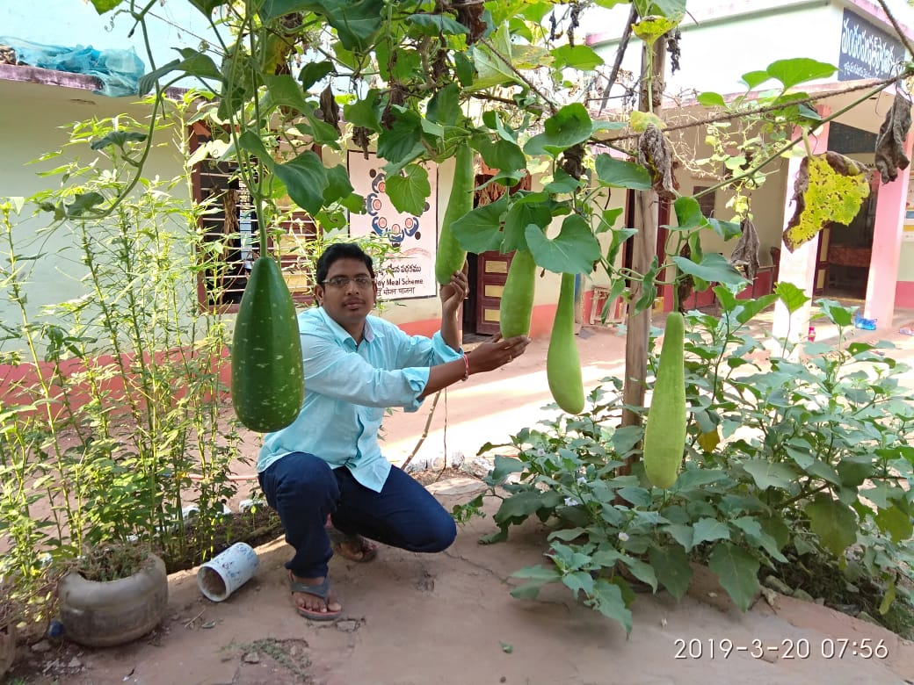
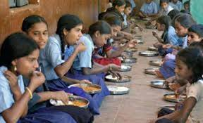
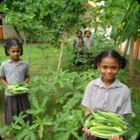
Mid Day Meal Scheme
Annual Work Plan & Budget – 2019-20
Dept. of School Education

Slide 2
Coverage during 2018-19
Sl.No. | Type of Schools | Approved by PAB |  | Achievement (31.03.2019) |  | % of Achievement
 |  | Schools | Children | Schools | Children
1. | Primary (I to V) | 34,812 | 16,80,000 | 34,776 | 15,40,018 | 92%
 | STC (NCLP) | 64 | 3955 | 64 | 3566 | 90%
2 | Upper Primary (VI to VIII) | 10629 | 9,70,000 | 10583 | 9,23,636 | 95%
GRAND TOTAL |  | 45,505 | 26,53,955 | 45,423 | 24,67,220 | 93%
3 | CCHs now working |  | 85143
4 | Working Days |  | 220
5 | Working Days for NCLP |  | 302

Slide 3
In Lakhs

Slide 4
Budget Releases Vs Expenditure 2018-19
Component | Releases |  |  | Expenditure |  |  | % of expdtr
 | Central | State | TOTAL | Central | State | TOTAL
Food-Grains | 1990.47 | -- | 1990.47 | 1897.29 | -- | 1897.29 | 95%
Transportation | 497.62 | -- | 497.62 | 497.62 | -- | 497.62 | 100%
Cooking Cost | 17268.02* | 11512.01 | 28780.03 | 16830.01 | 11206.39 | 28036.40 | 97%
Honorarium to CCHs | 4858.50* | 3239.01 | 8097.51 | 5108.58 | 3239.01 | 8347.59 | 100%
MME | 464.81 | -- | 464.81 | 464.81 | -- | 464.81 | 100%
TOTAL | 25079.42 | 14751.02 | 39830.44 | 24798.31 | 14612.11 | 39410.42 | 99%
In Lakhs
*Excluding Rs.769.18 lakhs for Cooking Cost & Rs.403.80 Lakhs for CCHs of Opening balance.

Slide 5
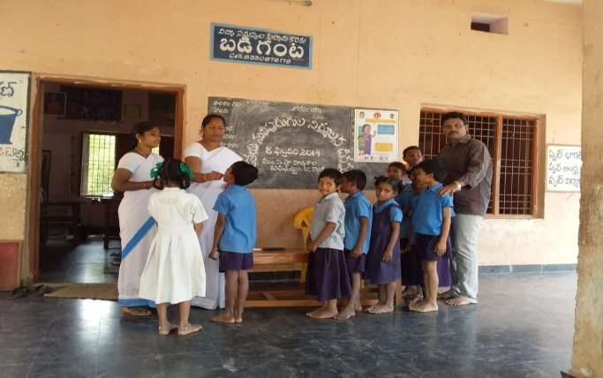
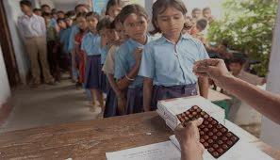
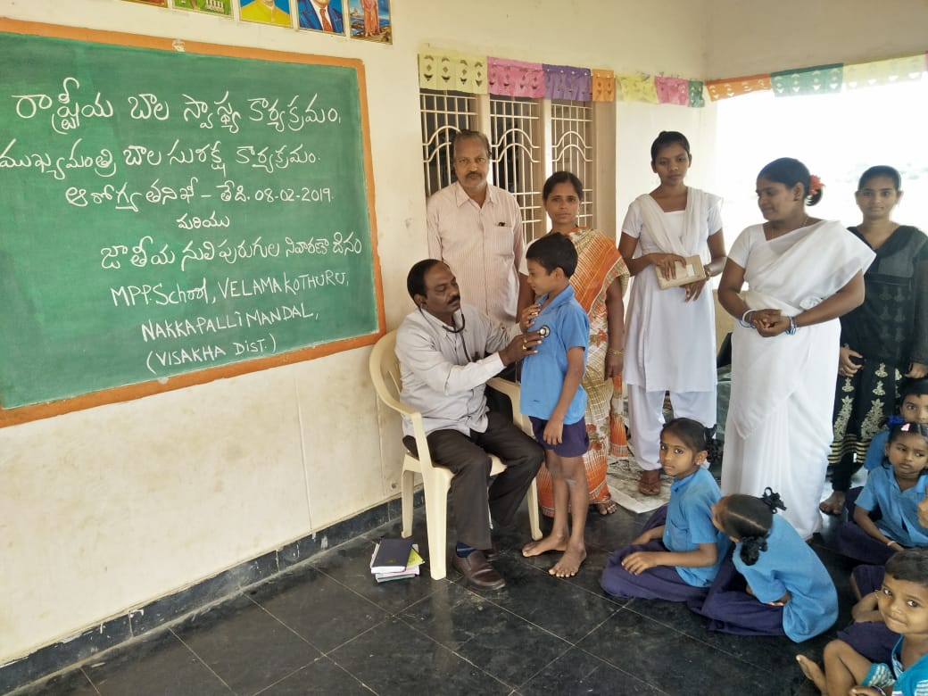
School Health Programme (RBSK)
The number of institutes and Children covered under RBSK
Health Checkups done under RBSK
Weekly Iron & Folic Acid Supplementation (WIPS)
De-worming Medicine distributed.
Spectacles distributed.
Stage | Health Check up |  | Distribution of Iron Folic Acid |  | De-worming
 | Centers | Children | Centers | Children | Centers | Children
Primary & Upper Priy | 42600 | 2644150 | 41433 | 2377648 | 41859 | 2333654

Slide 6
Best Practices in Andhra Pradesh State
E-Monitoring: Website for affective Online Monitoring of MDM was launched. Entry of MDM data through online is effectively working in the State.
Aadhaar Linkage: To have accurate enrolment data the Aadhar Seeded Child info data, UDISE data & Mid Day Meal data is being integrated.
Supply of Eggs: 5 Eggs per week per child being supplied at an additional cost of Rs.266.72 crs.
Supply of Oil & Dal: Edible Oil and Dal is being supply to School point through Centralised system from 2018-19.

Slide 7
5. Civil Supplies e-Pos System & MDM integrated – All Schools & HMs mapped with the nearest Fair Price Shops; Aadhaar authentication for supply of Food-grains, Oil, Dal
6. Centralisation of payment: Iintroduced from August 2017. The bank details of SHGs/NGOs are captured through the website and mapped to the School UDISE.
7. MDM Citizen Satisfaction Surveys by Real Time Governance System – IVRS calls up monthly an average 30,000 Parents of the children studying and enquires about their satisfaction about School MDM – Quality, Quantity, Hygiene, reasons for dissatisfaction etc. Improved from 66% satisfaction in January to 85% in Feb. 2019
8. Surprise Visits: Centralised Monitoring System introduced whereby surprise visits are made to random-computer generated school to review quality, hygiene, etc.3088 Schools visited from Oct’18 to Jan’19 Month 3088 Schools – Satisfaction levels improved significantly

Slide 8
RTGS Survey – PARENTS Satisfaction ON mdm in AP
Improvement in public Satisfaction over quality, Hygienic conditions, etc. of MDM from Feb-19 due to happened owing to surprise visits through Centralized monitoring system .

Slide 9
MDM commodities Distribution through – CS ePOS (NIC)
Closing balance placed by the school in charge through Mobile app/Web portal
Commodity RO’s generated based on allocation
Dispatch the MDM commodity from MLS point to FP Shops and then distribute to the schools
MLS Points
FP Shop
FP Shop
School
School

Slide 10
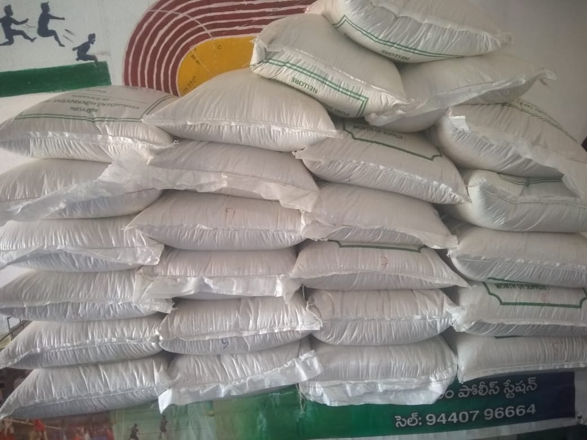
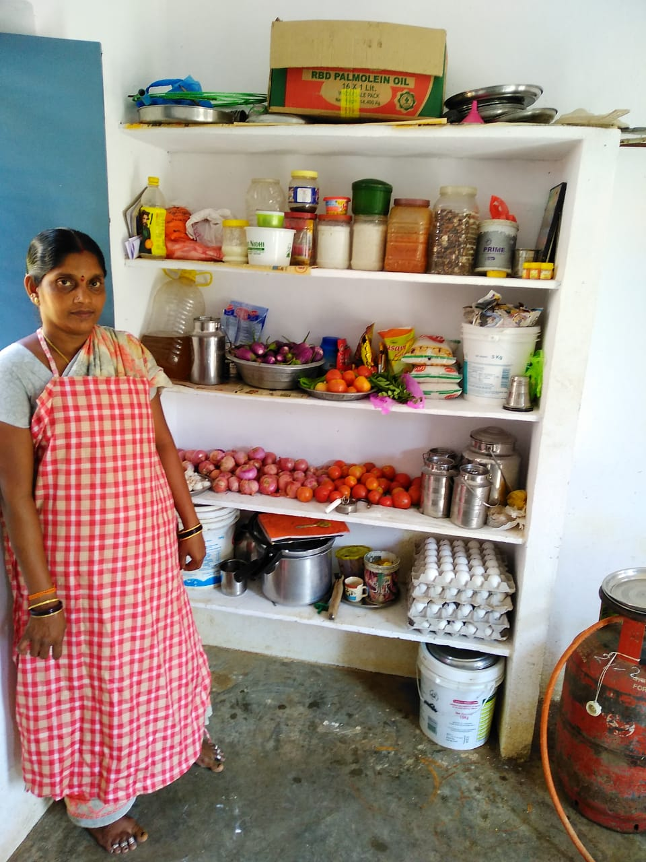
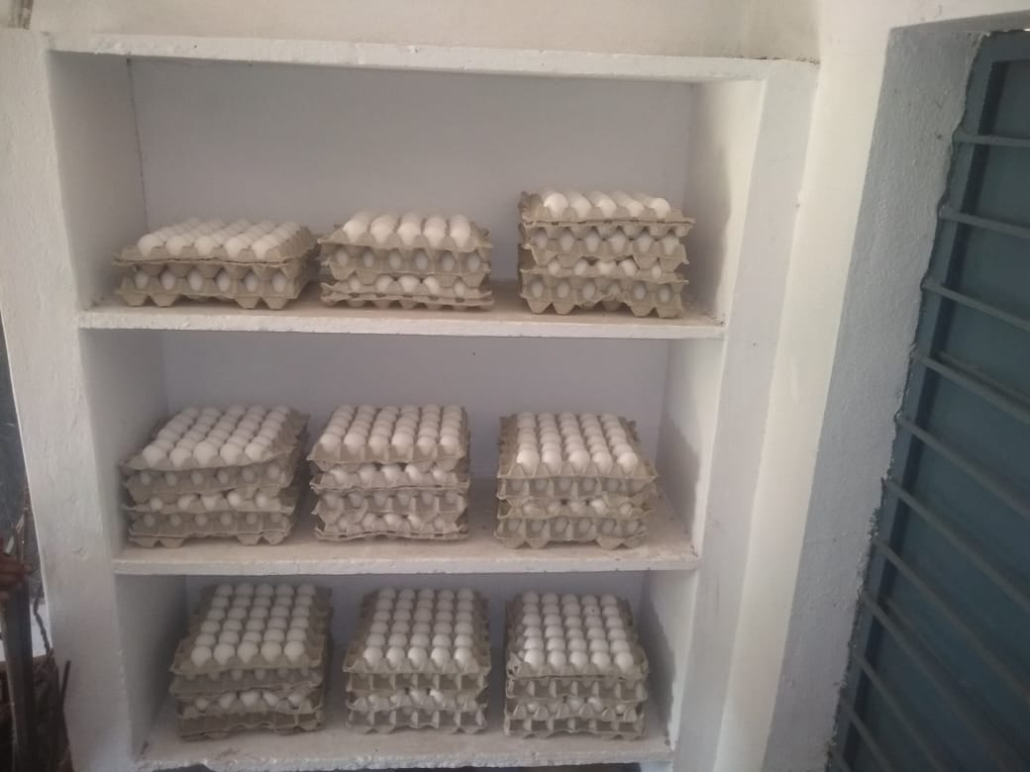
Model MDM Kitchens being promoted
MEOs & HMs encouraged to modify/develop Model kitchens with community support
Pilot 252 Model Kitchens under development.
Training was given to the MEOs/HMs related to these schools.
CCHs will be trained to maintain kitchen and hygienic conditions within the budget provision.

Slide 11
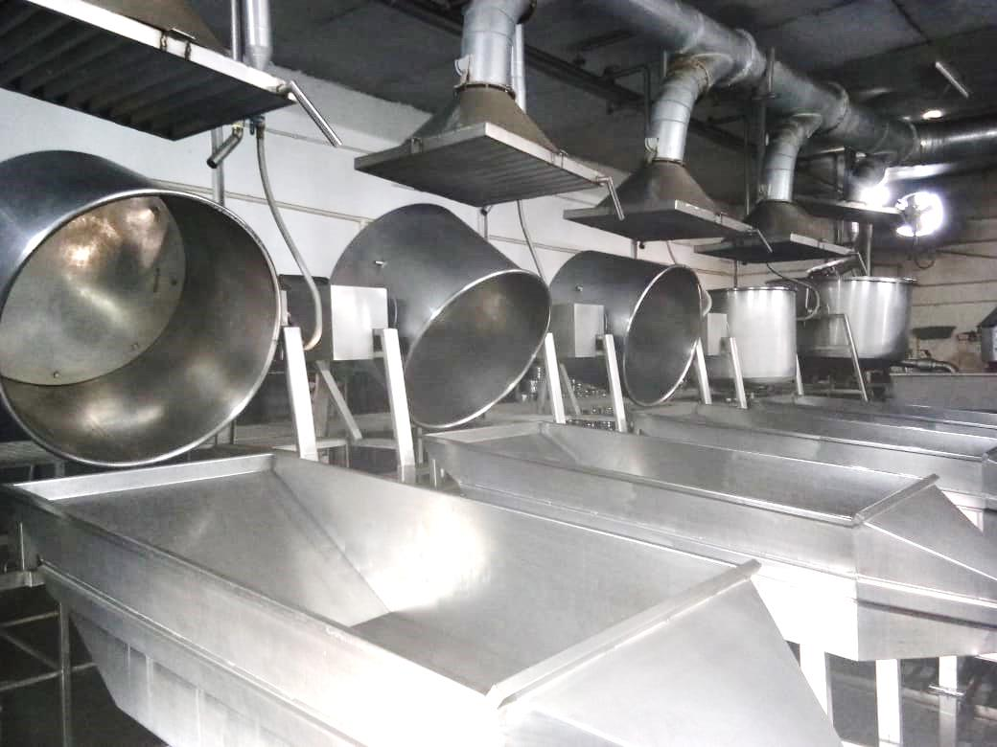
Involvement of NGOs / Trusts
7 NGOs/Trusts are involved in serving Mid-Day Meal Scheme covering 2,12,964 students in 1794 schools.
Out of approved Centralized Kitchens in 71 clusters covering 17,974 schools in 281 Mandals/Blocs, 11 kitchens started serving meals covering 2.20 lakh students.
Cooked Meals transported in insulated containers
Responsibility of receiving cooked meals at the schools from the centralized kitchens is the HM / Teacher.

Slide 12
Automated Monitoring System
Meals Availed % 2018-19

Slide 13
MIS-Online Data Entry Status 2018-19, GOI

Slide 14
Budget Proposed for 2019-20 (Rs.56625.00 lakhs)
Component |  | Central | State | Total
Recurring | Normal | 26206.73 | 17471.15 | 43677.88
 | Drought | 2379.93 | 1586.62 | 3966.55
Non-Recurring | Kitchen Devices/ Replacement | 3424.09 | 2282.73 | 5706.82
 | Repairs to Kitchen Sheds | 423.42 | 282.28 | 705.70
 | Flexi Funds | 1540.83 | 1027.22 | 2568.05
TOTAL |  | 33975.00 | 22650.00 | 56625.00

Slide 15
Government of A.P Additional Budget – Rs.684 crs.
Item | 2018-19 | 2019-20 (proposed)
Coverage to IX & X class | 12235.00 | 18878.00
Supply of Eggs (5 Eggs for a week) for I to X classes | 26672.00 | 26672.00
Enhanced Honorarium to CCHs | 4238.21 | 17659.20
TOTAL | 43145.21 | 63209.20
During the year 2018-19 the Scheme was extended to 174683 students of 450 Government Junior Colleges with an expenditure of Rs.5200.00 Lakhs (100% State share).

Slide 16
Construction of Kitchen cum Store Rooms
Phase | Units Sanction | Completed | Progress | To be started
I | 31,213 | 11,690 | 19,523 (units surrender to Govt.)
II | 13,103 | 6,601 | 1,033 | 5,469
III | Re-allotment From Phase-I | - | - | 16,689
TOTAL | 44,316 | 18,291 | 1,033 | 22,158

Slide 17
Estimated Budget for Kitchen cum Store Rooms
Enrollment Range | No.of Schools | Estimated Expendr. In Lakhs
0-100 (20sq Mtr) | 18251 | 52927.90
101-200 (24sq Mtr) | 1818 | 6326.64
201-300 (28sq Mtr) | 429 | 1741.74
301-400 (32sq Mtr) | 213 | 988.32
401-500 (36sq Mtr) | 125 | 652.50
501 & Above (40sq Mtr & above) | 151 | 1037.04
TOTAL | 20,987 | 63674.14
Amount already sanctioned by GOI Rs.11713.80 lakhs+ State Share Rs7809.20 lacs
Additional Requirement Rs.26490.68 lakhs (Central share) + Rs.17660.45 lakh (State share)

Slide 18
Pilot - Breakfast: & Supplementary food
Utilization of Flexi Funds (Estimate:Rs.2665.55 lakh)
Item | Unit Price (in Rs) | W.Days | Est. Cost (in lakhs)
Drought Affected Areas: (197829 children)
Veg. bath | 3.91 | 73 | 564.66
Raagi Laddu | 4.00 | 73 | 577.66
Chikki | 5.00 | 74 | 731.97
Children selected for National Games (2000):
Raagi Laddu | 4.00 | 110 | 8.80
Chikki | 5.00 | 110 | 11.00
Expenditure |  |  | 1894.09
Primary class children drought affected areas of two districts (Anantapur and Prakasam) are covered. (Veg bath, Raagi Laddu and Chikki 2 days each)
Chikki and Raagi Laddu for three days each is proposed to be provided to 2000 children, who are selected by SAAP for National Games in convergence with AP State Sports Authority.
Kitchen Gardens:
Proposed for development: 13,324 - Budget (@Rs.5000/- ) Rs.666.00 lakhs
Total Estimated Expenditure : Rs.2560.09 lakh

Slide 19
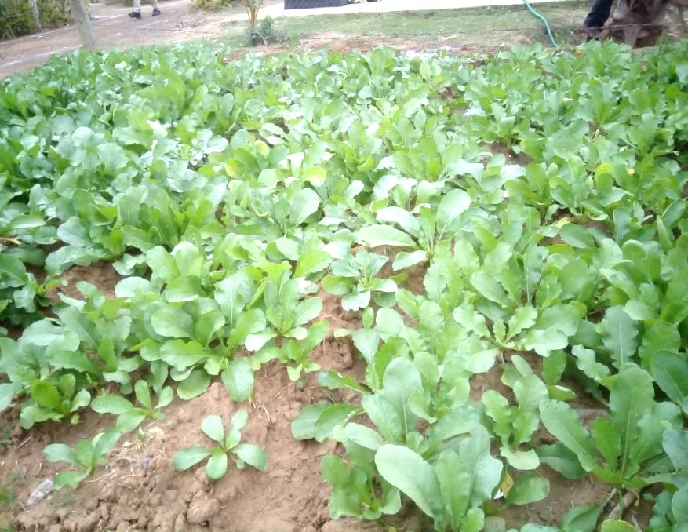
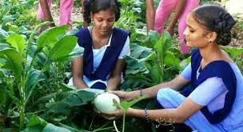
Kitchen / Nutri Gardens
District | Kitchen gardens - Scope | Already Set up & functioning | Kitchen Gardens U/ Progress | Proposed 2019-20
Srikakulam | 1596 | 406 | 212 | 978
Vizianagaram | 4792 | 610 | 2091 | 2091
Visakhapatnam | 915 | 766 | 0 | 149
East Godavari | 1690 | 450 | 329 | 911
West Godavari | 6426 | 2930 | 243 | 3253
Krishna | 807 | 361 | 212 | 234
Guntur | 620 | 35 | 35 | 550
Prakasam | 1220 | 280 | 240 | 700
Nellore | 3232 | 96 | 0 | 3136
Chittoor | 1945 | 980 | 58 | 907
Kadapa | 258 | 0 | 8 | 250
Ananthapur | 45 | 0 | 0 | 45
Kurnool | 284 | 0 | 164 | 120
TOTAL | 23,830 | 6,914 | 3,592 | 13,324

Slide 20
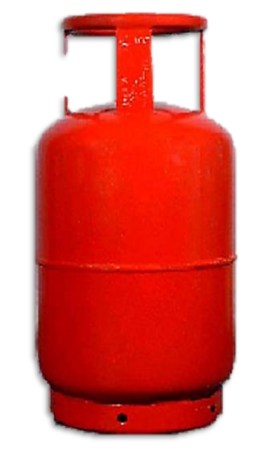
Requirement of additional Sub sidized LPG cylinders
Item | Details
Weight of domestic cylinder | 14.2 kgs
1 cylinder sufficient to cook | 720 Meals
Number cylinders actually required | 7,72,063
Number of cylinders provided on subsidy | 5,45,076
Additional requirement of cylinders on subsidy based on meals availed students | 2,26,987

Slide 21
Initiatives under MME - 2019-20
Improving the existing kitchens into Model Kitchens with small improved storage, hygiene.
Workshops to Cook-cum-Helpers and teachers/ Officers on the aspects like hygienic conditions at kitchens, maintenance of kitchen, storage of food grains, quality of meals, etc.
Training Programmes to Cook-cum-Helpers and Field Functionaries.
Conducting cooking competitions for CCH – Expert & Children Panel as Jury for selecting Awardees & different levels. The recipe so selected will be taking up to other schools,

Slide 22
Issues for Discussion
Enhancement of Cooking Cost in view of the hike in the prices of Vegetables, Dal, Oil and all other ingredients.
Providing necessary budget provision for procurement LPG Gas Stoves, storage bins in addition to the Kitchen devices.
Providing additional subsidized LPG cylinders.
Providing budget for construction of Kitchen sheds as per plinth area norm.
Notes:
22
22

Slide 23
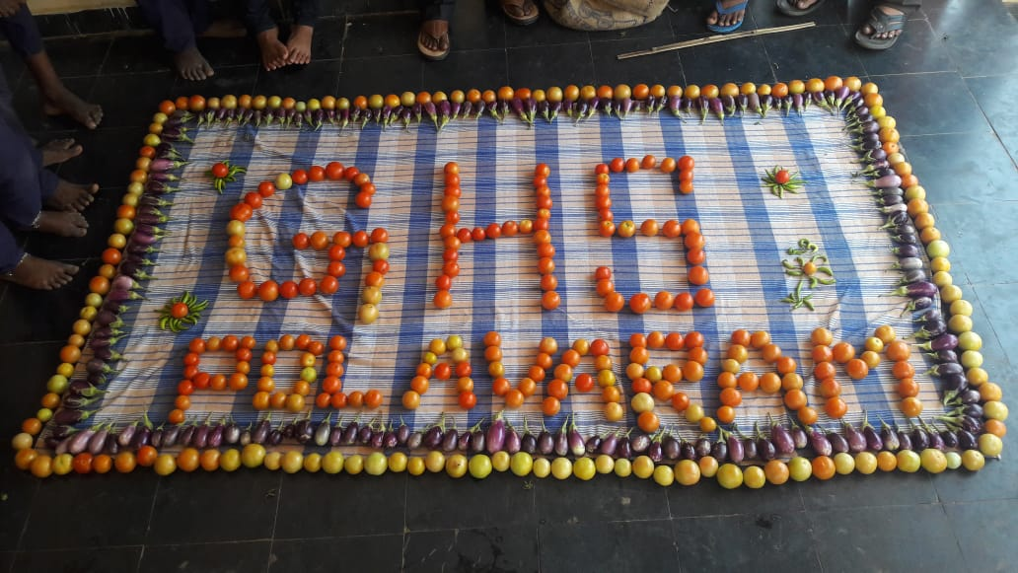
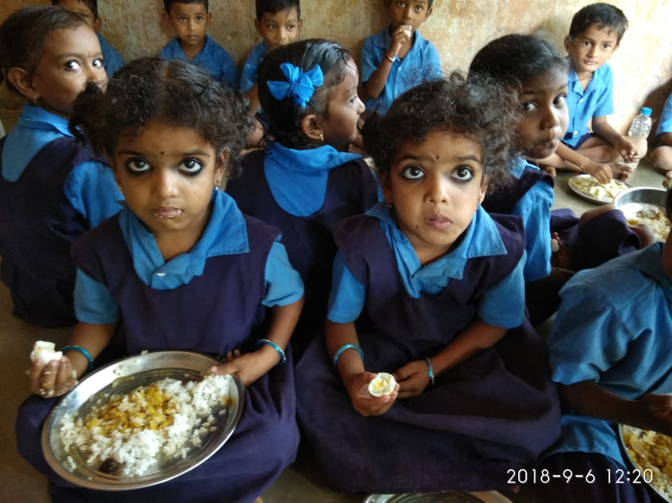
Thank you!

