Slide 1
Annual Work Plan & Budget, 2020-21
[Mid Day Meal Scheme]
MDM - PAB Meeting
25.06.2020
Arunachal Pradesh

Slide 2
OVERVIEW
Initiatives taken up by State Government. Other Issues.

Slide 3
INITIATIVES OF STATE GOVERNMENT
1. Top-up additional Honorarium to Cook-cum-Helper from State Government
An amount of Rs.610.50 lakh has been sanctioned during 2019-20 as a Top-up additional honorarium to CcH @Rs.1000/- per month for 10 months in a year. Payment is made through DBT mode under PFMS.
2. Construction of MDM Kitchen-cum-Store under CMSSY
Condition of MDM kitchen-cum-store in the schools are very poor. During 2018-19, total 74 kitchen-cum-store were constructed in 9 districts under CM’s Samast Shiksha Yojana. Fund for construction of 34 kitchen-cum-store in another 9 districts have been sanctioned under CM’s Samast Shiksha Yojana during 2019-20. Funds are placed to Deputy Commissioner through PFMS.

Slide 4
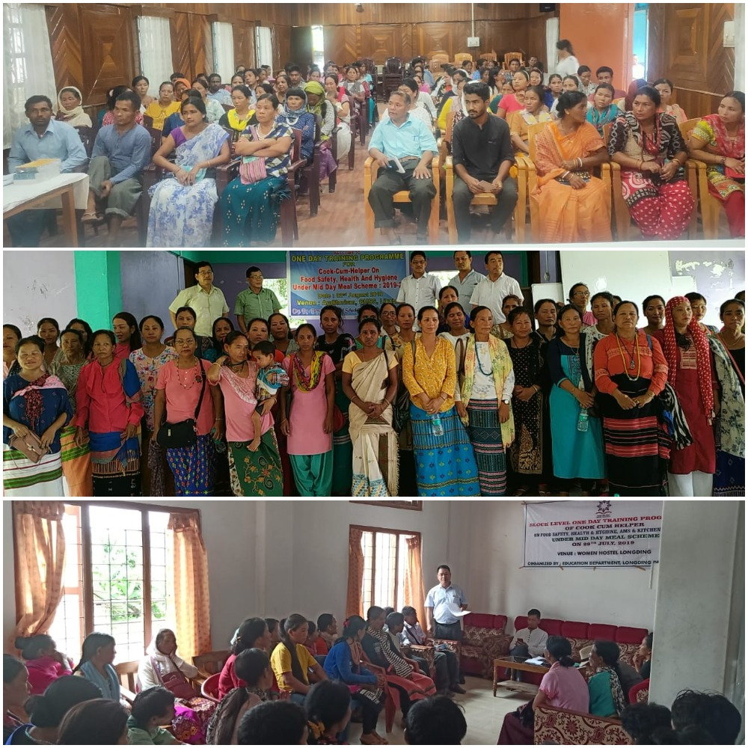
INITIATIVES….
3. Training of Cook-cum-Helper.
 | One day Training of Cook-cum-Helper on MDM entitlement norms, personal hygiene, washing & cleaning, garbage disposal, importance of nutrition garden to supplement MDM, etc. was conducted in all the districts during the month of July & August 2019. Training was conducted Departmentally with resource persons from Health Deptt. and Food & Civil Supply Deptt. As many as 4418 Cook-cum-Helpers were reportedly imparted training in all districts.

Slide 5
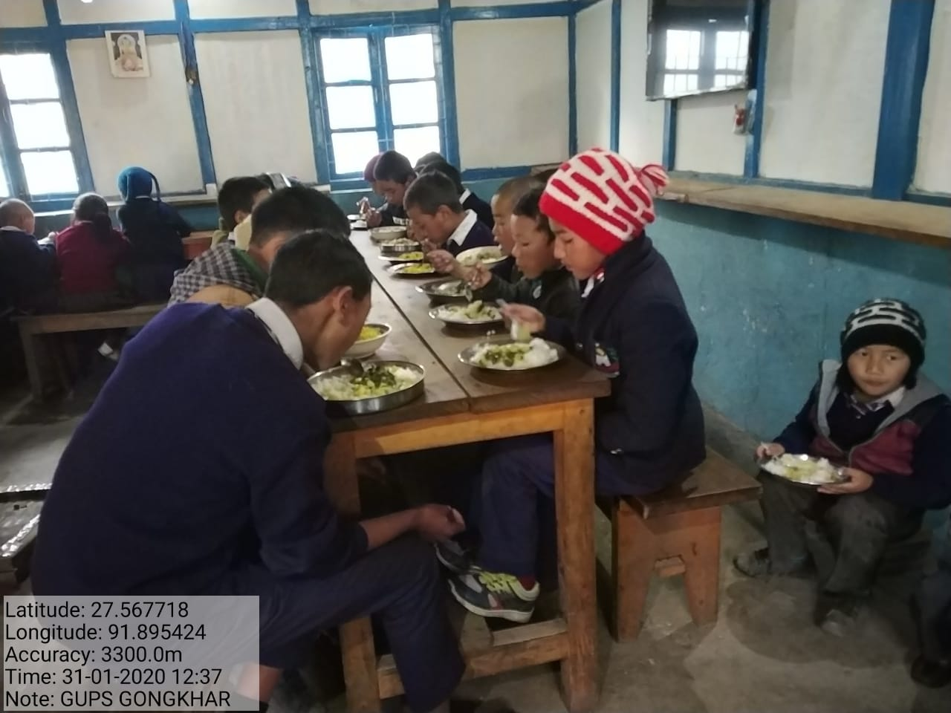
MDM being served…
Govt. Upper Primary School, Gongkhar, Tawang District

Slide 6
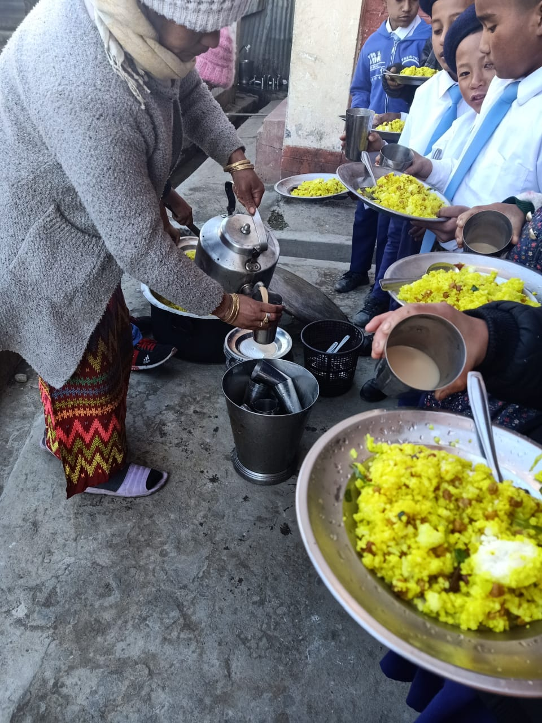
MDM being served…
GMS, Bomdila (West Kameng District)

Slide 7
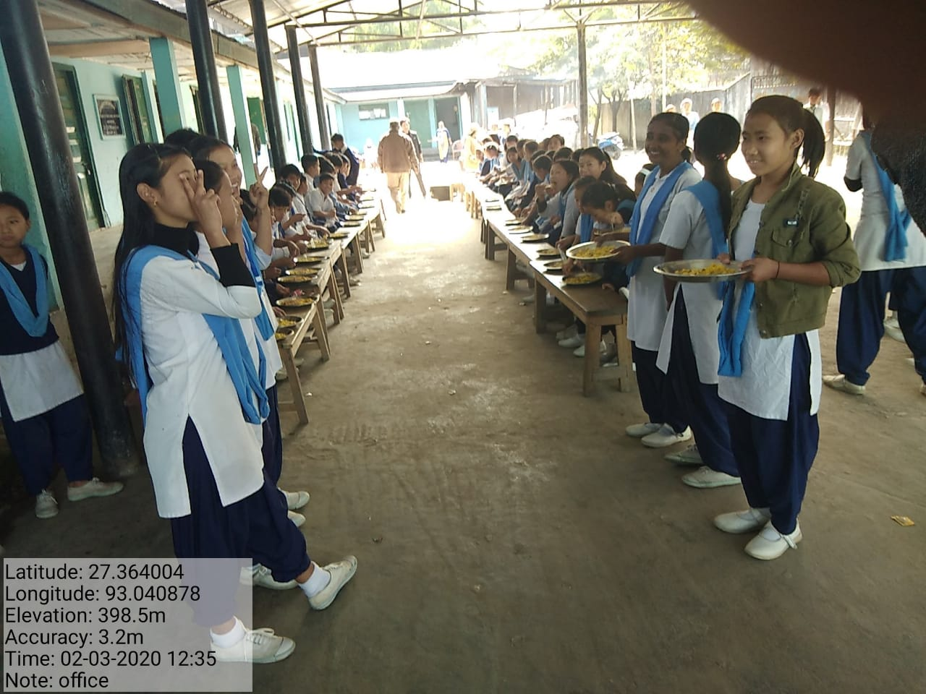
MDM being served…
Govt. Middle School, Seppa (East Kameng District)

Slide 8
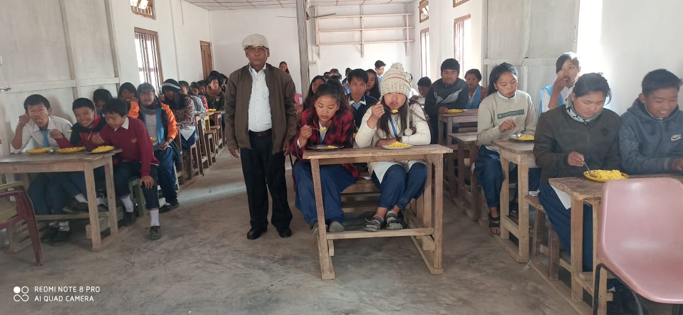
MDM being served…
Govt. Sec. School, Yazali (lower Subansiri District)

Slide 9
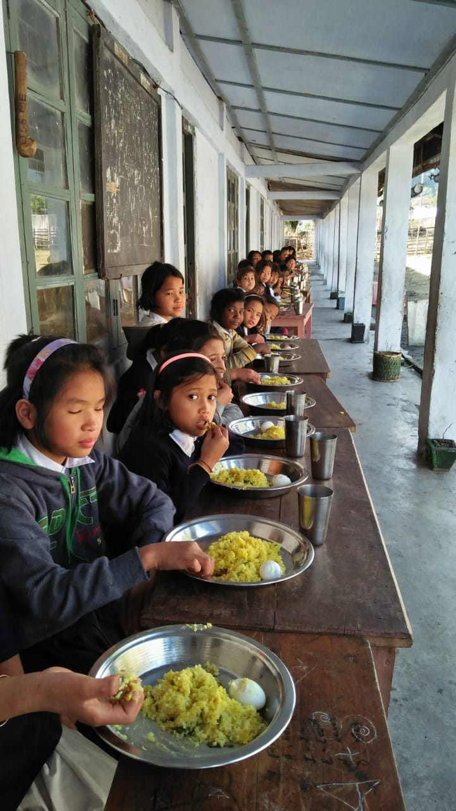
MDM being served…
GUPS, Khupa (Anjaw District)
GUPS, Pangkeng (Siang District)

Slide 10
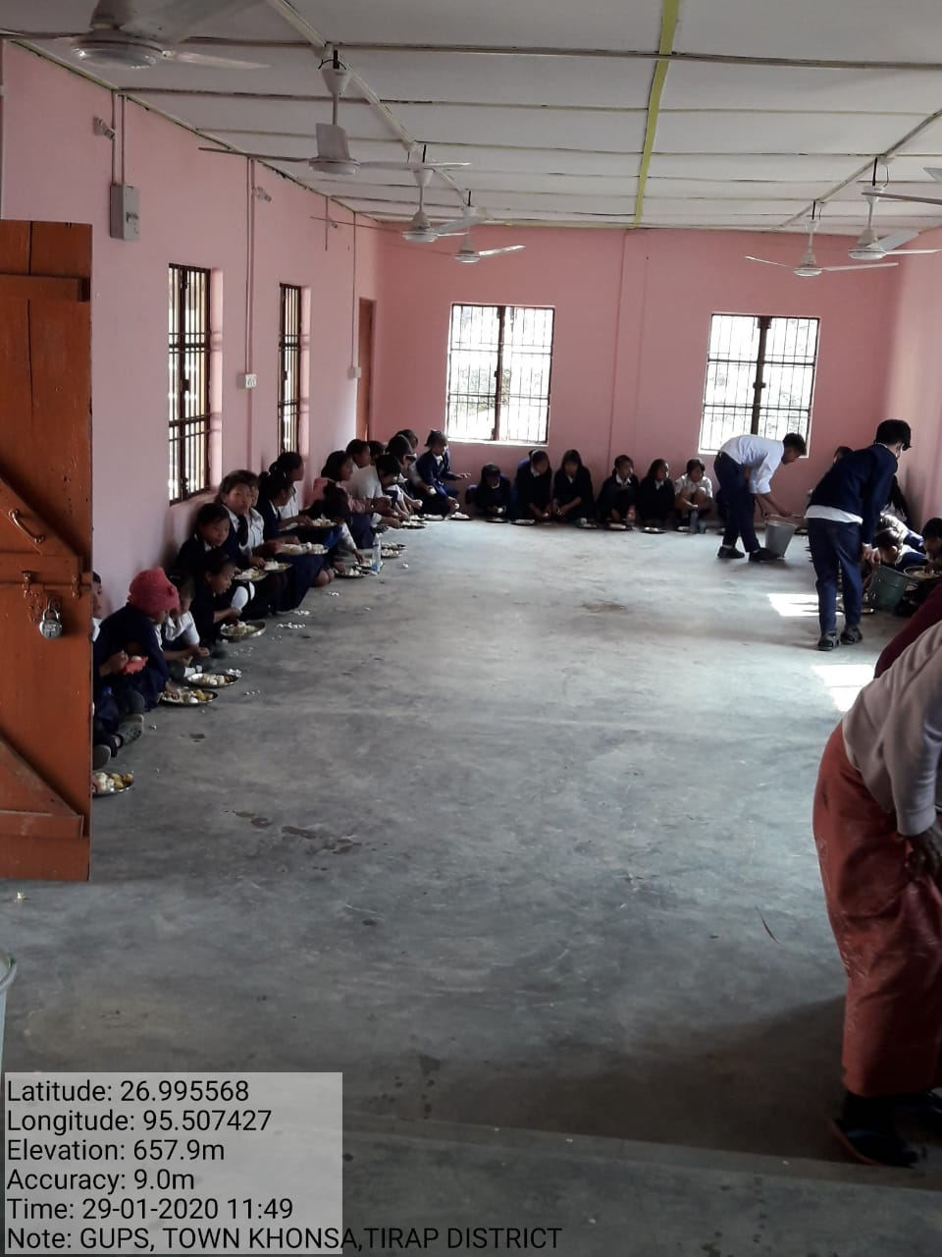
MDM being served…
GUPS, Khonsa (Tirap District)

Slide 11
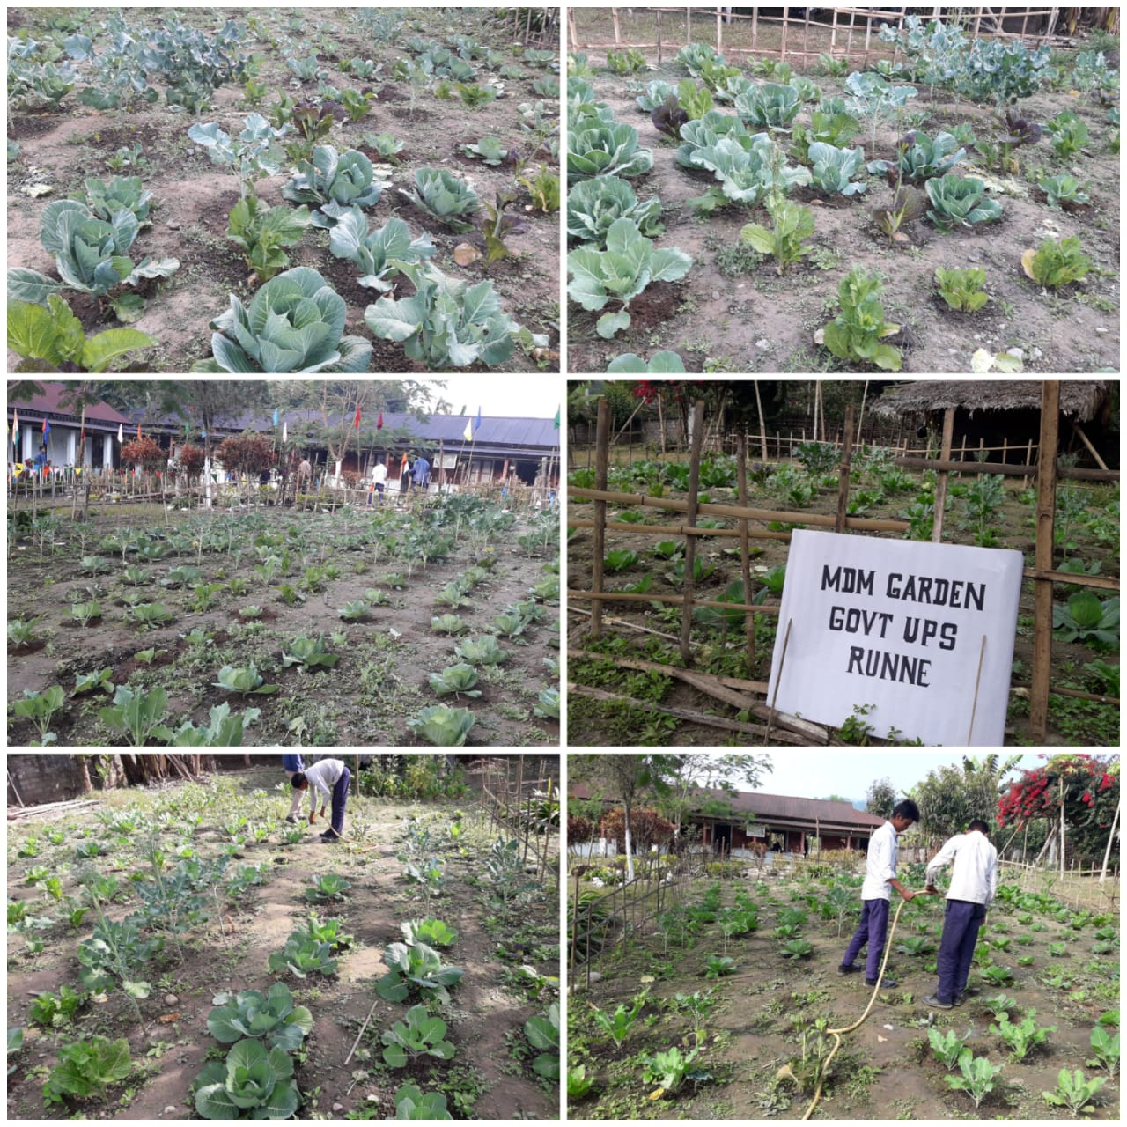
BEST PRACTICES
Nutrition Garden to supplement MDM
Govt. Upper Primary School, Runne (East Siang District)

Slide 12
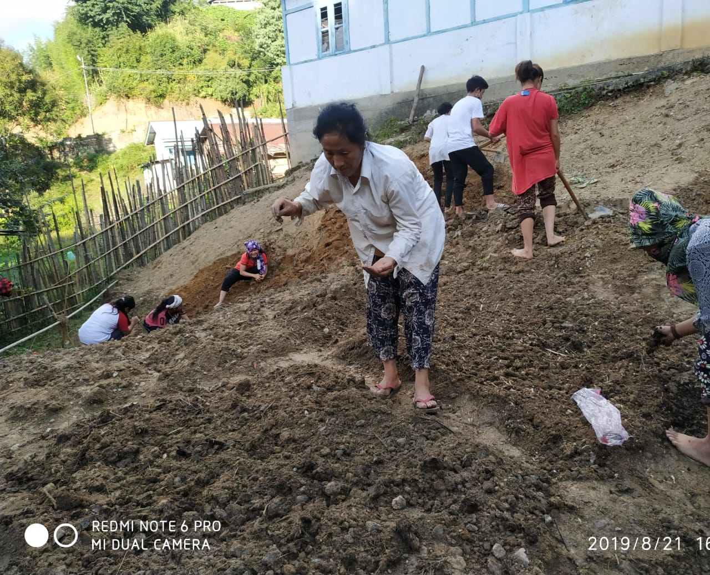
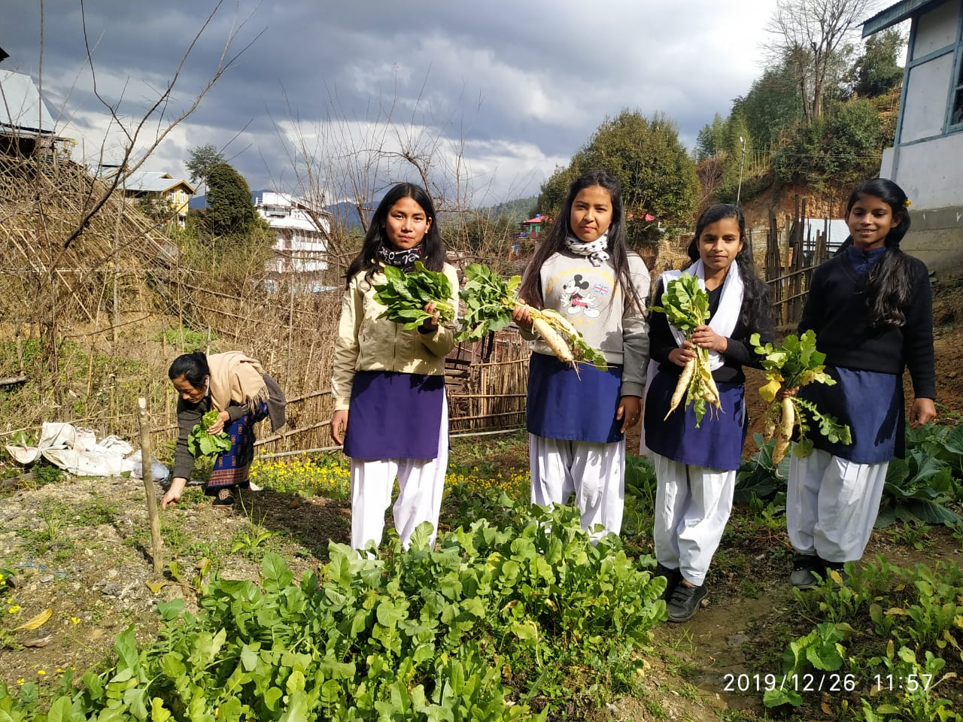
BEST PRACTICES….
Nutrition Garden to supplement MDM
GSS, Hill Top-Ziro (Lower Subansiri District)

Slide 13
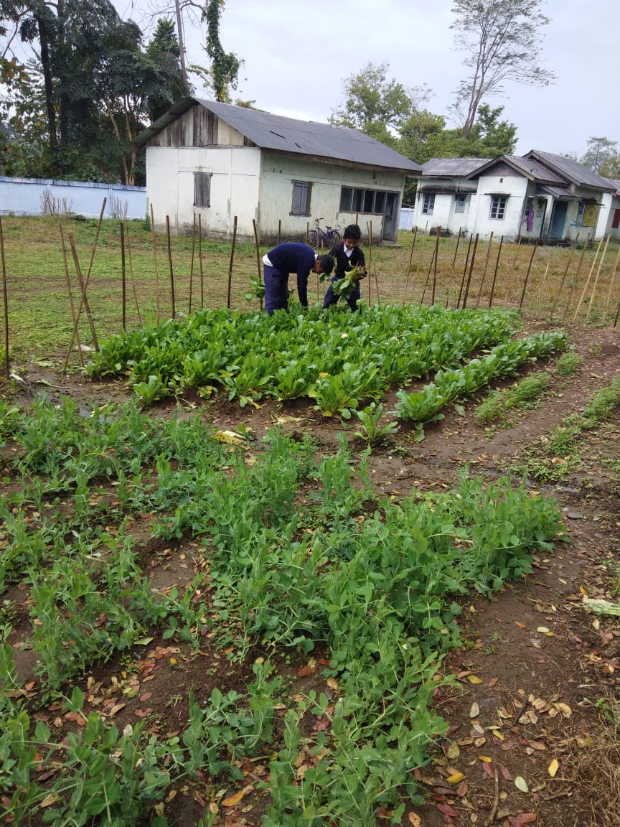
BEST PRACTICES….
Nutrition Garden to supplement MDM
Govt. UPS, Pomliang (Lohit District)

Slide 14
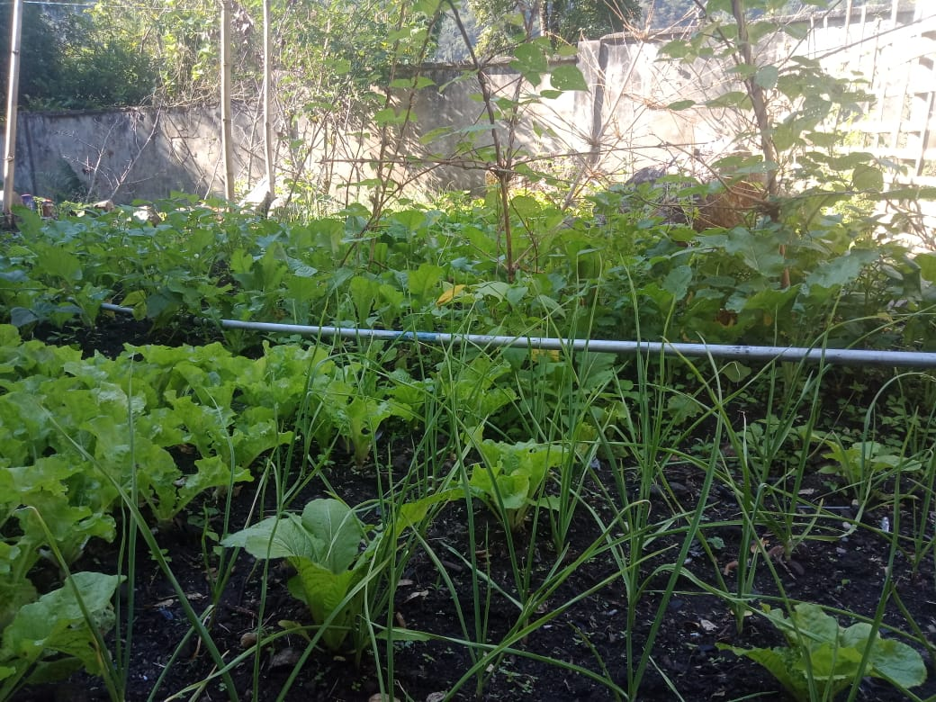
BEST PRACTICES….
Nutrition Garden to supplement MDM
Govt. UPS, Tafraliang (Anjaw District)

Slide 15
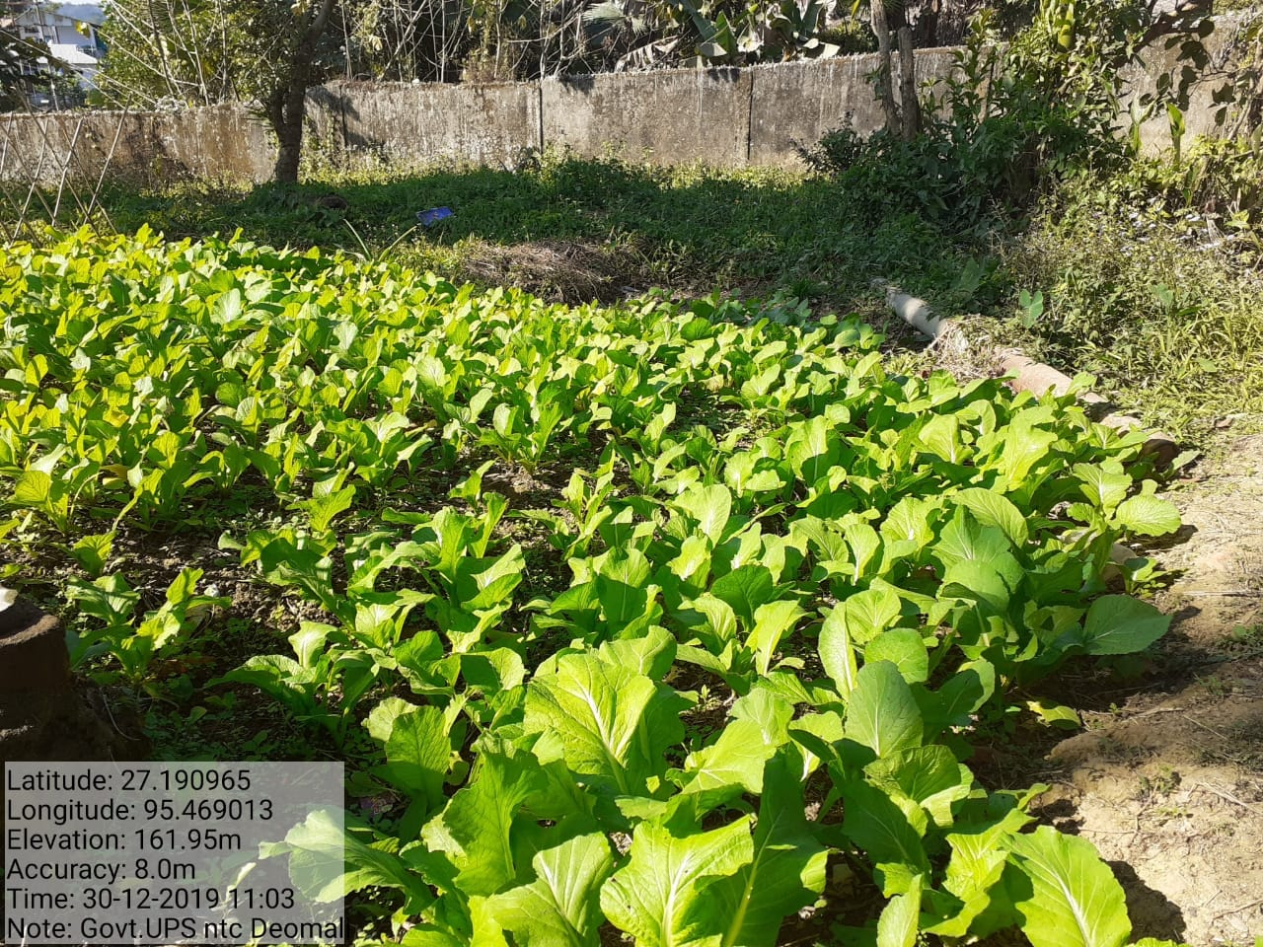
BEST PRACTICES….
Nutrition Garden to supplement MDM
Govt. UPS, Deomali (Tirap District)

Slide 16
OTHER ISSUES….
1. Central Assistance for repairing of Kitchen-cum-Store
All the kitchen-cum-store of MDM scheme in the State were built at a cost of Rs.60,000/- per kitchen-cum-store during 2006-07 & 2007-08. Most of the kitchen-cum-stores are in dilapidated condition. Proposal for repairing of 2934 kitchen-cum-Store @Rs.10000/- per kitchen-cum-store was approved in PAB 2019-20 amounting to Rs.293.40 lakh (Central share being Rs.264.06 lakh and State share being Rs.29.34 lakh). Instead of fund for repairing of kitchen-cum-Store, GoI may consider providing fund for construction of new kitchen-cum-store.

Slide 17
OTHER ISSUES….
2. Testing of food samples by accredited laboratories
Due to absence of reputed /accredited laboratory in the State of Arunachal Pradesh, testing of food samples served under Mid Day Meal scheme has not been conducted. Testing of food samples served under Mid Day Meal scheme will become more necessary with setting up of Centralized Kitchens in districts. Till setting up of accredited food testing laboratory in the State, it will not be viable to send the food samples to other State for testing.

Slide 18
OTHER ISSUES….
3. Automated Monitoring System (AMS) through SMS
Like other States, Arunachal Pradesh also registered for Automated Monitoring System of MDM scheme by onboarding with Himachal Pradesh AMS system. Daily reporting from schools through SMS is very poor at maximum 12%. Reasons for poor reporting are precarious mobile network connectivity at block level & frequent change of mobile numbers of teacher in charge of MDM.

Slide 19
OTHER ISSUES….
4. Cook-cum-Helper
Honorarium paid to Cook-cum-Helper is very meagre. Frequent change in cook-cum-helper due to meagre honorarium amount is a critical problem being faced in every schools. Enhancement of honorarium to cook-cum-helper may be considered by GoI.

Slide 20
Thank You

