Slide 1
Mid-Day Meal Scheme
Chandigarh Administration
PAB Meeting 16.06.2020

Slide 2
Schools Covered Under MDMS
No. of schools Enrolment 2019-20
Primary U. Primary
Govt. : 113 49702 40385
Govt. Aided : 06 1787 1461
Madarasa : 03 294 133
Total : 51783 41979
Grand Total : 93762

Slide 3
Weekly MDM Menu/Cooking Cost
 | Prantha Based From AIHM-42 | Veg. Pulao Based From CITCO-17 | Veg. Pulao Based From CIHM-42
Monday | Prantha + Rongi | Veg. Pulao + Aaloo Matar | Veg. Pulao +Samber
Tuesday | Prantha+ Karhi Pakora | Veg. Pulao + White Channa | Veg. Pulao + Karhi Pakora
Wednesday | Prantha+Dal Chana+ Veg. | Veg. Pulao + Dal Rajmah | Veg. Pulao + White Channa
Thursday | Prantha + Rajmah | Veg. Pulao + Karhi Pakora | Veg. Pulao + Rajmah
Friday | Prantha+ Karhi Pakora | Veg. Pulao + Mix Dal | Veg. Pulao + Karhi Pakora
Saturday | Prantha + Mah Dal Rajmah | Veg. Pulao + Sambhar | Veg. Pulao + Aalo Mattar Nutri
Per Meal Rate | Rs. 15.02 (Both for Primary & U. Primary) | Rs. 9.34 for Primary Rs. 12.92 for U. Primary | Rs. 9.26 and for Primary Rs. 11.80 for U. Primary

Slide 4
Per Meal Cooking Cost
Fixed by GOI (w.e.f. 01-04-20) | Centre Share (100% as per norms) | Actual Avg. Per Meal Cooking Cost | Additional Support from State Budget (Col 3-2)
1 | 2 | 3 | 4
Rs. 4.97 (Pry.) Rs. 7.45 (U. Pry.) | Rs. 4.97 (Pry.) Rs. 7.45 (U. Pry.) | Rs 9.06* (Pry.) Rs. 11.29* (U. Pry.) | Rs. 4.09 (Pry.) Rs. 3.84 (U. Pry.)
* Includes Cost of Vegetables, Oils and Fats, Salt and Condiments, Fuel and labour & others overhead charges claimed by centralized institute excluding the cost of food-grains.

Slide 5
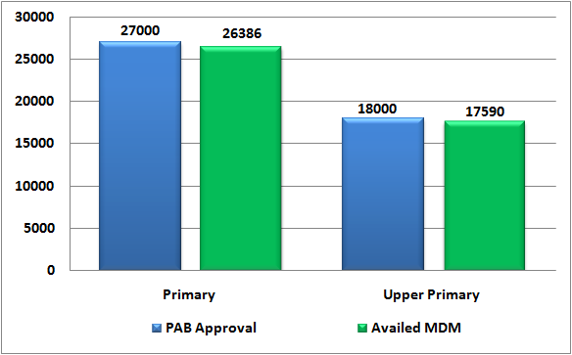
Coverage of Children
During the year 2019-20
Institutions | PAB Approval | Availed MDM upto 31.12.2020 | % Coverage | Proposed 2020-21
Primary | 27000 | 26386 | 98 | 51783
Upper Primary | 18000 | 17590 | 98 | 41979
Total | 45000 | 43976 | 98 | 93762
Note : Proposal 2020-21 calculated as per total enrolment of Class 1st to 8th w.r.t. FSA.

Slide 6
Budget Utilization
During the year 2019-20 upto 3rd Quarter
(In Lakh)
Total Budget Allocation | Centre Share (100% as per Norms) | UT Provision (Addl) | Utilization 2019-20 (Upto 31.12.19) | % Utilization
1489.86 | 739.86 | 750.00 | 1142.63 | 76.69
Break-up of Utilization: Central Share – 533.29 Lakh and UT Budget – 609.24 Lakh

Slide 7
Component wise Budget Utilization
(In Lakh)
Component | Allocation 2019-20 |  |  | Utilization 2019-20 (Upto 3rd Qtr) |  | % Utilization
 | Centre Share | UT Share | UT Provision (Addl) | Centre | UT | Centre | UT Share
Cost of Food-grains | 31.26 | 0 | 0 | 14.95 | 0 | 47.82 | 0
Cooking cost | 599.51 | 0 | 470.06 | 434.68 | 370.30 | 72.51 | 78.78
Honorarium of CCH | 80.60 | 0 | 161.24 | 64.08 | 149.02 | 79.50 | 92.42
Transportation Assistance | 9.04 | 0 | 50.78 | 4.43 | 34.63 | 49.00 | 68.20
Monitoring Management, and Evaluation (MME) | 19.45 | 0 | 67.92 | 15.25 | 55.29 | 78.41 | 81.40
Total | 739.86 | 0 | 750.00 | 533.39 | 609.24 | 72.09 | 81.23

Slide 8
Payment of Bills of Food Grains to FCI
During the year 2019-20 (Figures in Lakh)
Food Grains for Both Primary & U. Primary | Central Assistance Allocated | Central Assistance Released | Bills Raised by FCI | Payment to FCI | Outstanding
Rice & Wheat | 31.26 | 31.26 | 20.48 | 20.48 | Nil

Slide 9
Data Entry Status under MDM-MIS Portal
&
Status of Automated Monitoring System
Annual Data Entry : 100 %
Monthly Data Entry : 100 %
SMS based Automated Monitoring System (AMS) has been implemented successfully in UT Chandigarh through NIC Chandigarh (Adopted the Model of NIC HP)

Slide 10
Coverage under RBSK (School Health Programme) During the year 2019-20
Components | No. of Children Covered
Health Checkup (Recording of Height & Weight etc.) | 123560
Coverage under WIFS (Distribution of IFA & De-worming medicine) | 136337
Spectacles Distributed | Nil*
Number of visits made by RBSK team - 3004
*As reported by Nodal Officer RBSK, Spectacles were not distributed to children with refractive error due to insufficient fund with Health Department.

Slide 11
Proposed Budget 2020-21
(Figures in Lakh)
 | Centre Share (100% as per norms) | UT Provision (Additional) | Total
Recurring Components | 1579.88 | 1106.00 | 2685.88
Non-recurring (Kitchen devices and utensils) | 0.00 | 94.00 | 94.00
Food Security Allowances (Summer Vacation) | 217.04 | 0.00 | 217.04
Total | 1796.92 | 1200.00 | 2996.92

Slide 12
Component wise Proposed Budget 2020-21
(Figures in Lakh)
Recurring Components | Centre Share |  |  | UT Provision
 | Primary | Upper Primary | Total | Primary | Upper Primary | Total
Cost of Food Grain | 32.04 | 38.97 | 71.01 | - | - | -
Cooking Cost | 612.52 | 744.33 | 1356.85 | 245.40 | 153.60 | 399.00*
Transportation Assistance | 9.24 | 11.24 | 20.48 | 36.00 | 24.00 | 60.00
Honorarium to Cook cum Helpers | 54.00 | 36.00 | 90.00 | 124.20 | 82.80 | 207.00
Monitoring Management and Evaluation (MME) | 24.92 | 16.62 | 41.54 | 55.25 | 36.83 | 92.08
Additional Food Item (Milk & Banana) | 0.00 | 0.00 | 0.00 | 208.75 | 139.17 | 347.92
Total | 732.72 | 847.16 | 1579.88 | 669.60 | 436.40 | 1106.00
*Cooking Cost under UT Share (Additional) – Rs.399.00 Lakh, calculated according to 50,000 beneficiaries for 200 working days.

Slide 13
Components wise Proposed MME
Components | Amount in Lakh
Salary of Existing Manpower | 82.63
Transport & Conveyance | 4.32
Office Expenditure | 3.00
Purchase of required Furniture, Computer Hardware and Accessories | 2.00
Testing of cooked Food & Foodgrains samples of MDM | 4.00
Fortification of Foodgrains | 5.00
Expenditure on Automated Monitoring System | 1.00
School Level Expenses | 31.67
Total | 133.62

Slide 14
Best/Innovative Practices
Chandigarh Administration has approved to construct 8 New School Based Cluster Kitchens with approximate financial implication of Rs. 472.00 Lakh from UT Budget.
School Cluster Kitchens have setup their own kitchen gardens for fresh vegetables.
CCTV Cameras are installed in all MDM kitchens.
Honorarium to Cook-cum-helpers is paid Rs. 3300/- per month per CCH whereas norms of GOI is Rs. 1000/- per month per CCH.
Fortified Wheat Flour, Fortified Rice and Double Fortified Salt is used for preparation of MDM.
Compost is prepared from the Kitchen waste.
MDM is cooked by the professionals of Hotel Management Cooking Institutes.
Additional fund support by the Chandigarh Administration of Rs. 750.00 Lakh during the year 2019-20.

Slide 15
Cooking Process/Monitoring of MDM
Cooking process at Centralized Cooking Institutes starts very early in the morning.
The preparation of MDM in the centralized cooking institutes is supervised by the retired personnel engaged as Inspectors/Supervisors.
The supervisory staff monitors the procedure with reference to quality, hygiene and other factors on daily basis.
The supervisory staff take delivery of cooked food from the cooking institutes and safely transport the meal upto the school, handover the hot cooked food to the MDM Teacher Incharge of each school.
Heads of Schools also monitor MDM on Daily Basis.
Monitoring of MDM is also carried out by PCS/HCS Officers and Senior Officers of Education Department.

Slide 16
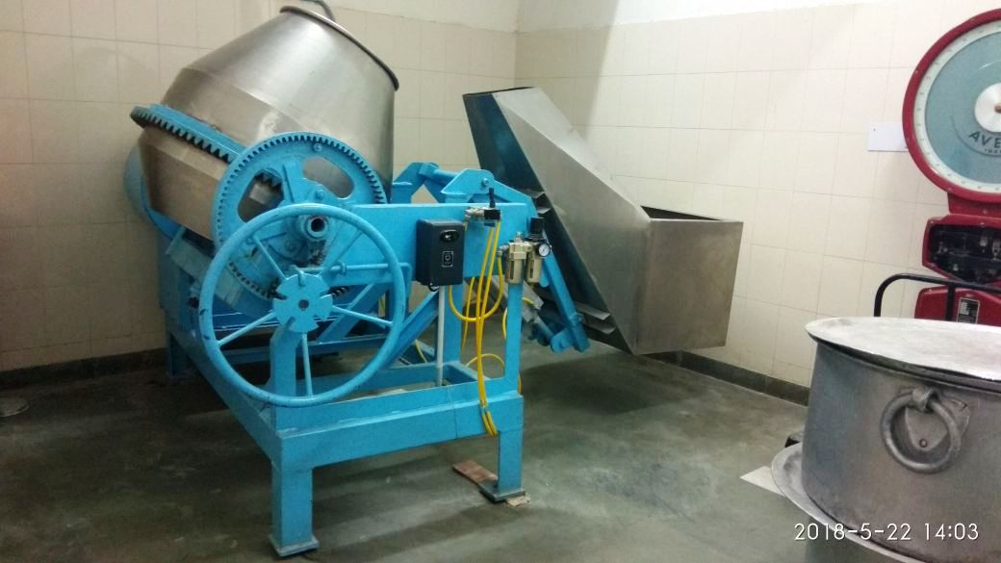
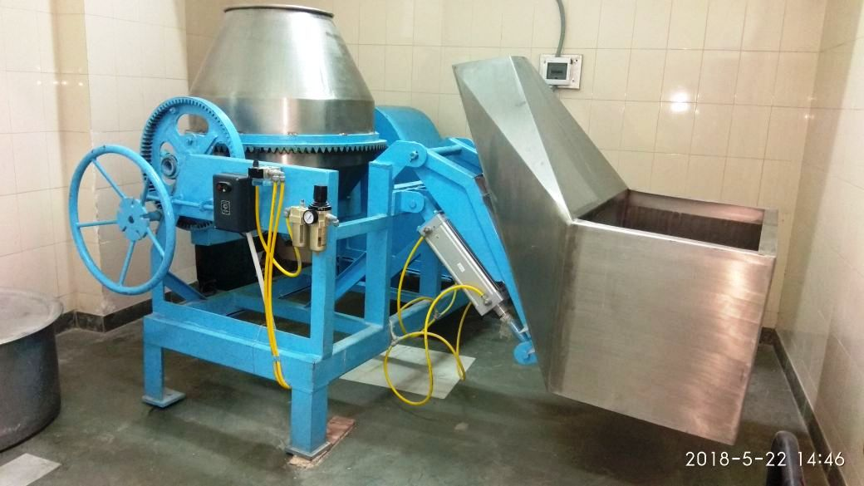
Mixture/Blender for Fortification of Rice
(Iron, Folic Acid & Vitamin B12)
Rice to be used for School Based Cluster Kitchens is fortified in the MDM store at GMHS-22 with the help of Blender provided by the NGO-PATH.
Centralized Cooking Institutes CIHM and CITCO are fortifying rice at their own level with the help of Blenders.

Slide 17
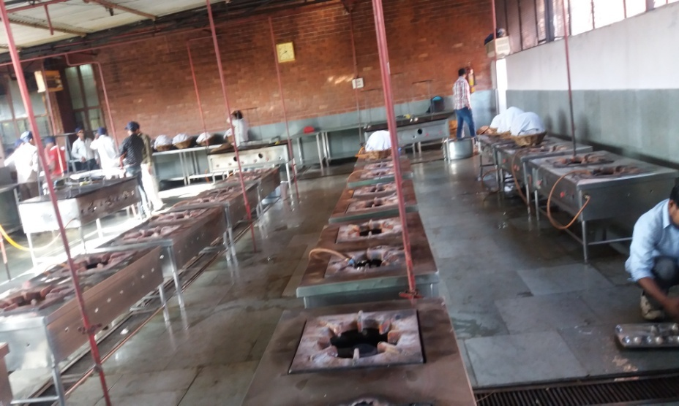
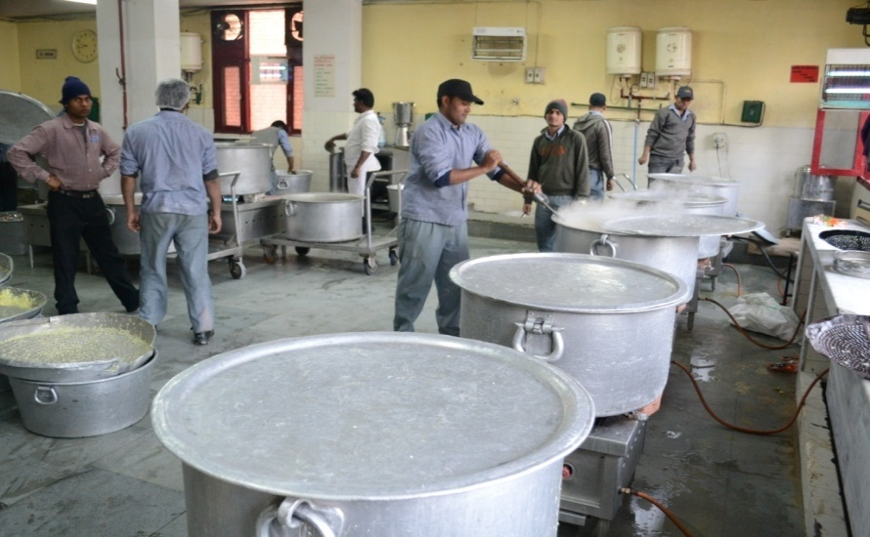
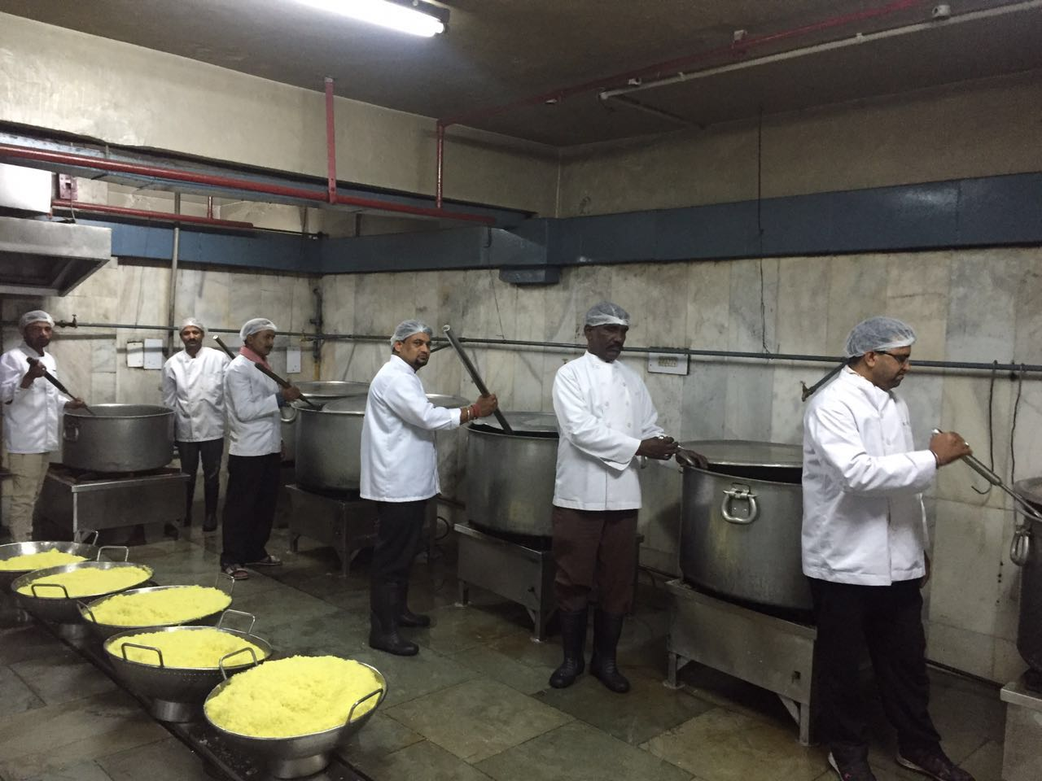
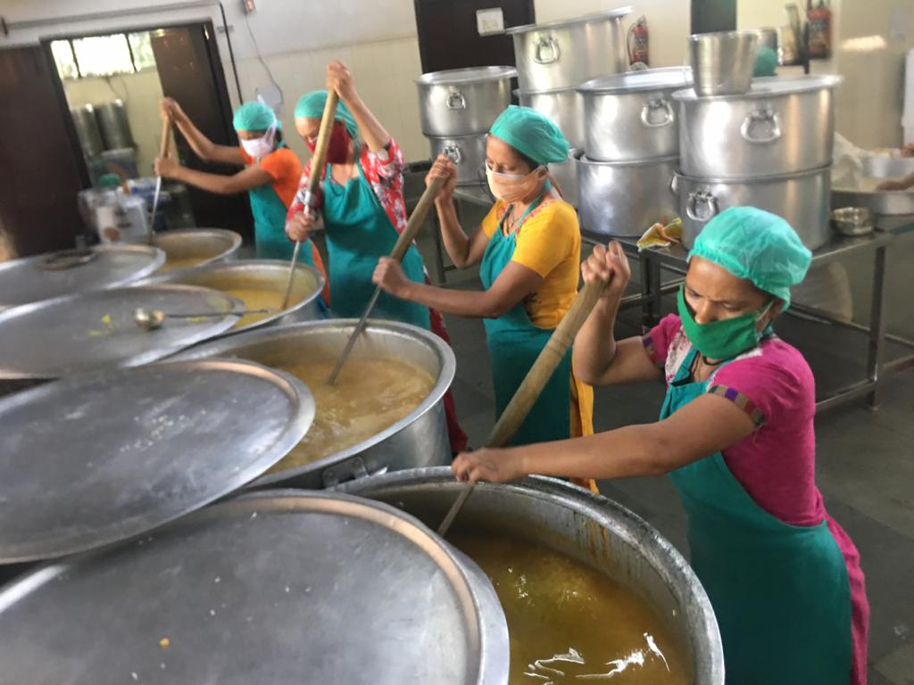
Centralized Kitchens at a Glance
AIHM-42 CIHM-42
CITCO-17 School Based Kitchen –GMSSS-10

Slide 18
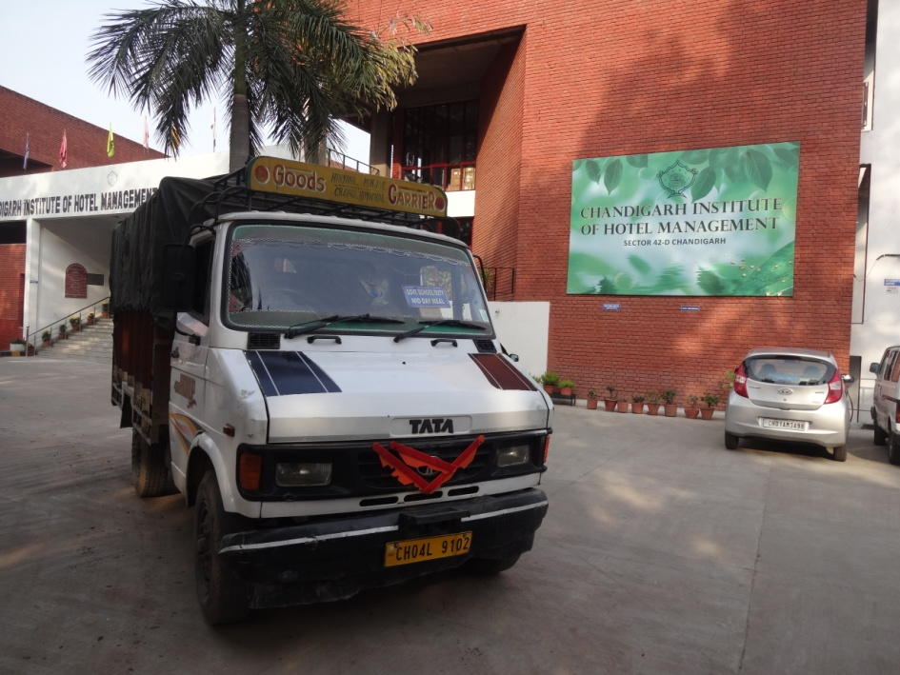
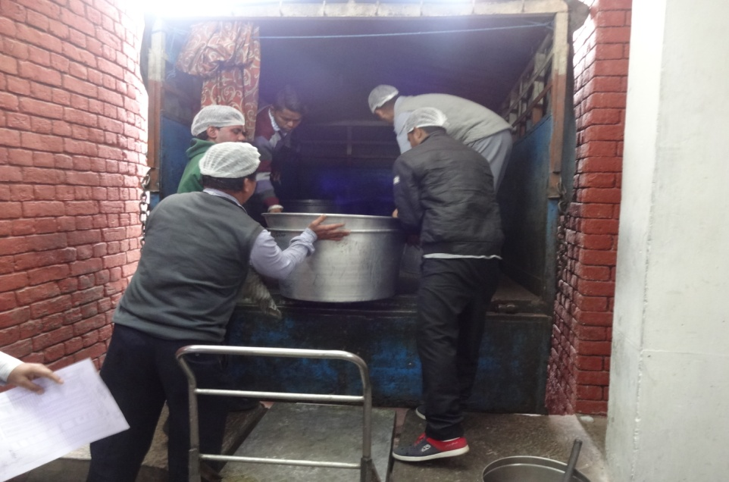
Transportation Arrangements
Food grains are transported by Big Trucks from FCI Godown to MDM stores and from stores to cooking sites by Mini trucks.
Cooked meals are transported to schools by mini trucks.

Slide 19
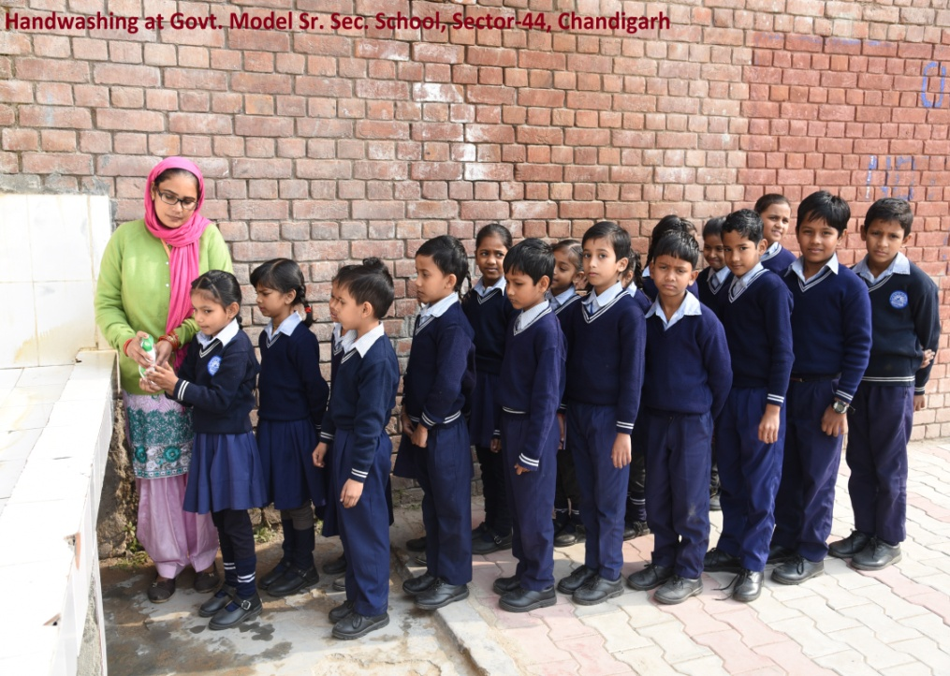
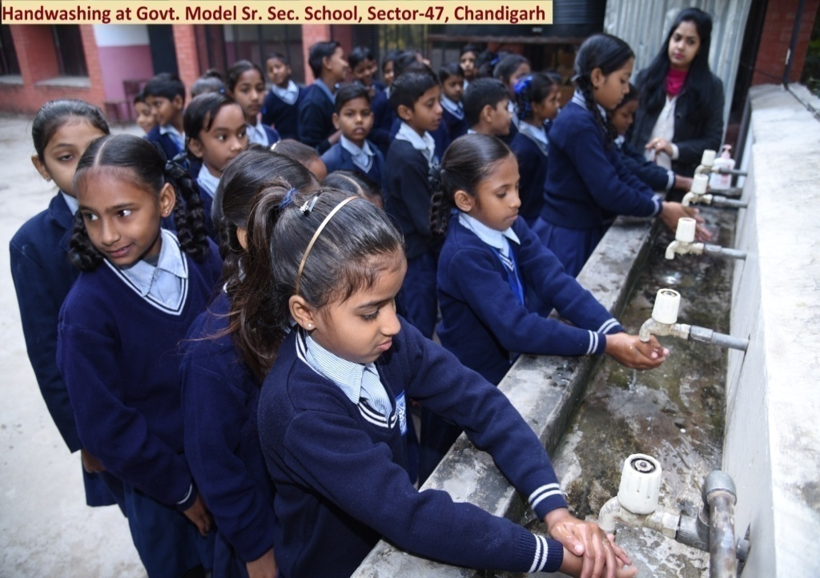
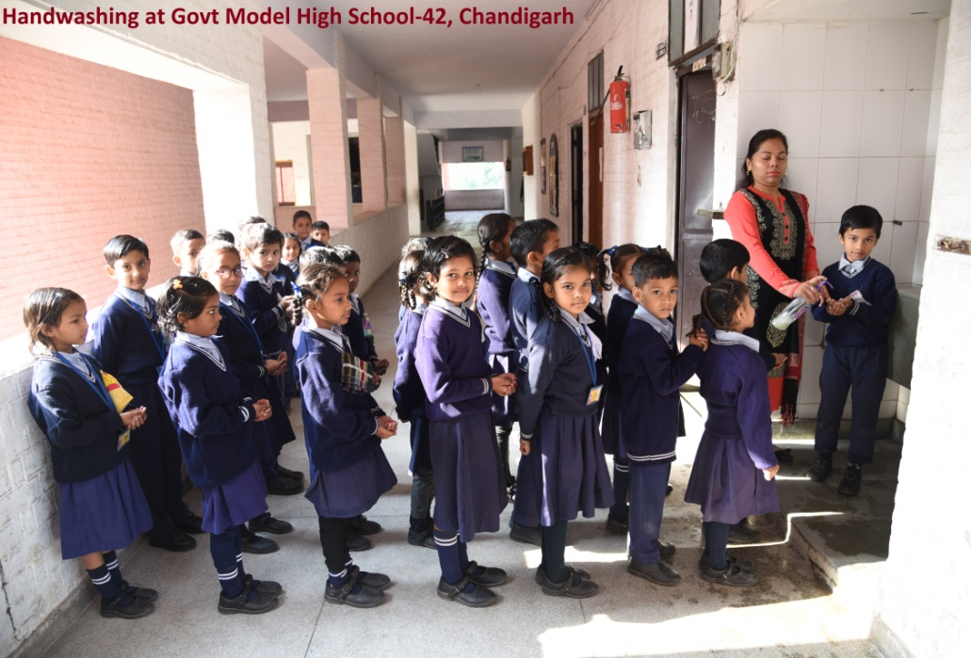
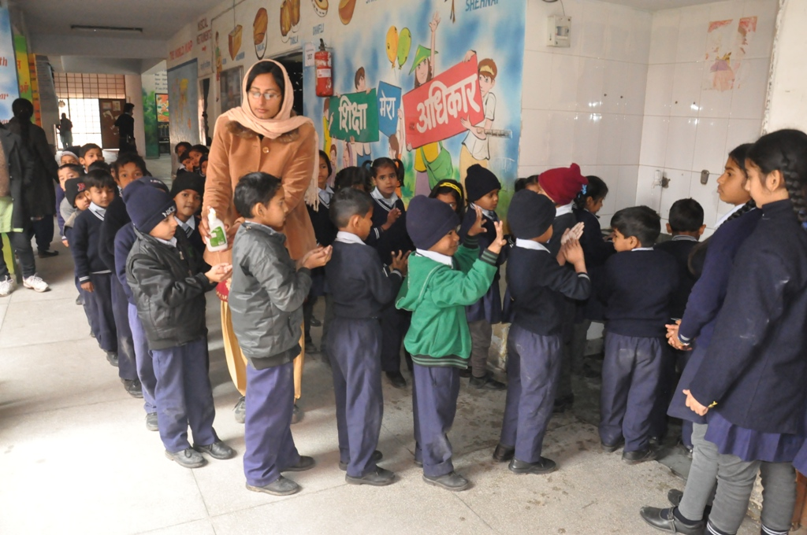
Hand Washing

Slide 20
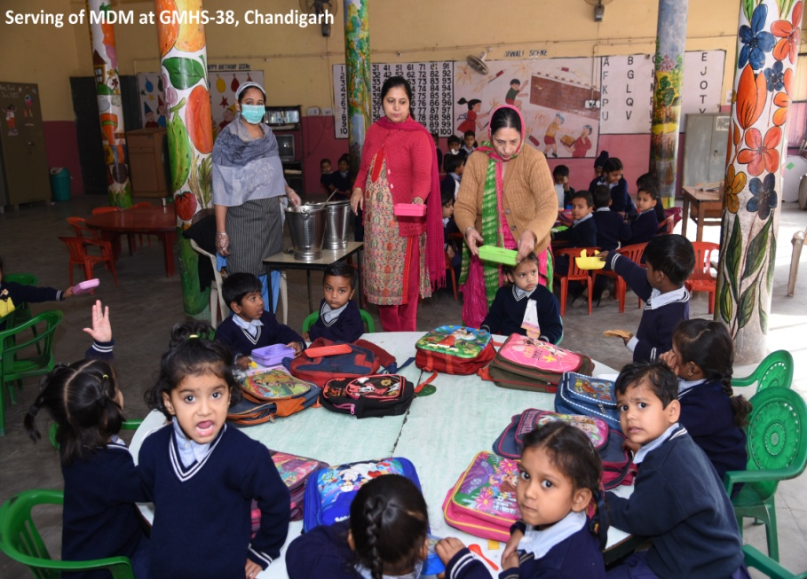
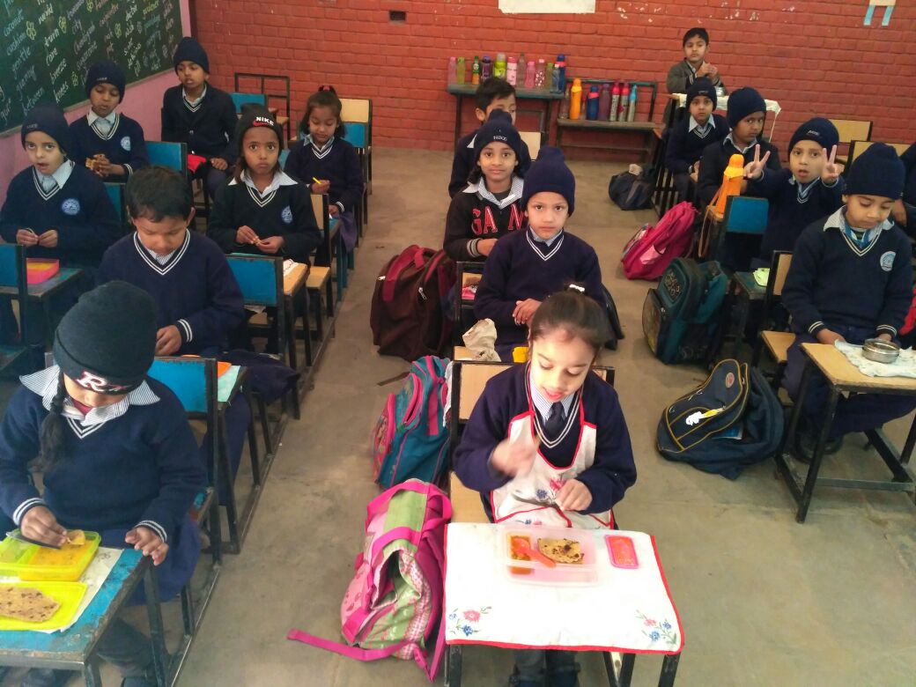
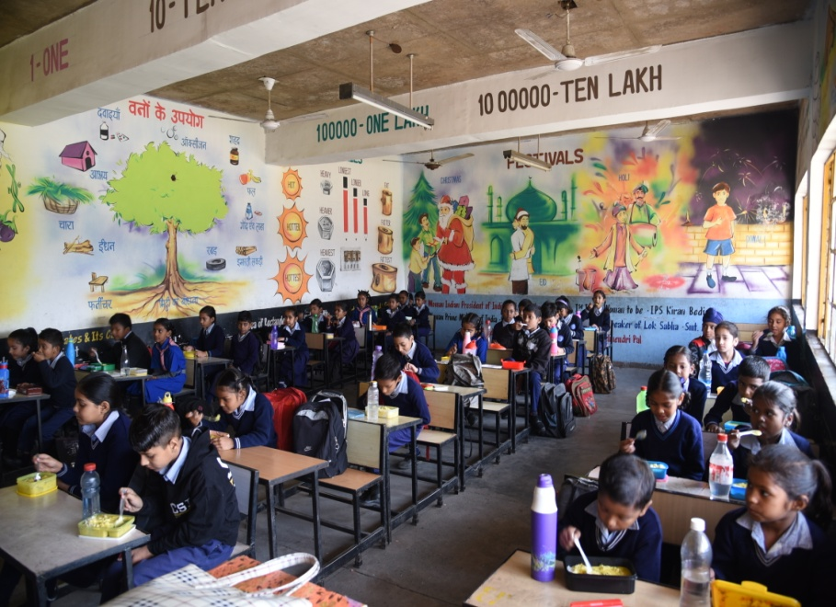
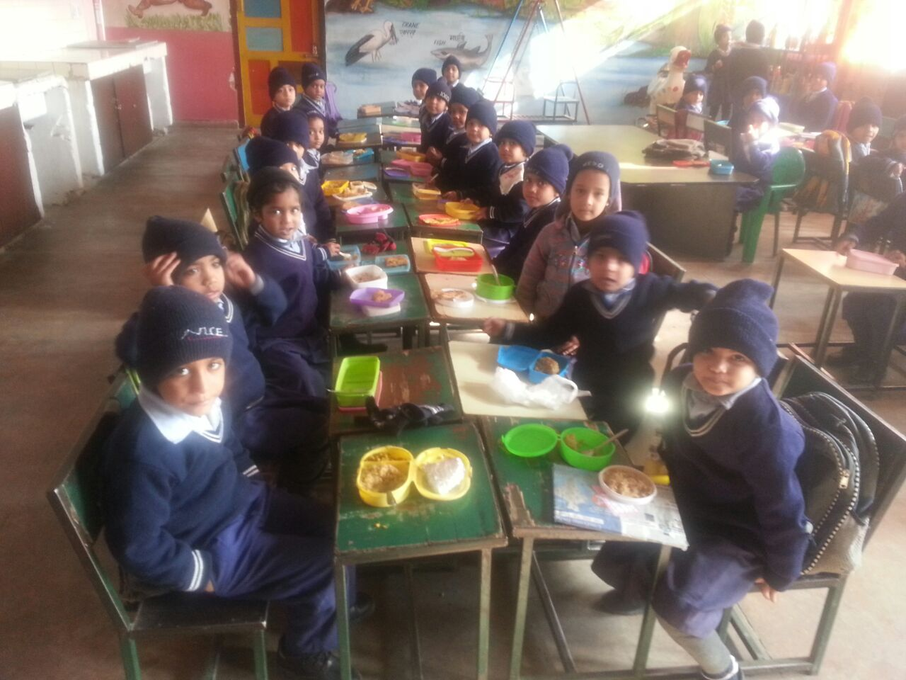
Distribution of meal in Schools

Slide 21
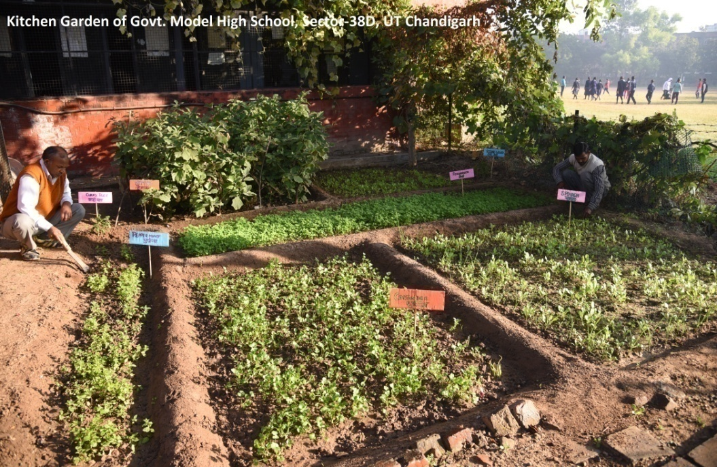
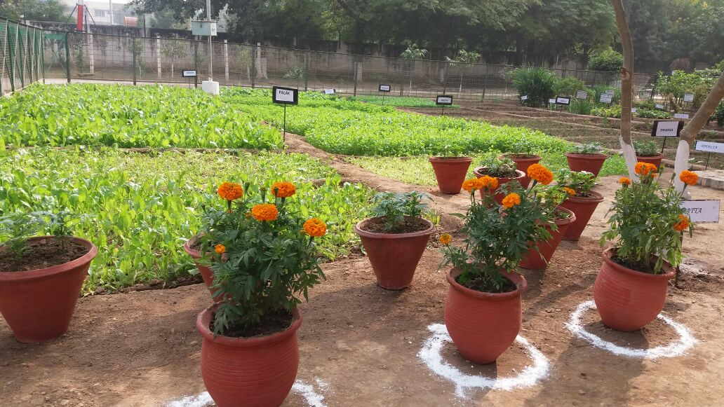
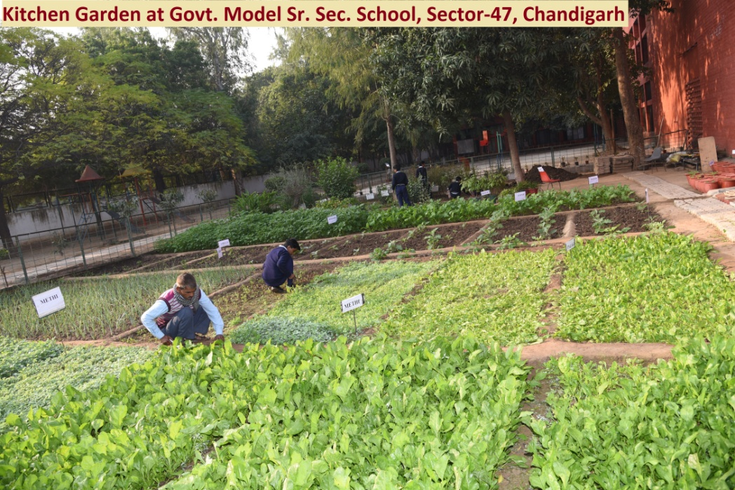
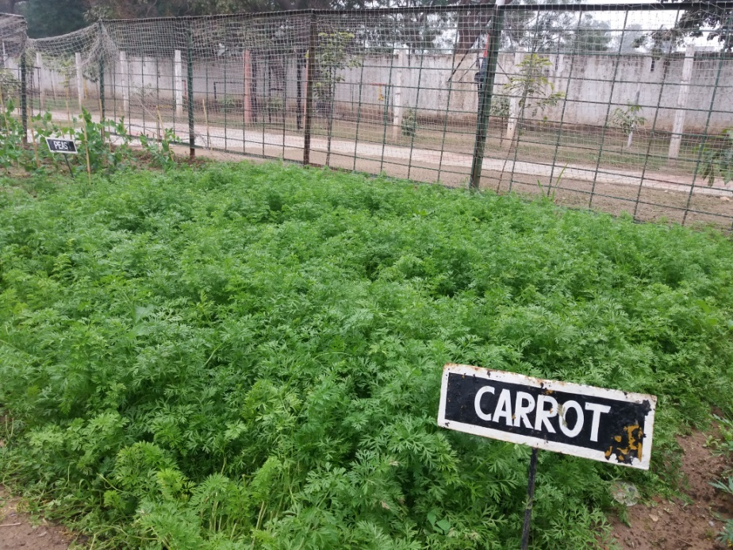
School Based Kitchen Gardening

Slide 22
Thanks

