Slide 1
PAB - MDM Meeting for Review of Implementation of MDMS in UT Administration of Dadra & Nagar Haveli and Daman & Diu on 12-05-2020
Mid Day Meal Scheme

Slide 2
Best Practices
Additional contribution of Rs. 2917/- per month in the honorarium of cook-cum-helpers from their own resources.
Additional contribution of Rs.2.87 per day by UT Administration (Primary and Upper Primary) in cooking cost from their own resources.
Developed Kitchen Gardens in all the schools in collaboration with Forest Department.
Provided additional food items such as Sukhadi and Lapsi under Tithi Bhojan to all schools.
94% children covered under Rashtriya Bal Swasthya Karykram (School Health Programme.
Ministry of HRD, Govt. of India

Slide 3
Issues
Less coverage of children against the enrolment both in Primary (76%) and in Upper Primary (75%).
In Dadra & Nagar Haveli district yet to cover 280 schools under Social Audit.
Ministry of HRD, Govt. of India

Slide 4
Coverage of Children (Primary & U. Primary)
Children (Primary) |  |  |  | Children (Upper Primary)
UT | PAB Approval | Coverage | %age | PAB Approval | Coverage | %age
DNH & DD | 32450 | 32139 | 99 | 17550 | 15903 | 91
Ministry of HRD, Govt. of India

Slide 5
Working Days (Primary & U. Primary)
UT | Working Days (Pry) |  |  | Working Days (U.Pry)
 | PAB Approval | Coverage | % | PAB Approval | Coverage | %
DNH & DD | 236 | 235 | 99.58 | 236 | 235 | 99.58
Ministry of HRD, Govt. of India

Slide 6
Engagement of Cook-cum-Helpers (Primary & U. Primary)
UT | PAB Approval | Coverage | %age
DNH & DD | 1246 | 1112 | 89
Ministry of HRD, Govt. of India

Slide 7
Procurement of Kitchen Devices (Primary & U. Primary)
Kitchen Devices | Sanctioned | Procured | %age
New Kitchen Devices | 377 | 377 | 100
Replacement of Kitchen devices | 347 | 347 | 100
Ministry of HRD, Govt. of India

Slide 8
Construction of Kitchen-cum-Stores (Primary & U. Primary)
UT | Sanctioned | Constructed | %age
DNH & DD | 82 | 82 | 100
Ministry of HRD, Govt. of India

Slide 9
Setting up of School Nutrition Gardens (SNG)
No. of Schools | No. of schools having SNG | %
368 | 336 | 91%
Ministry of HRD, Govt. of India

Slide 10
Health Component - Performance
Details | Institutions | Children
Total in State | 368 | 63274
Health check up | 361 | 59762
IFA Distribution | 361 | 75528
Deworming Tablets | 361 | 70687
Ministry of HRD, Govt. of India

Slide 11
Testing of food samples
MHRD issued guidelines to ensure quality, safety and hygiene under MDMS in 2015
Testing of meals by NABL accredited laboratories.
Mandatory tasting of the meal by 2-3 adults including at least one teacher.
MDM Rules 2015 mandates collection of samples once a month from randomly selected schools or centralized kitchens for testing.
Testing may also be done through FSSAI accredited laboratories.
No. of samples |  | Result (No. of samples)
Collected | Tested | Meeting norms | Below norms
71 | 71 | 71 | 0

Slide 12
Status of implementation of MIS & AMS

Slide 13
Performance Grading Index (PGI)
Performance Grading Index (PGI):
Score against the weightage of 10 for indicator No. 1.3.7 i.e. “% of elementary school’s children taking MDM against target approved in PAB – in Govt. and aided schools”.
Score against the weightage of 10 for indicator No 1.3.8 i.e. “% of days Mid Day Meal served against total working days – Govt. and aided elementary schools.”
Score (children taking MDM) | Score (MDM served days)
10 | 10
Ministry of HRD, Govt. of India

Slide 14
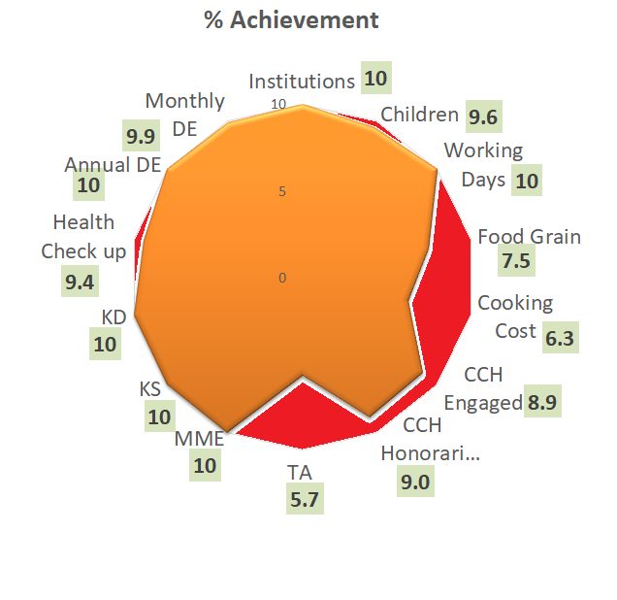
Performance Score Card
Component | PAB-Approval | Achievement | % Achievement
Institutions | 368 | 368 | 100
Children | 50000 | 48041 | 96
Working Days | 236 | 235 | 100
Food Grain Utilizations (in MTs) | 1399.04 | 1049.61 | 75
Cooking Cost (Rs. in Lacs) | 1526.05 | 958.11 | 63
CCH Engaged | 1246 | 1112 | 89
CCH Honorarium (Rs. in Lacs) | 458.62 | 413.68 | 90
TA (Rs. in Lacs) | 19.14 | 10.87 | 57
MME (Rs. in Lacs) | 21.85 | 21.85 | 100
Kitchen cum Stores | 82 | 82 | 100
Kitchen Devices | 724 | 724 | 100
Health Check up of children | 63274 | 59762 | 94
Annual Data Entry | 368 | 368 | 100
Monthly Data Entry | 368 | 363 | 99
Ministry of HRD, Govt. of India

Slide 15
Social Audit
Social Audit is collective monitoring of a scheme by people’s active involvement.
It covers the issues of equity and equality along with expenditure in programme implementation.
The Social Audit Units (SAU) under MNREGS, may be actively involved in conducting Social Audit of MDM in all districts.
Key Features and Benefits:
It informs and educates people about their rights and entitlements.
It provides a collective platform for people to ask queries, express their needs and grievances.
It promotes people's participation in all stages of implementation of programme.
It brings about transparency and accountability in Govt. schemes.
It strengthens decentralised governance.
UT has conducted Social Audit in 2 districts ( 62 schools in Daman & 10 schools in Diu).

Slide 16
Proposals and Recommendations
S. N | Component | PAB Approval 2019-20 | State’s Proposal for 2020-21 | Recommendations 2020-21
1 | Children (Pry) | 32450 | 34887 | 34724
2 | Children (U Pry) | 17550 | 16443 | 16443
3 | Children (NCLP) | Nil | Nil | Nil
4 | Working Days – Pry & Upy | 236 | 241 | 241
5 | Working Days - NCLP | Nil | Nil | Nil
6 | Cook-cum-Helpers (Pry +U.Pry) | 1246 | 1220 | 1220
7 | Drought
7.1 | Children (Pry) | Nil | Nil | Nil
7.2 | Children (U Pry) | Nil | Nil | Nil
7.3 | Working Days | Nil | Nil | Nil
7.4 | Cook-cum-Helpers | Nil | Nil | Nil
8 | Kitchen cum Store | Nil | Nil | Nil
9 | Kitchen cum Stores (Repair) | Nil | Nil | Nil
10 | Kitchen Devices (New) | Nil | Nil | Nil
11 | Kitchen Devices (Rep.) | Nil | Nil | Nil
Central Assistance (Rs in Lakh) |  | 894.38 | 958.68 | 920.76

Slide 17
Proposals for Summer Vacation
Provision of MDM during summer vacation in 2020-21.
Stage | Number of Children | No. of working days | Food grains (in MTs | Cost of Food Grains (Rs. In Lakh) | Cooking Cost (Rs. In Lakh) | Transportation Assistance (Rs. In Lakh) | Total Central Assistance in (Rs. In Lakh)
Primary | 41913 | 42 | 176.03 | 5.33 | 87.49 | 2.46 | 95.28
Upper Primary | 20867 | 42 | 131.46 | 3.98 | 65.29 | 1.84 | 71.11
Total | 62780 | 42 | 307.49 | 9.31 | 152.78 | 4.30 | 166.39

Slide 18
Recommendations of Central Assistance
(Rs. in Lakhs)
PAB Approval for FY 2019-20 | State’s Proposal for FY 2020-21 | Recommendations for FY - 2020-21
894.38 | 958.68 | 920.76
Ministry of HRD, Govt. of India

Slide 19
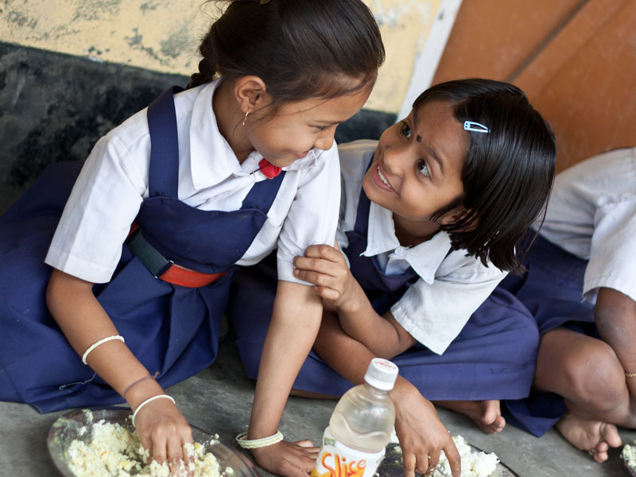
Every Meal to a Child is an offering to the Divinity.
Thank You

