Slide 1
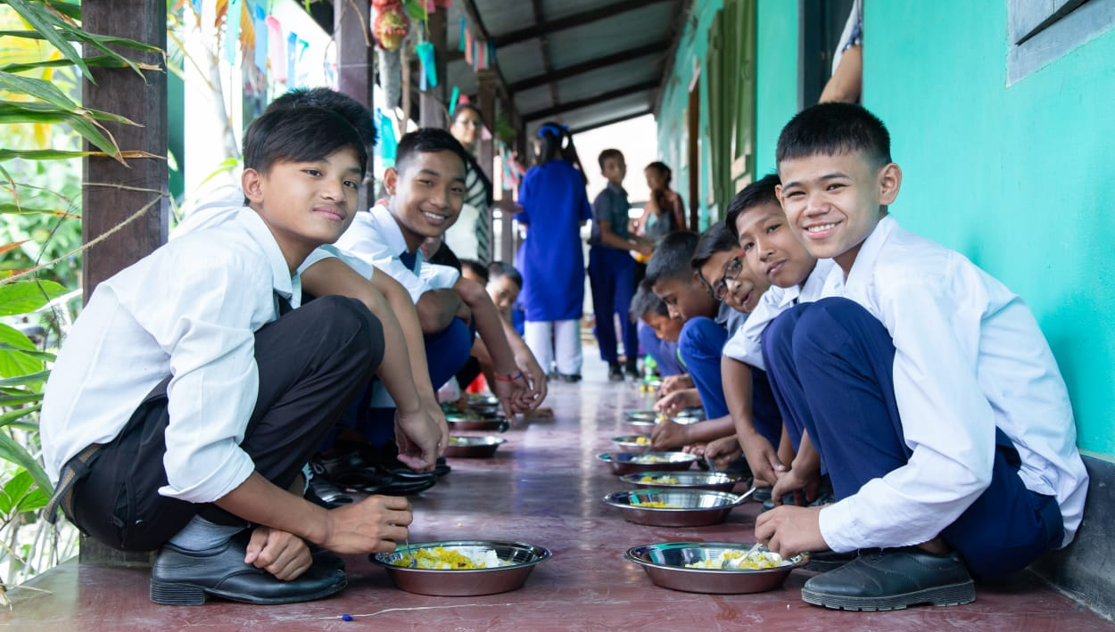
Mid Day Meal Scheme
PAB - MDM Meeting for
Review of Implementation of MDMS in Manipur on 12.06.2020

Slide 2
Best Practices
State has conducted cooking competitions in all the districts.
State has prepared videos on handwashing, cooking competitions & distribution of ration during lockdown, for awareness generation among beneficiaries and functionaries.
Parents of school children and other community members oversee the preparation and serving of meals at school level.
Ministry of HRD, Govt. of India

Slide 3
Issues
Less coverage of working days i.e. 213 against 227.
Delay in release of funds from State to school level (7 to 10 months).
Slow progress in construction of kitchen cum stores (only 37% constructed).
State has not yet surrendered the funds pertaining to 513 units of kitchen-cum-stores sanctioned @Rs. 60,000/- per unit and also not submitted the revised proposal.
Only 46% children screened under Rashtriya Bal Swasthya Karyakram.
Only 10%(avg.) schools reporting data under Automated Monitoring System.
No meeting of District level Committee held in 9 out of 16 districts.
State has not conducted testing of food samples.
Social Audit not conducted in any of the district.
Ministry of HRD, Govt. of India

Slide 4
Coverage of Children (Primary & U. Primary)
Children (Primary) |  |  |  | Children (Upper Primary)
State | PAB Approval | Coverage | % | PAB Approval | Coverage | %
Manipur | 117327 | 114410 | 98% | 33506 | 32662 | 97%
Ministry of HRD, Govt. of India

Slide 5
Working Days (Primary & U. Primary)
State | Working Days (Pry) |  |  | Working Days (U. Pry)
 | PAB Approval | Coverage | % | PAB Approval | Coverage | %
Manipur | 227 | 213 | 94% | 227 | 213 | 94%
Ministry of HRD, Govt. of India

Slide 6
Engagement of Cook-cum-Helpers (Primary & U. Primary)
State | PAB Approval | Engaged | %
Manipur | 7487 | 6277 | 84%
Ministry of HRD, Govt. of India

Slide 7
Procurement of Kitchen devices
(Primary & U. Primary)
State | Sanctioned | Procured | %
Manipur | 6929* | 5096 | 74%
*PAB-MDM approved 183 (new) and 1650 (replacement) in 2016-17 and 2017-18 kitchen devices respectively, however funds were not released due to non-submission of physical and financial progress of earlier sanctioned KD by State Govt.
Ministry of HRD, Govt. of India

Slide 8
Construction of Kitchen-cum-stores
(Primary & U. Primary)
State | Sanctioned | Constructed | %
Manipur | 2966 | 1083 | 37%
Ministry of HRD, Govt. of India

Slide 9
Setting up of School Nutrition Gardens (SNG)
No. of Schools | No. of schools having SNG | %
3476 | 264 | 8%
SNGs in 783 schools are in progress and 2429 proposed to be developed during 2020-21
Ministry of HRD, Govt. of India

Slide 10
Health Component - Performance
Details | Institutions | Children
Total in State | 3476 | 169803
Health Check-up | 1235 | 78106
IFA Distribution | 2058 | 151147
Deworming Tablets | 3476 | 169803
Ministry of HRD, Govt. of India

Slide 11
Testing of food samples
MHRD issued guidelines to ensure quality, safety and hygiene under MDMS in 2015
Testing of meals by NABL accredited laboratories.
Mandatory tasting of the meal by 2-3 adults including at least one teacher.
MDM Rules 2015 mandates collection of samples once a month from randomly selected schools or centralized kitchens for testing.
Testing may also be done through FSSAI accredited laboratories.
No. of samples |  | Result (No. of samples)
Collected | Tested | Meeting norms | Below norms
0 | 0 | NA | NA
No accredited lab available in the State

Slide 12
Status of implementation of MIS & AMS
Ministry of HRD, Govt. of India

Slide 13
Performance Grading Index (PGI)
Performance Grading Index (PGI):
Score against the weightage of 10 for indicator No. 1.3.7 i.e. “% of elementary school’s children taking MDM against target approved in PAB – in Govt. and aided schools”.
Score against the weightage of 10 for indicator No 1.3.8 i.e. “% of days Mid Day Meal served against total working days – Govt. and aided elementary schools.”
State | Score (children taking MDM) (1.3.7) out of 10 | Score (MDM served days (1.3.8) out of 10
Manipur | 10 | 10
Ministry of HRD, Govt. of India

Slide 14
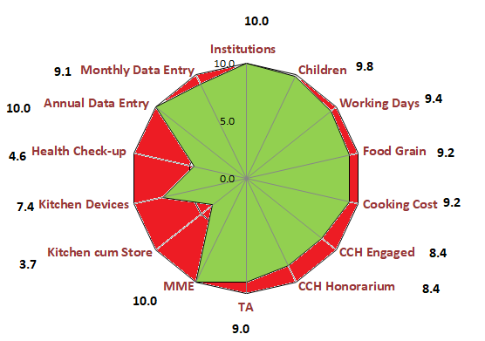
Performance Score Card – Manipur
Component | PAB-Approval (Target) | Achievement | % Achievement
Institutions | 3476 | 3476 | 100%
Children | 150833 | 147072 | 98%
Working Days | 227 | 213 | 94%
Food Grain Utilization (in MTs) | 3804.20 | 3484.18 | 92%
Cooking Cost (Rs. in Lacs) | 1703.56 | 1560.23 | 92%
CCH Engaged | 7487 | 6277 | 84%
CCH Honorarium (Rs. in Lacs) | 748.70 | 625.98 | 84%
TA (Rs. in Lacs) | 90.16 | 80.93 | 90%
MME (Rs. in Lacs) | 64.54 | 64.53 | 100%
Kitchen cum Store | 2966 | 1083 | 37%
Kitchen Devices | 5096 | 5096 | 100%
No. of Children's Health Check-up | 169803 | 78106 | 46%
Annual Data Entry | 3476 | 3459 | 100%
Monthly Data Entry | 3481 | 3185 | 91%
Ministry of HRD, Govt. of India

Slide 15
Social Audit
Social Audit is collective monitoring of a scheme by people’s active involvement.
It covers the issues of equity and equality along with expenditure in programme implementation.
The Social Audit Units (SAU) under MNREGS, may be actively involved in conducting Social Audit of MDM in all districts.
Key Features and Benefits:
It informs and educates people about their rights and entitlements.
It provides a collective platform for people to ask queries, express their needs and grievances.
It promotes people's participation in all stages of implementation of programme.
It brings about transparency and accountability in Govt. schemes.
It strengthens decentralised governance.
State has not conducted Social Audit in any of the 16 districts in 2019-20.

Slide 16
Proposals and Recommendations
S. N | Component | PAB Approval 2019-20 | State’s Proposal for 2020-21 | Recommendations 2020-21
1 | Children (Pry) | 117327 | 116244 | 116244
2 | Children (U Pry) | 33506 | 33305 | 33305
3 | Children (NCLP) | - | - | -
4 | Working Days – Pry & Upy | 227 | 226 | 226
5 | Working Days - NCLP
6 | Cook-cum-Helpers | 7487 | 7487 | 7487
7 | Kitchen cum Store | - | - | -
8 | Kitchen cum Stores (Repair) | - | - | -
9 | Kitchen Devices (New) | - | 183* | 183*
10 | Kitchen Devices (Rep.) | - | 1650** | 1650**
A: Central Assistance (Rs in Lakh) |  | 2429.04 | 2816.04 | 2816.04
11 MDM during Summer vacations
11.1 | Children (Pry) | - | 132461 | 132461
11.2 | Children (U Pry) | - | 37342 | 37342
11.3 | Working Days | - | 20 | 20
B: Summer Vacations: Central Assistance (Rs in Lakh) |  | - | 188.70 | 188.70
(A+B) Total Central Assistance (Rs in Lakh) |  | 2429.04 | 3004.74 | 3004.74
Note: Already approved in 2016-17* and 2017-18** at old rate, recommended as per revised rate

Slide 17
Mid Day Meal during Summer Vacations
MDM during Summer vacations
Component | State’s Proposal for 2020-21 | Recommendations 2020-21
Children (Pry) | 132461 | 132461
Children (Upper Primary) | 37342 | 37342
Working Days | 20 | 20
Central Assistance (Rs in Lakh) | 188.70 | 188.70

Slide 18
Flexible funds for new interventions
Maximum admissible funds for flexible funds: Rs. 144.29 lakhs (Centre + State Share)
Component | Physical | Financial (Rs. In lakh)
 |  | Central Assistance | Min. Mandatory State Share | Total
Development of School Nutrition Gardens (SNG) @5000 | SNG to be developed in 2429 schools | 109.31 | 12.15 | 121.45
This expenditure will be met from the funds available with the State (Recurring Central Assistance + State Share)
Ministry of HRD, Govt. of India

Slide 19
Recommendations of Central Assistance
(Rs. in Lakhs)
 | PAB Approval for FY 2019-20 | State’s Proposal for FY 2020-21 | Recommendations for FY 2020-21
Central Assistance (Recurring & Non Recurring) | 2429.04 | 2816.04 | 2816.04
Central Assistance (Summer Vacations) | - | 188.70 | 188.70
Central Assistance (Total) | 2429.04 | 3004.74 | 3004.74
Ministry of HRD, Govt. of India

Slide 20
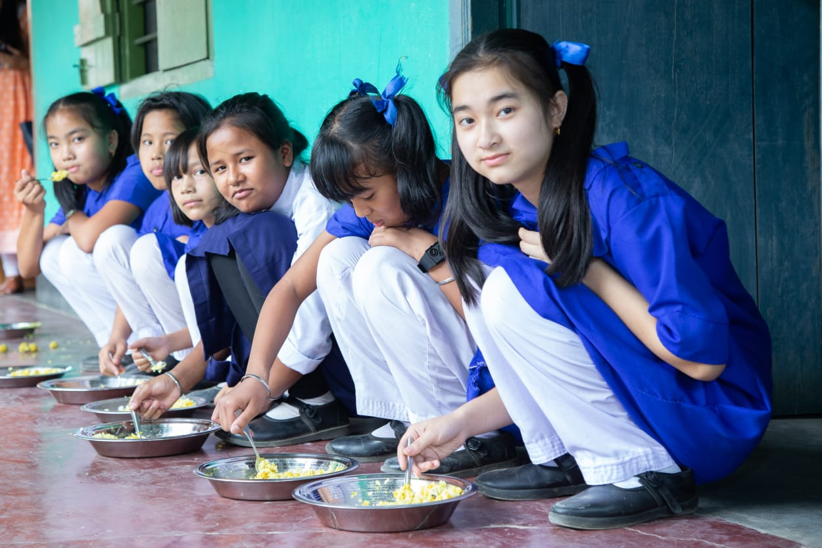
A meal to a Child is an offering to the Divinity.
Thank You

