Slide 1
AWP&B 2020-21 MID-DAY MEAL SCHEME mizoram

Slide 2
performance during 2019 - 2020
Mid-Day Meal Scheme : MIZORAM

Slide 3
Institution
PAB Approval 2019-20 |  |  | Existing School
PS | UPS | Total | PS | UPS | Total
1431 | 1093 | 2524 | 1420 | 1091 | 2511

Slide 4
STUDENTS COVERAGE
Enrolment PAB Approval 2019-20 |  |  | Enrolment 2020-21 against PAB 2019-20
PS | UPS | Total | PS | UPS | Total
87152 | 39021 | 126174 | 82573 (95%) | 38897 (99%) | 121470 (96%)

Slide 5
ENGAGEMENT OF COOK-CUM HELPER
PAB Approval 2019-20 |  |  | Actual engaged
PS | MS | Total | PS | MS | Total
2822 | 2072 | 4894 | 2779 (98%) | 2014 (97%) | 4793 (98%)

Slide 6
WORKING DAYS
PAB Approval 2019-20 |  | Performance as on 31st December 2019 |  | Performance upto 31st March 2020
PS | MS | PS | MS | PS | MS
202 | 212 | 165 (82%) | 175 (83%) | 202 (100%) | 212 (100%)

Slide 7
AADHAAR ENROLMENT
S. No. | Name of District | Total Enrolment | % of children Aadhaar enrolled
1 | Aizawl | 25137 | 98%
2 | Champhai | 12671 | 67%
3 | Kolasib | 10686 | 38%
4 | Lawngtlai | 25168 | 62%
5 | Lunglei | 25793 | 82%
6 | Mamit | 15056 | 61%
7 | Serchhip | 6563 | 95%
8 | Siaha | 10775 | 62%
Total |  | 131849 | 73%

Slide 8
STATUS OF KITCHEN DEVICES & KITCHEN-CUM-STORE
Funds for procurement of new Kitchen Devices for 7 new schools & replacement of Kitchen Devices for 608 schools, construction of 9 Kitchen-cum-Store and repair of 1533 nos. of Kitchen-cum store, though released by Central and State Governments have not yet been utilised till date due to the current pandemic Covid-19.

Slide 9
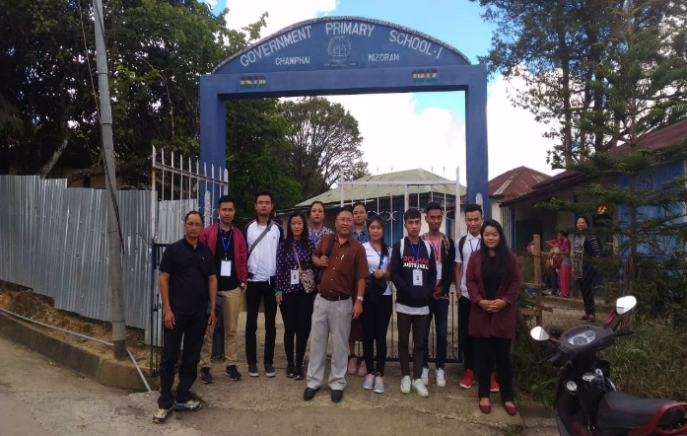
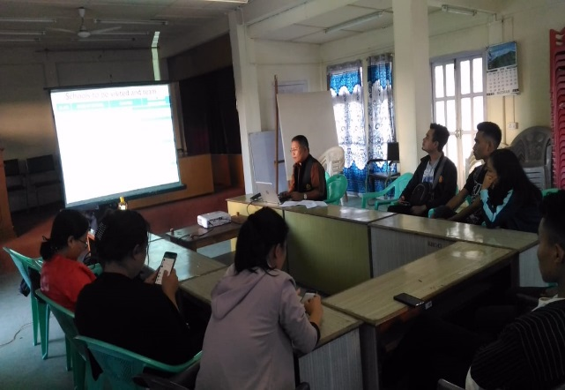
SOCIAL AUDIT
Social Audit was conducted for Champhai District by engaging State Institute of Rural Development & Panchayati Raj (SIRD & PR). 40 Schools were covered and reports of the Social Audit has already been submitted to MHRD.
So far, 6 districts have been covered. It is intended to cover the remaining unaudited two districts namely, Aizawl and Serchhip District during 2020-21.

Slide 10
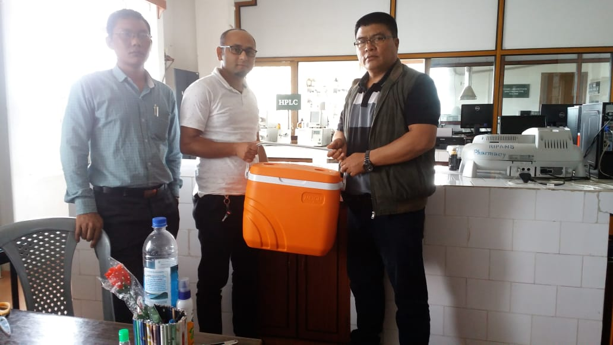
FOOD SAMPLE TESTING
Food testing samples have been conducted in 7 out of 8 Districts during 2019-20 at RIPANS. Out of 46 Samples tested 83% of samples tested were above the prescribed norms.

Slide 11
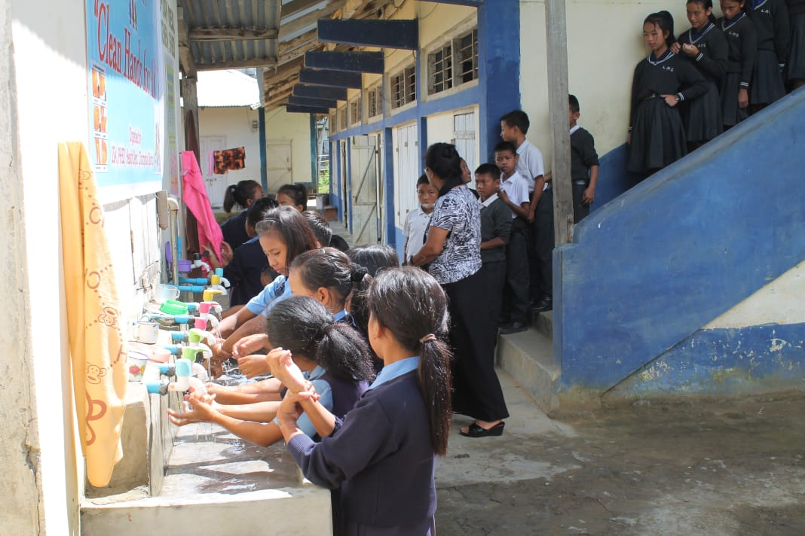
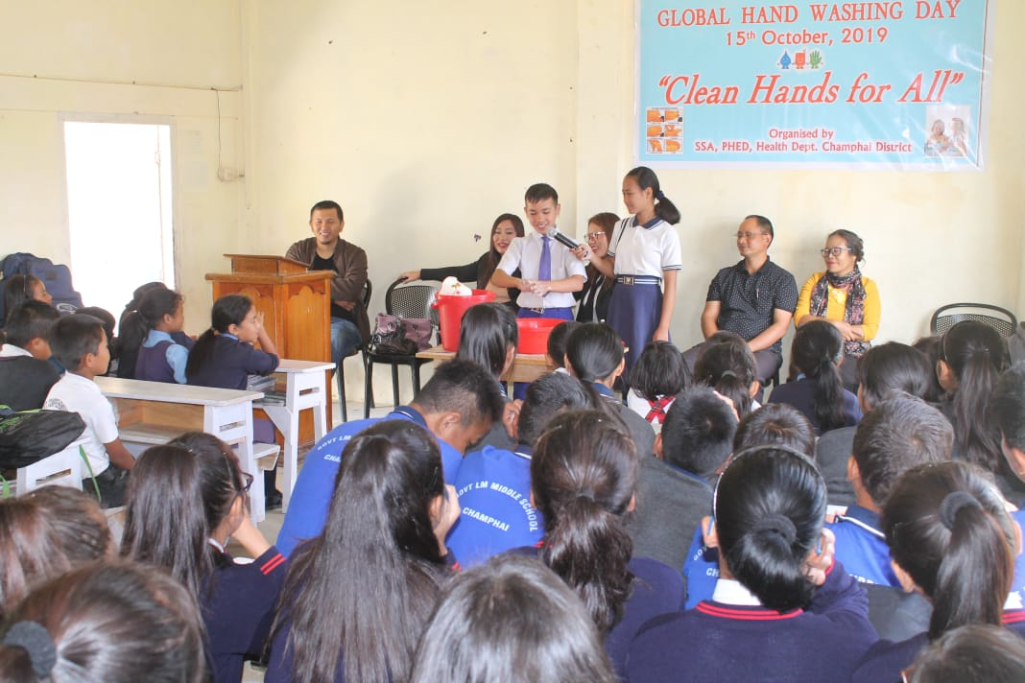
OBSERVANCE OF GLOBAL HAND WASHING DAY
In coordination with H&FW Dept. (RBSK) and PHE Dept. Global Hand Washing Day was observed on 15th October, 2019. The practice of proper hand washing technique learnt during Global Hand Washing Day proves very effective during this Covid-19 pandemic.

Slide 12
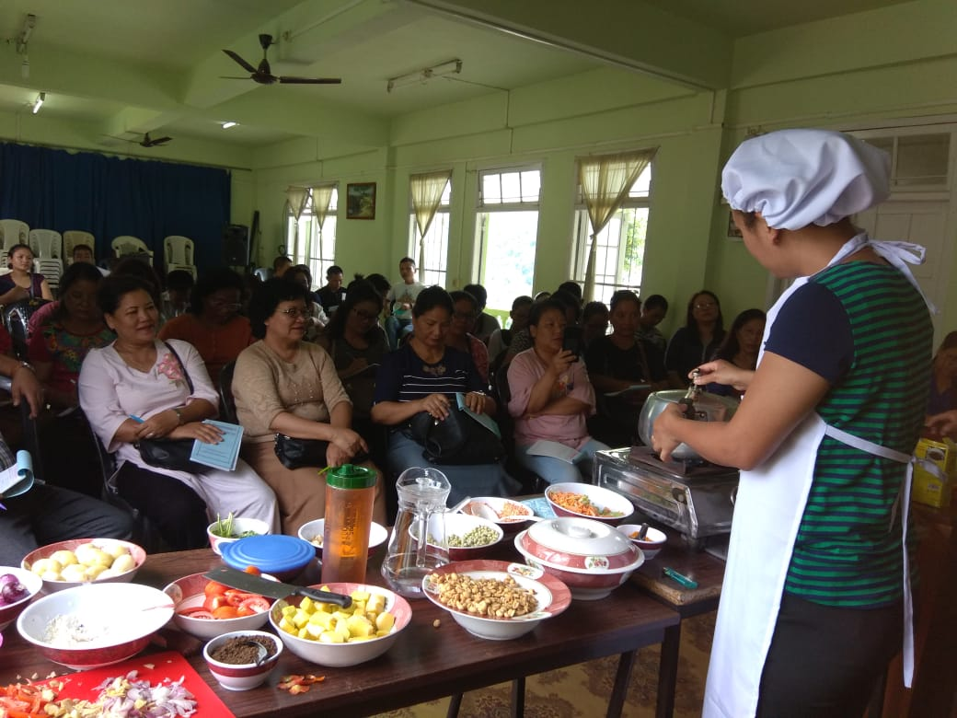
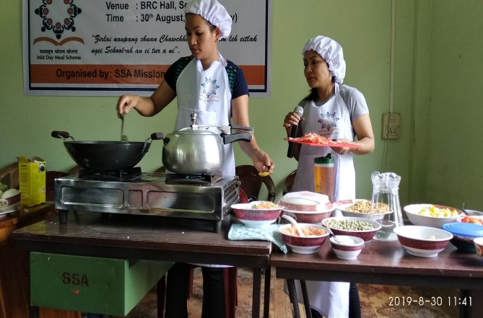
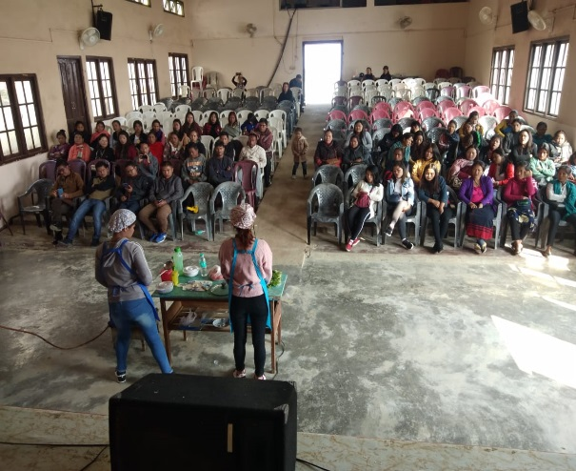
TRAINING OF COOK CUM HELPERS
Training of Cook-cum-Helpers (CCH) and Master Trainer’s Training was conducted with the help of Tourism Department, Govt. of Mizoram. As many as 852 CCH and 33 Master Trainers’ were trained in cooking course during 2019-20.

Slide 13
TRAINING OF COOK CUM HELPERS
S.No. | Name of District | Total no. of Cook-cum-Helpers engaged | Total no. of Cook-cum-Helpers trained during the year | No. of Master Trainers | Duration of training
1 | Aizawl | 946 | 370 | 8 | 1 day
2 | Champhai | 462 | - | 4
3 | Kolasib | 359 | 340 | 4 | 2 days
4 | Lawngtlai | 834 | - | 3
5 | Lunglei | 1012 | - | 4
6 | Mamit | 543 | 41 | 5 | 1 day
7 | Serchhip | 248 | 101 | 3 | 1 day
8 | Siaha | 389 | - | 2
Total |  | 4793 | 852 | 33

Slide 14
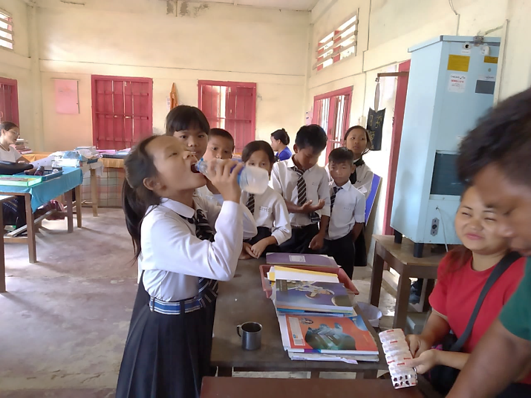
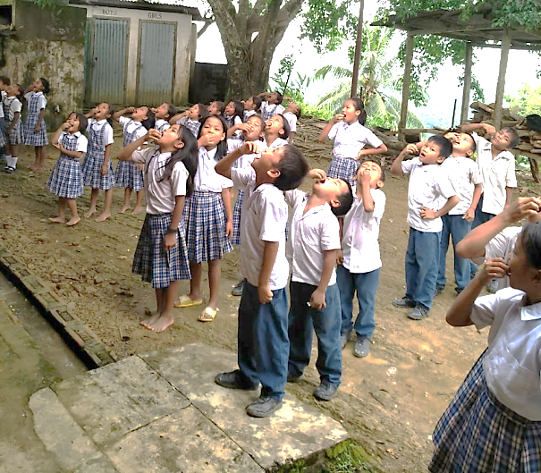
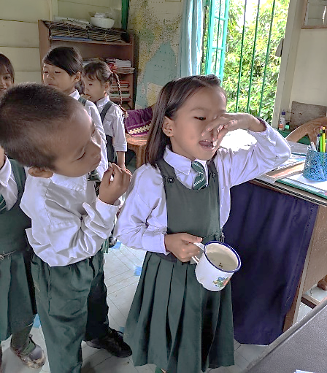
COVERAGE UNDER RBSK (SCHOOL HEALTH) - 2018-19
Medical team under RBSK Programme visited our school children to check their health status. From the findings of these visits, children requiring medical care were referred to hospitals and to those requiring spectacles, the same were given free of cost.
Under school Health programme, WIFS were given to students on a weekly basis. On National Deworming Day, Deworming Tablets were given to 98% students.

Slide 15
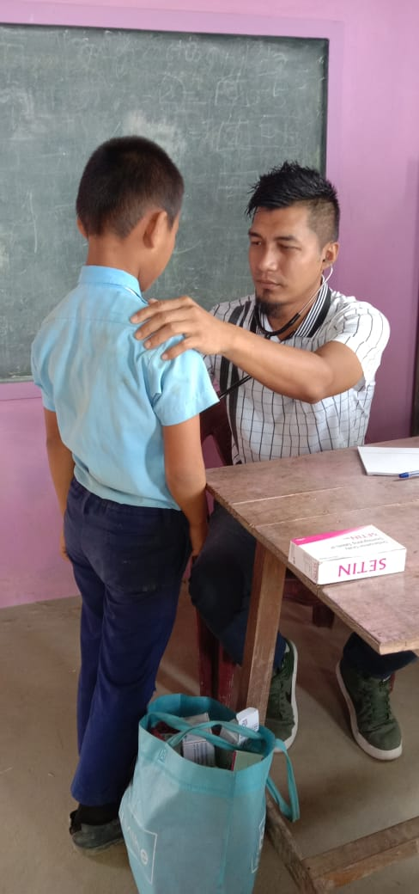
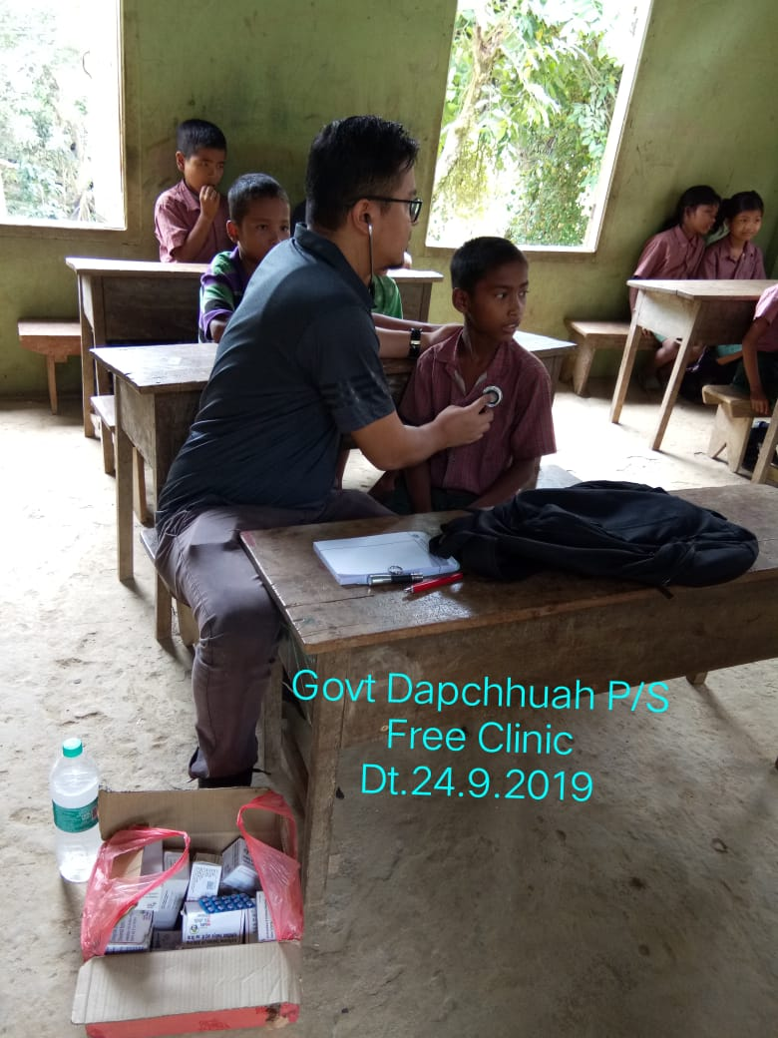
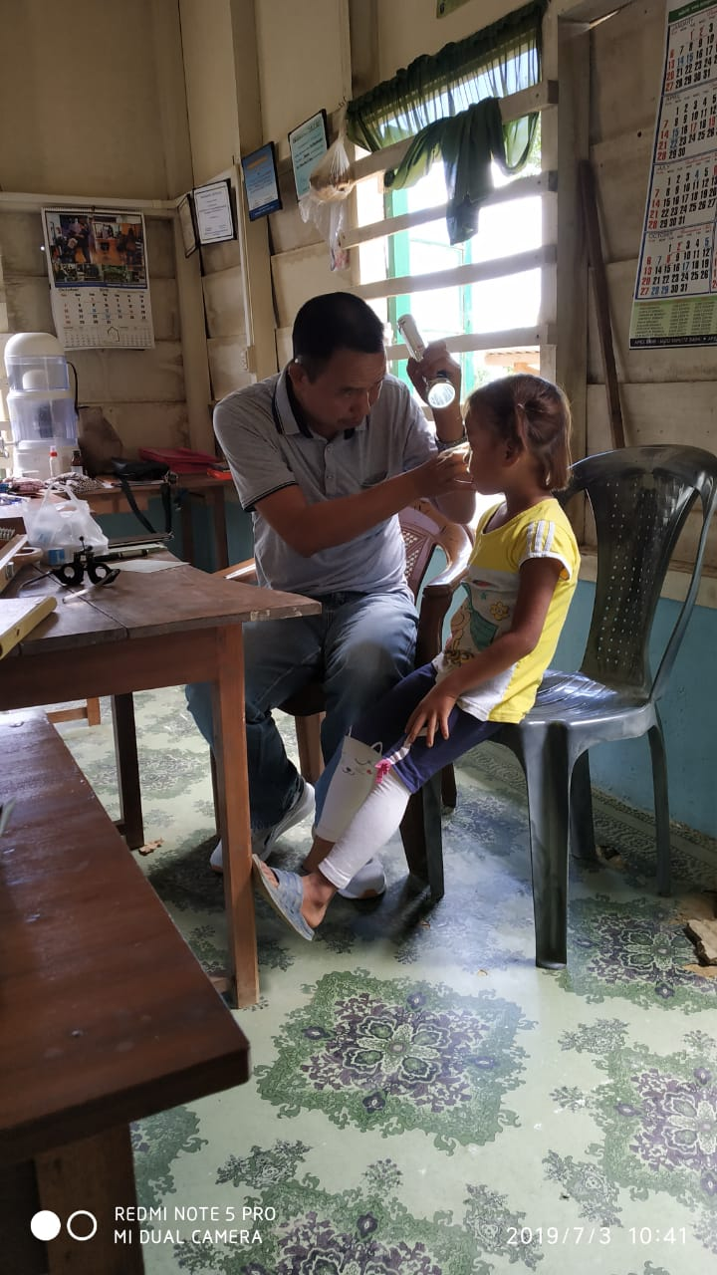
COVERAGE UNDER RBSK- HEALTH CHECK UP

Slide 16
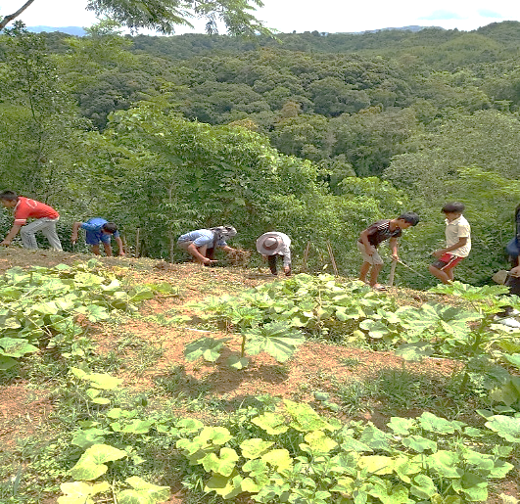
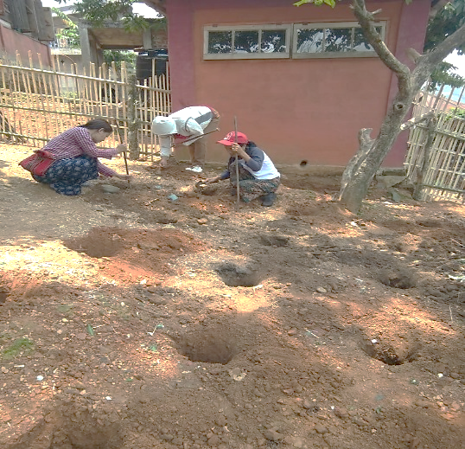
ORGANIC KITCHEN GARDENS IN THE STATE
As compared to 227 Nutrition Garden in 2019-20, the state is now having 684 schools Organic Nutrition Garden even without receiving 5% Flexi Fund for Organic Nutrition Garden from the Central Govt.

Slide 17
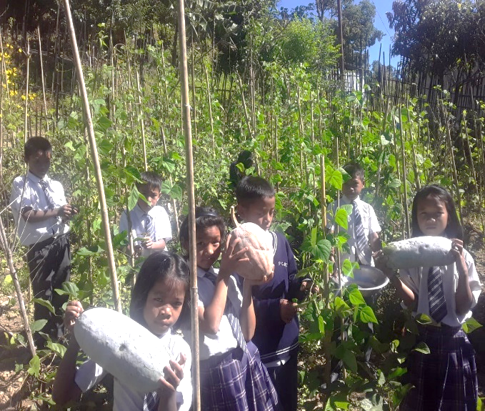
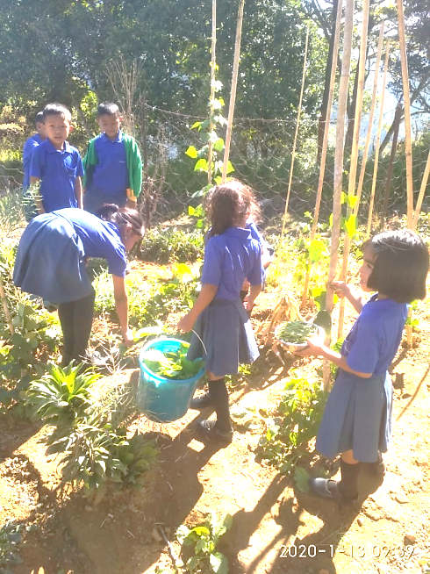
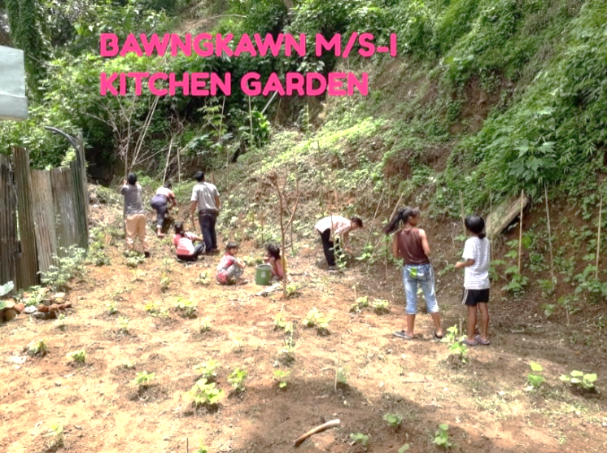
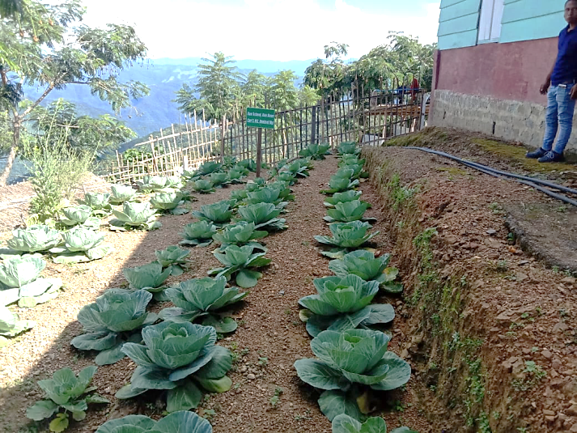
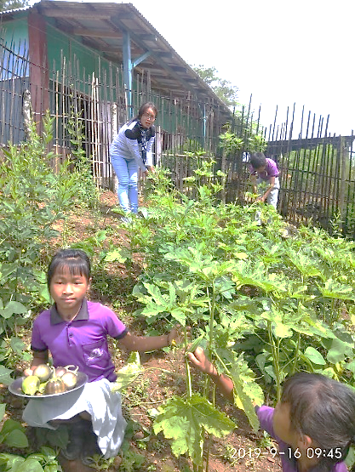
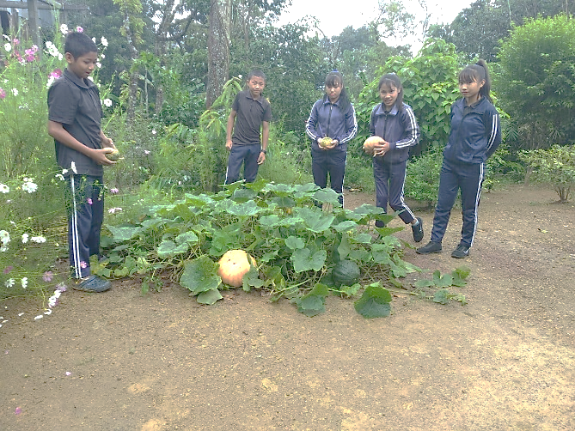
ORGANIC KITCHEN GARDENS

Slide 18
ORGANIC NUTRITION GARDENS COMPETITION
During 2019-20 competition for best Organic Nutrition Garden was organised in all Districts. The best 10 Organic Nutrition Garden were awarded citation and Prize Money as under:-
1st Prize : Citation with Rs. 6000/-
2nd Prize : Citation with Rs. 4000/-
3rd Prize : Citation with Rs. 2000/-
And other 7 consolation prize were given Citation with Rs. 1000/-.

Slide 19
BEST PRACTICES 2019-20
Mid-Day Meal Scheme : MIZORAM

Slide 20
BEST PRACTICES
The State Government is contributing cooking cost of Re. 1.00, which is more than the minimum mandatory share of Re. 0.75 in Upper Primary School (Cl-VI-VIII) whereas in Primary Schools the state is contributing Rs. 1.2 which is more than the minimum mandatory share of Re. 0.50.
As for Honorarium to Cook-cum-Helper, the State Government is contributing Rs. 600/- or (40%) which is Rs. 500/- more than the minimum mandatory share of Rs. 100/-
Conduct of Cook-cum Helpers and Master Trainers’ Training with the help of Tourism Department, Govt. of Mizoram.
Competition for selection of Organic Nutrition Garden is conducted during 2019-20.

Slide 21
COMMUNITY PARTICIPATION
The Community is actively involved for the succesful implementation of Mid-Day Meal. They take keen interest in collection of firewood, rendering their services for repair, maintenance of Kitchen Shed and setting up of Organic Kitchen Gardens. They also enthusiastically contributed their garden products like fruits and vegetables for their childrens’ Mid-Day Meal.

Slide 22
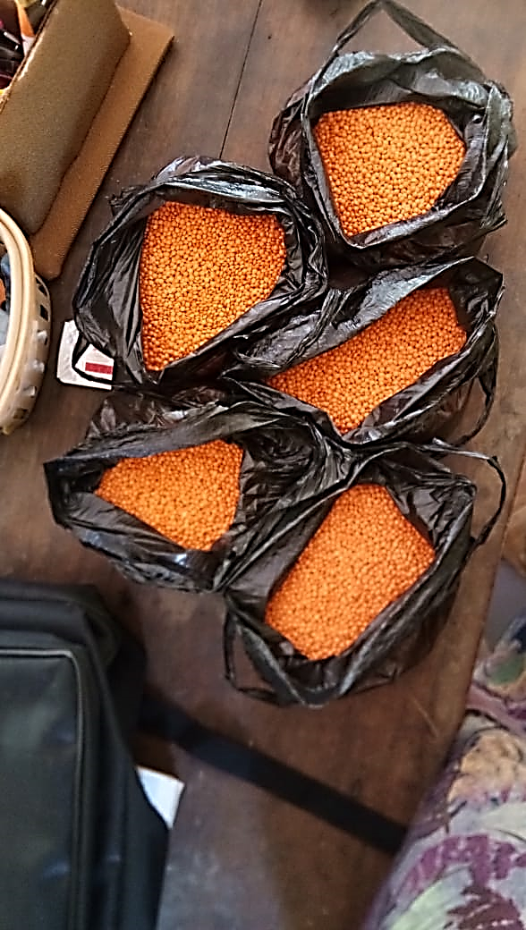
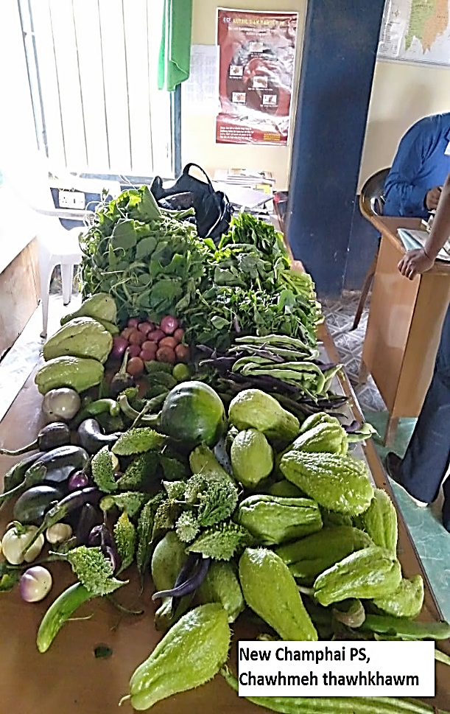
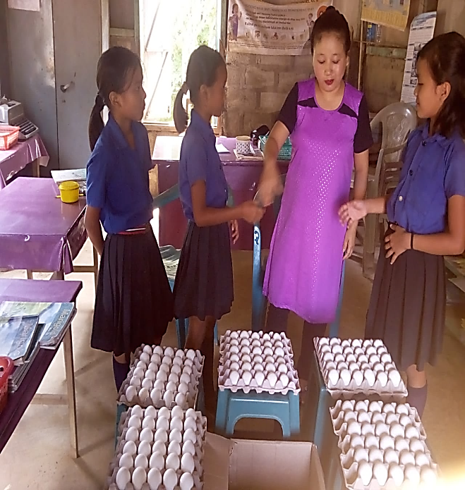
COMMUNITY PARTICIPATION
Community Contribution

Slide 23
ISSUES
Mid-Day Meal Scheme : MIZORAM

Slide 24
ISSUES
Delay in release of fund from the state Government.
Low Hononarium of Cook-cum-Helpers.
Due to inadequate supply of gas cylinder in the state even for domestic consumption increase use of gas based cooking for MDM could not be done.

Slide 25
TARGET FOR IMPROVEMENT DURING 2020-2021
1. Training of Cook-cum-Helpers :- In coordination with Tourism Department, Govt. of Mizoram, School Education Department plans to conduct training of Cook-cum-Helpers in all District.
2. Aadhaar Enrolment :- Increase Coverage of Aadhaar Enrolment of Children.
3. Organic Nutrition Garden:- It is intended to set up a committee at District level under the chairmanship of the District Commissioner with heads of Offices of Agriculture, Horticulture and KVKs. This committee will pool resources available for setting up reliable and productive Nutrition Garden.

Slide 26
STRUGGLE AGAINST COVID-19 PANDEMIC
During the present crisis of Covid-19 Pandemic, school children were provided raw rice and conversion cost in the months of April and May 2020 as per the guidelines of National Food Security Act. As many as 88% of our schools had provided Mid-Day Meal by observing the required Social Distancing, wearing of mask etc.

Slide 27
PROPOSAL FOR 2020-21

Slide 28
PROPOSAL FOR 2020-21
Sl. No | Component | PS | UPS | TOTAL
1 | Enrollment | 82,573 | 38,897 | 121,470
2 | Working Days | 201 days/ 1005 hrs. | 216 days/ 1188 hrs. | -
3 | Cook-Cum-Helper | 2779 | 2014 | 4,793
4 | Kitchen-cum-Store | - | - | -
5 | Kitchen Devices (New) | - | - | -
6 | Kitchen Devices (Replacement) | 340 | 227 | 567
7 | Repair of kitchen-cum-stores | - | - | -

Slide 29
Requirement of funds and foodgrains for provision of MDM during summer vacations in 2020-21
Stage | Number of children | Number of days | Foddgrains (in MTs) | Cooking cost (Rs in lakh) | Transportation Assistance (Rs in lakh)
Primary | 90602 | 29 | 262.75 | 117.45 | 10.43
Upper Primary | 41247 | 29 | 179.42 | 80.14 | 7.12
Total | 131849 | 29 | 442.17 | 197.59 | 17.55

Slide 30
PROPOSAL FOR 5% FLEXI FUND
Sl. No | Components | CENTRAL | STATE | TOTAL
1 | Proposal for allocation of fund for provision of egg | 55.97 | 6.22 | 62.19
2 | Proposal of fund for installation of Bio Mass Cook Stove | 62.65 | 6.96 | 69.61
 | TOTAL | 118.62 | 13.18 | 131.80

Slide 31
Thank you

