Slide 1
PAB - MDM Meeting for Review of Implementation of MDMS in West Bengal on 16.06.2020
Mid Day Meal Scheme

Slide 2
Best Practices
i) Additional contribution of Rs.500/- per month over and above the mandatory State Share in honorarium of Cook-cum-helpers from their own resources.
ii) Providing an egg once in a week to all children from their own resources.
iii) Construction of 8263 units of dining hall in the schools from their own resources.
iv) LPG is used as mode of cooking in 100% schools.
Ministry of HRD, Govt. of India

Slide 3
Issues
i) Less utilization of food grains in 12 districts viz. Siliguri(33%), Kolkata(45%), Jhargram(56%), Cooch Behar(66%), D/Dinajpur(67%), U/Dinajpur(70%), Howrah(71%), Alipurduar(71%), W/Bardhaman(73%), Jalpaiguri(74%), Nadia(75%) and Purulia(75%).
Social audit did not conduct in the State.
Less coverage of heath check up of children (57%) under Rashtriya Bal Swasthya Karykram.
Deworming medicine provided to only 14% children.
IFA tablets provided to 69% children.
Only 9716 schools have School Nutrition Gardens out of 83945 schools.
Ministry of HRD, Govt. of India

Slide 4
Coverage of Children (Primary & U. Primary)
Children (Primary) |  |  |  | Children (Upper Primary)
State | PAB Approval | Coverage | %age | PAB Approval | Coverage | %age
West Bengal | 6753947 | 6830713 | 101 | 4137265 | 4111755 | 99
Ministry of HRD, Govt. of India

Slide 5
Working Days (Primary & U. Primary)
State | Working Days (Pry) |  |  | Working Days (U.Pry)
 | PAB Approval | Coverage | % | PAB Approval | Coverage | %
West Bengal | 230 | 230 | 100 | 230 | 230 | 100
Ministry of HRD, Govt. of India

Slide 6
Engagement of Cook-cum-Helpers (Primary & U. Primary)
State | PAB Approval | Coverage | %age
West Bengal | 248799 | 240830 | 97%
Ministry of HRD, Govt. of India

Slide 7
Procurement of Kitchen Devices (Primary & U. Primary)
Kitchen Devices | Sanctioned | Procured | %age
New Kitchen Devices | 90855 | 90855 | 100%
Replacement of Kitchen devices | 89914 | 89914 | 100%
Ministry of HRD, Govt. of India

Slide 8
Construction of Kitchen-cum-Stores (Primary & U. Primary)
State | Sanctioned | Constructed | %age
West Bengal | 81856 | 81582 | 99.7%
Ministry of HRD, Govt. of India

Slide 9
Setting up of School Nutrition Gardens (SNG)
No. of Schools | No. of schools having SNG | %
83945 | 9716 | 12%
Ministry of HRD, Govt. of India

Slide 10
Health Component - Performance
Details | Institutions | Children
Total in State | 83945 | 11560465
Health check up | 56244 | 6632732
IFA Distribution | 67155 | 7919380
Deworming Tablets | 67155 | 1655383
Ministry of HRD, Govt. of India

Slide 11
Testing of food samples
MHRD issued guidelines to ensure quality, safety and hygiene under MDMS in 2015
Testing of meals by NABL accredited laboratories.
Mandatory tasting of the meal by 2-3 adults including at least one teacher.
MDM Rules 2015 mandates collection of samples once a month from randomly selected schools or centralized kitchens for testing.
Testing may also be done through FSSAI accredited laboratories.
No. of samples |  | Result (No. of samples)
Collected | Tested | Meeting norms | Below norms
40 | 40 | 40 | 0

Slide 12
Status of implementation of MIS & AMS

Slide 13
Performance Grading Index (PGI)
Performance Grading Index (PGI):
Score against the weightage of 10 for indicator No. 1.3.7 i.e. “% of elementary school’s children taking MDM against target approved in PAB – in Govt. and aided schools”.
Score against the weightage of 10 for indicator No 1.3.8 i.e. “% of days Mid Day Meal served against total working days – Govt. and aided elementary schools.”
Score (children taking MDM) | Score (MDM served days)
10 | 10
Ministry of HRD, Govt. of India

Slide 14
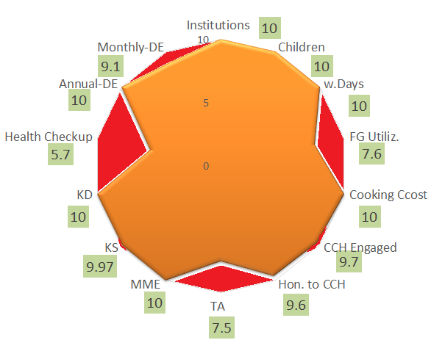
Performance Score Card
Component | PAB-Approval | Achievement | % Achievement
Institutions | 83945 | 83945 | 100%
Children | 10891212 | 10942468 | 100%
Working Days | 230 | 230 | 100%
Food Grain Utilizations (in MTs) | 298807.49 | 226536.61 | 76%
Cooking Cost (Rs. in Lacs) | 133769.63 | 133769.63 | 100%
CCH Engaged | 248799 | 240830 | 97%
CCH Honorarium (Rs. in Lacs) | 37319.85 | 35867.33 | 96%
TA (Rs. in Lacs) | 4183.30 | 3143.18 | 75%
MME (Rs. in Lacs) | 2914.97 | 2914.97 | 100%
Kitchen cum Stores | 81856 | 81582 | 99.7%
Kitchen Devices(R) | 89914 | 89914 | 100%
Health Check up of children | 11560465 | 6632732 | 57%
Annual Data Entry | 83945 | 83652 | 99.7%
Monthly Data Entry | 83945 | 76721 | 91%

Slide 15
Social Audit
Social Audit is collective monitoring of a scheme by people’s active involvement.
It covers the issues of equity and equality along with expenditure in programme implementation.
The Social Audit Units (SAU) under MNREGS, may be actively involved in conducting Social Audit of MDM in all districts.
Key Features and Benefits:
It informs and educates people about their rights and entitlements.
It provides a collective platform for people to ask queries, express their needs and grievances.
It promotes people's participation in all stages of implementation of programme.
It brings about transparency and accountability in Govt. schemes.
It strengthens decentralised governance.
State has not conducted Social Audit.

Slide 16
Proposal for providing MDM during Summer Vacation
Stage | Number of Children | Number of days (11.May.20 to 10.Jun.20) | Foodgrains (in MTS) | Cost of foodgrains | Cooking Cost (Rs. In Lakh) | Transportation Assistance (Rs. In Lakh) | Total (Rs. in Lakh)
Primary | 6804546 | 25 | 17011.37 | 510.34 | 5069.39 | 238.16 | 5817.89
Upper Primary | 4137922 | 25 | 15517.21 | 465.52 | 4624.13 | 217.24 | 5306.89
Total | 10942468 | 25 | 32528.58 | 975.86 | 9693.52 | 455.4 | 11124.78

Slide 17
Recommendations of Central Assistance
(Rs. in Lakhs)
PAB Approval for FY 2019-20 | State’s Proposal for FY 2020-21 | Recommendations for FY - 2020-21
139867.72 | 126093.37 | 126093.37
Summer vacation |  | 11124.78
Total |  | 137218.15
Ministry of HRD, Govt. of India

Slide 18
Proposals and Recommendations
S. N | Component | PAB Approval 2019-20 | State’s Proposal for 2020-21 | Recommendations 2020-21
1 | Children (Pry) | 6723230 | 6804546 | 6804546
2 | Children (U Pry) | 4137265 | 4111755 | 4111755
3 | Children (NCLP) | 30717 | 26167 | 26167
4 | Working Days – Pry & Upy | 230 | 230 | 230
5 | Working Days - NCLP | 312 | 312 | 312
6 | Cook-cum-Helpers (Pry +U.Pry) | 248799 | 248799 | 248799
7 | Drought : NIL
8 | Kitchen cum Store | 274 | Nil | Nil
9 | Kitchen cum Stores (Repair) | 11692 | 36958 | 36958
10 | Kitchen Devices (New) | Nil | Nil | Nil
11 | Kitchen Devices (Rep.) | 33954 | 33954 | 33954
Central Assistance (Rs in Lakh) |  | 139867.72 | 137218.15 | 137218.15

Slide 19
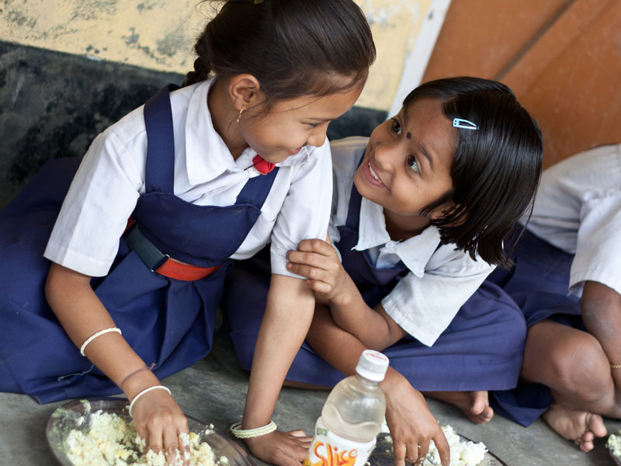
Every Meal to a Child is an offering to the Divinity.
Thank You

